Slide 1
TRIGINTA OPTIMI
(Thirty of the Best)
Founded 1895
Class of 1974

Slide 2
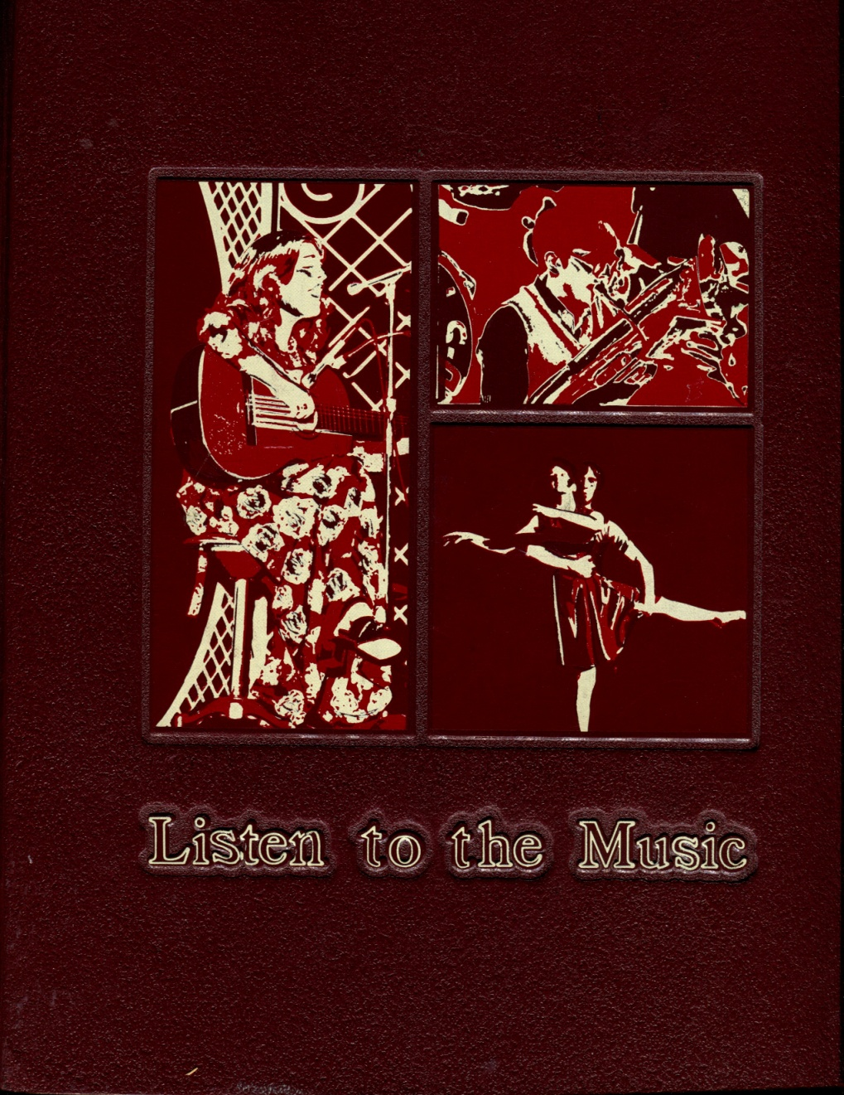
1974 Western Hills Yearbook

Slide 3
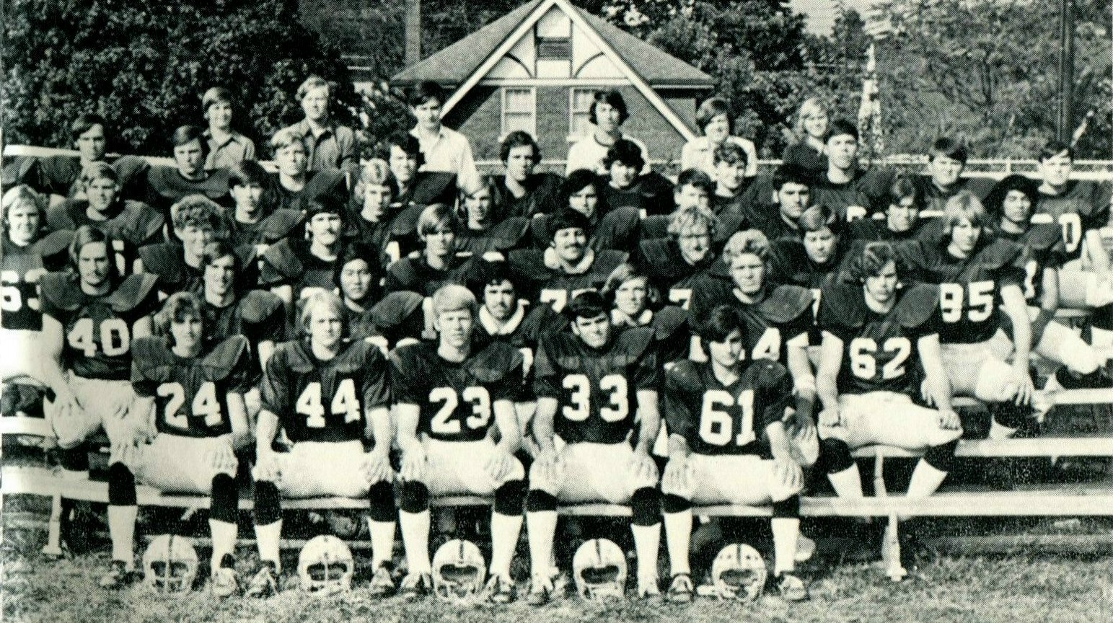
1974 Western Hills Yearbook
(1973 Varsity Football Team)
Bob Harper
(Class of 1974)
David Watanabe
(Class of 1974)
Dave Hampton
(Class of 1974)
Charles Gross
(Class of 1974)
Kenneth Wells
(Class of 1974)
Gary Keyes
(Class of 1975)
John Andrews
(Class of 1975)

Slide 4
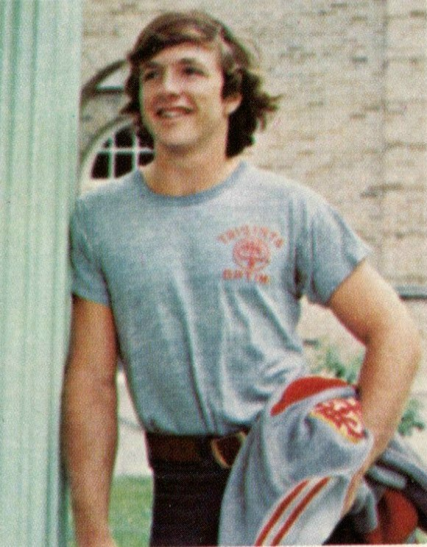
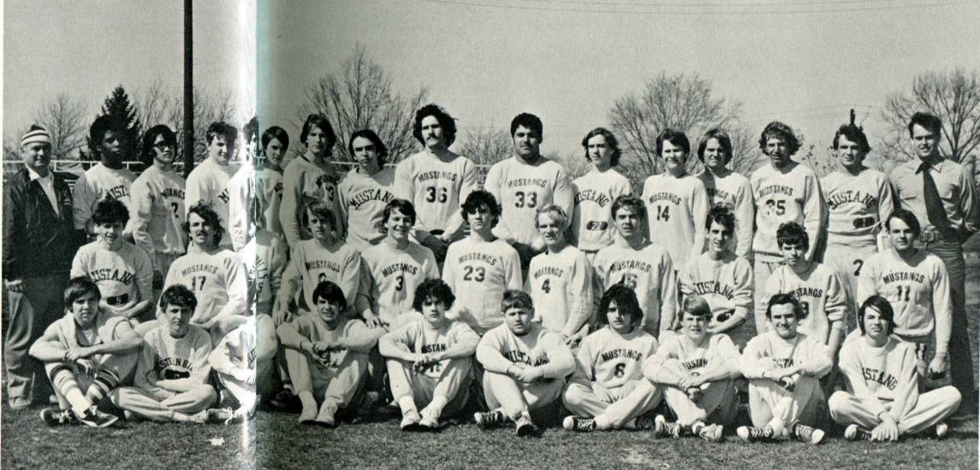
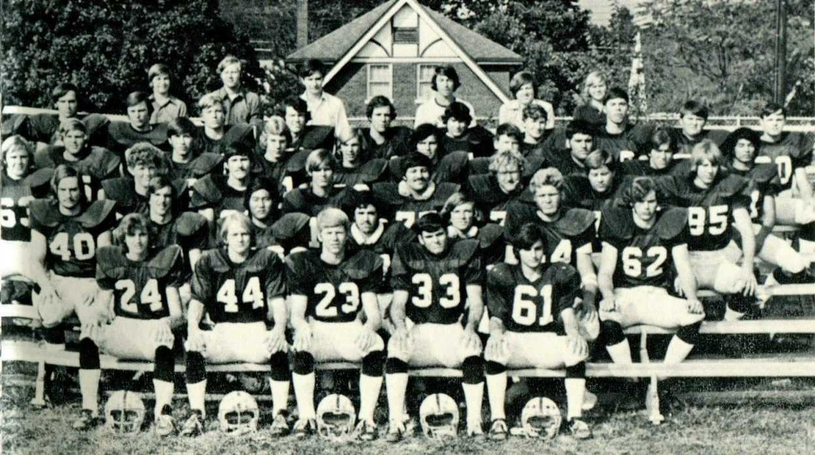
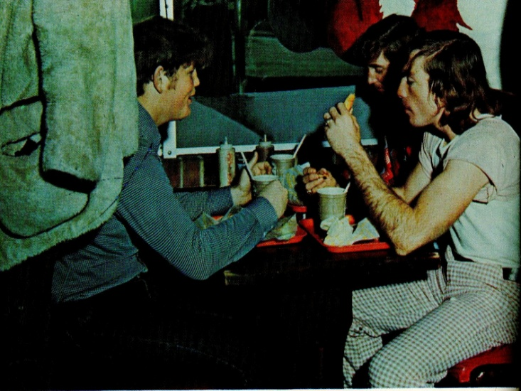
1974 Western Hills Yearbook
(Class of 1974)
David Earl Hampton

Slide 5
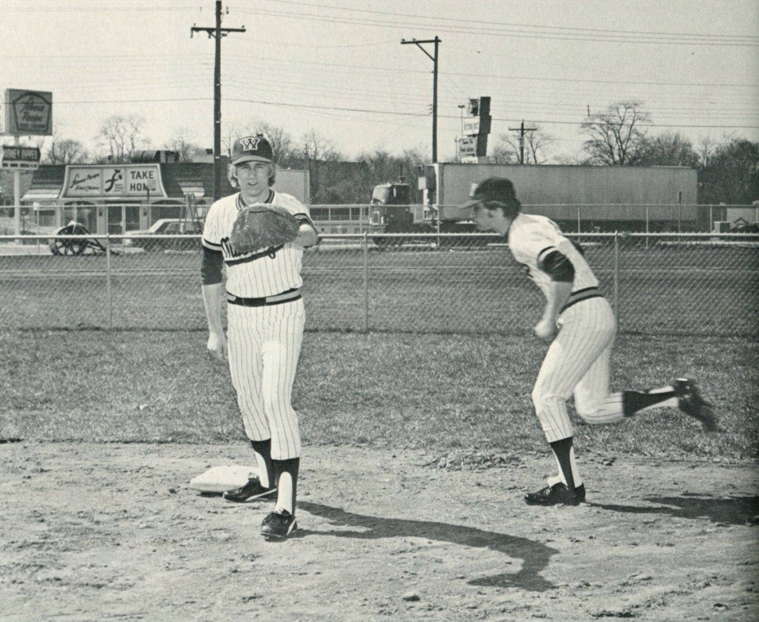
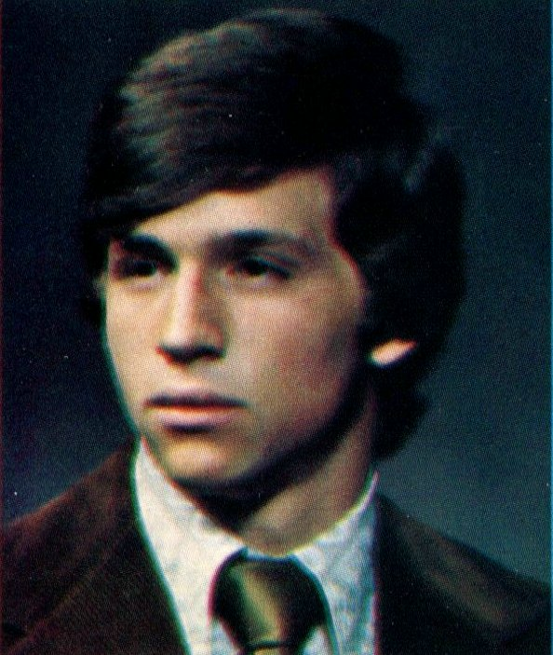
1974 Western Hills Yearbook
(Class of 1974)
Mark Groppe

Slide 6
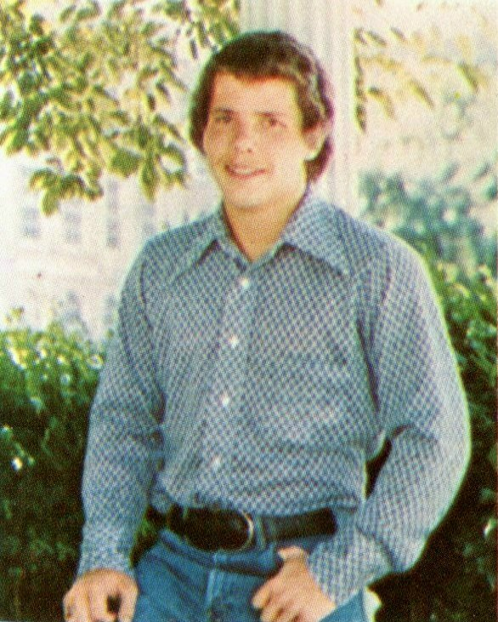
1974 Western Hills Yearbook
Charles Phillip Arthur

Slide 7
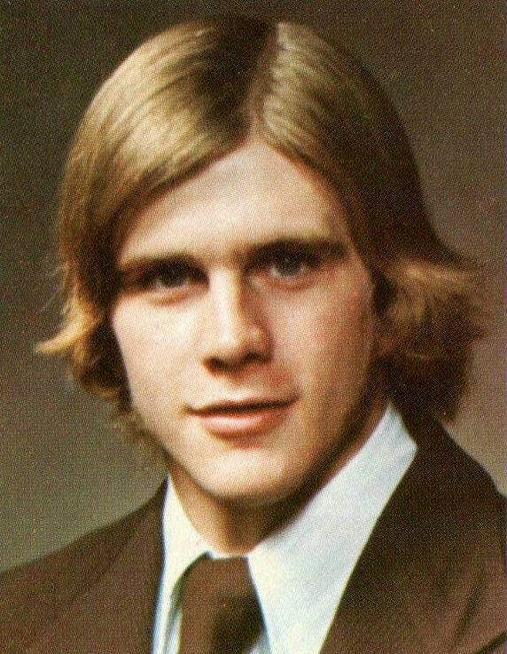
1974 Western Hills Yearbook
Charles Cummins

Slide 8
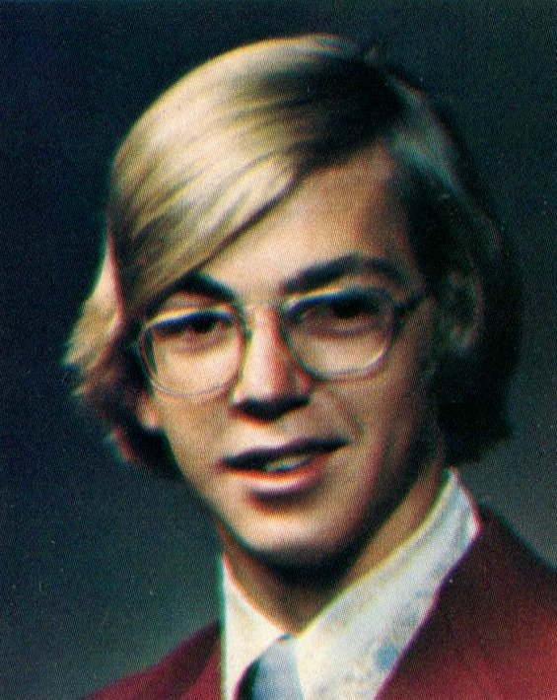
1974 Western Hills Yearbook
Charles Gross

Slide 9
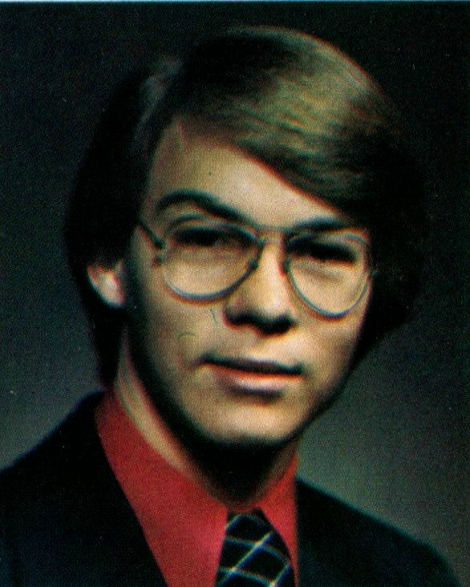
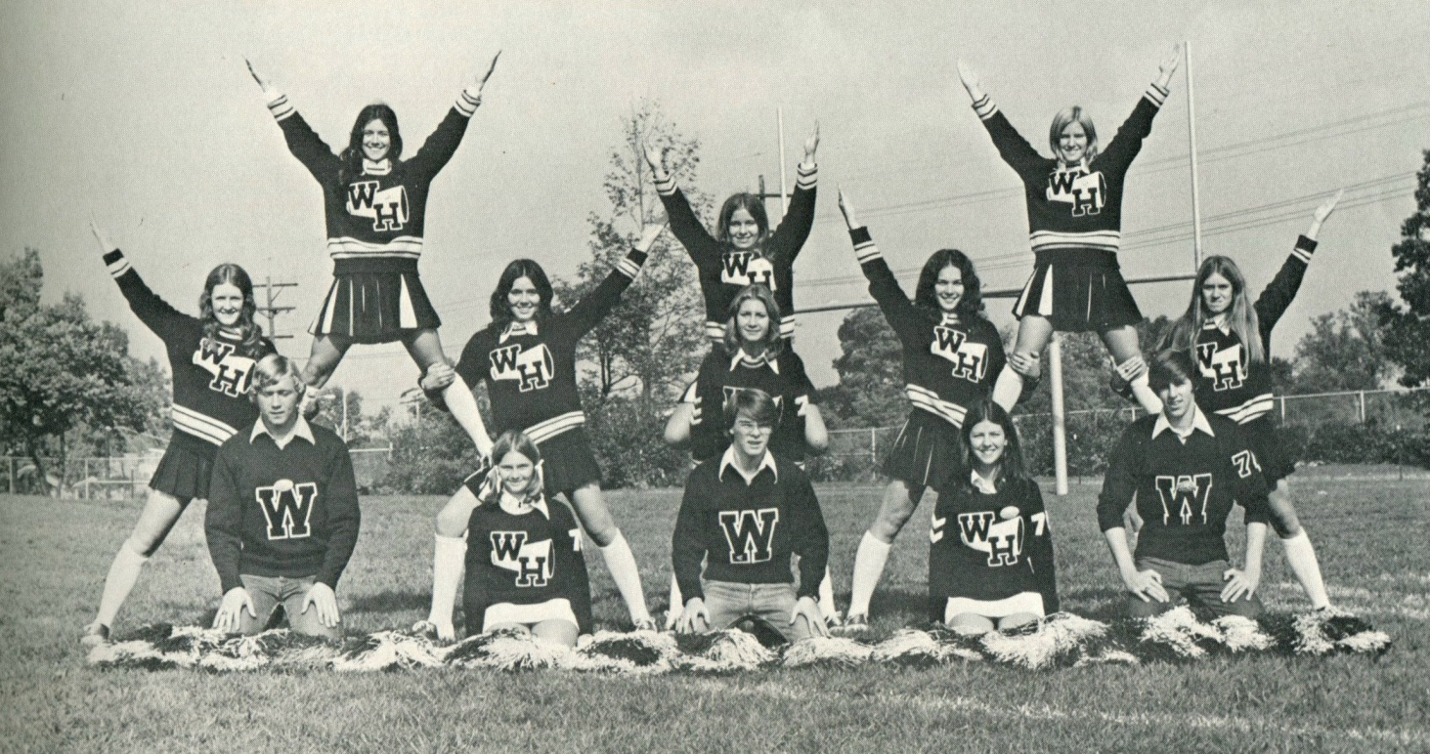
1974 Western Hills Yearbook
James Grishaw

Slide 10
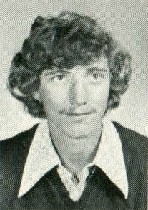
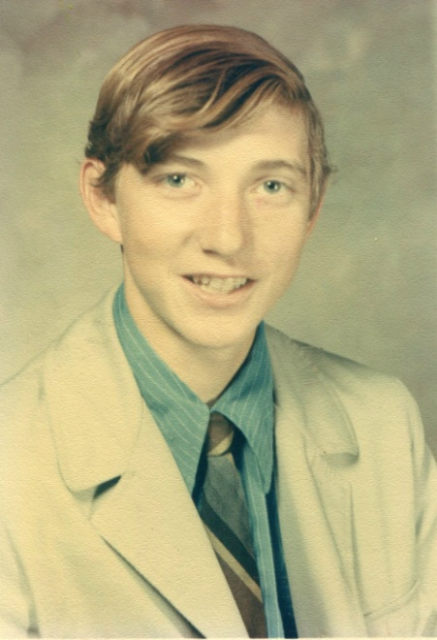
1974 Western Hills Yearbook
Robert Harper
Robert Harper
(1973)

Slide 11
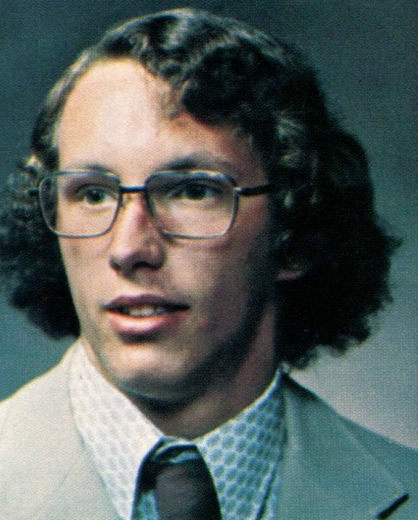
1974 Western Hills Yearbook
David Krause

Slide 12
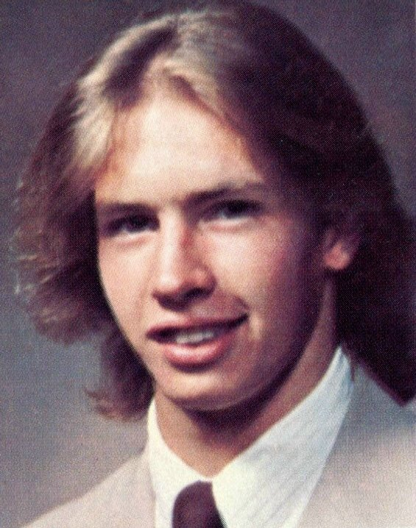
1974 Western Hills Yearbook
Robert Montag

Slide 13
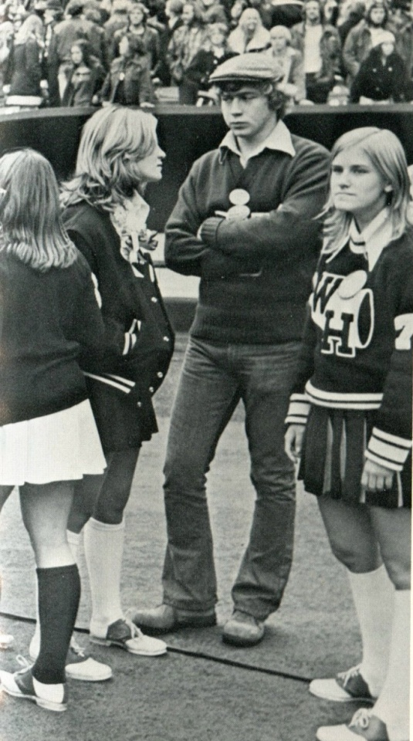
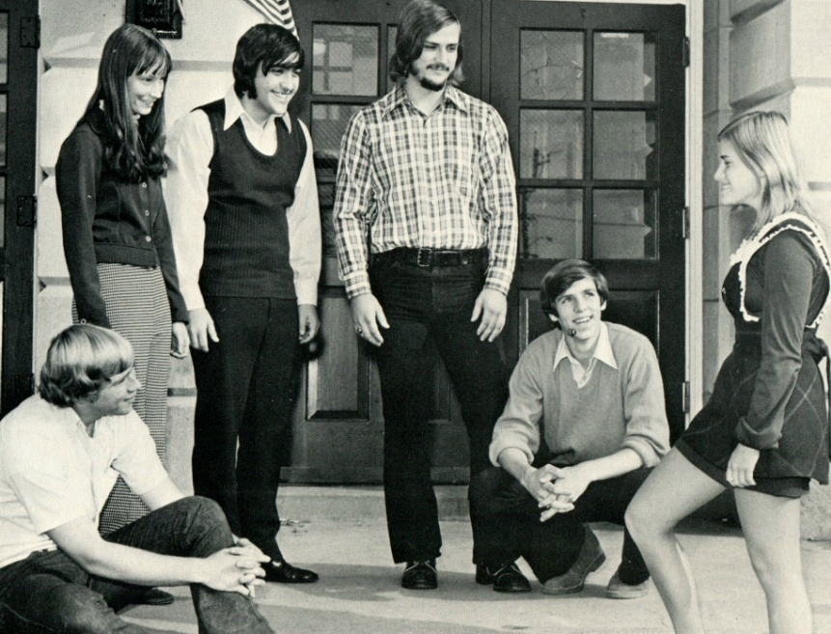
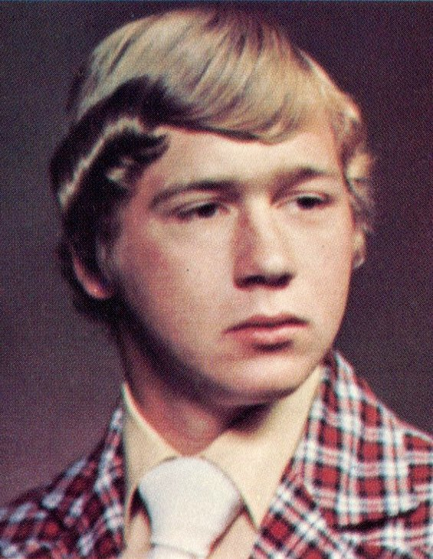
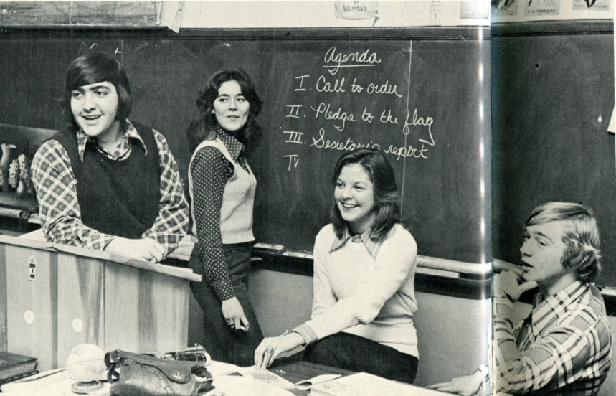
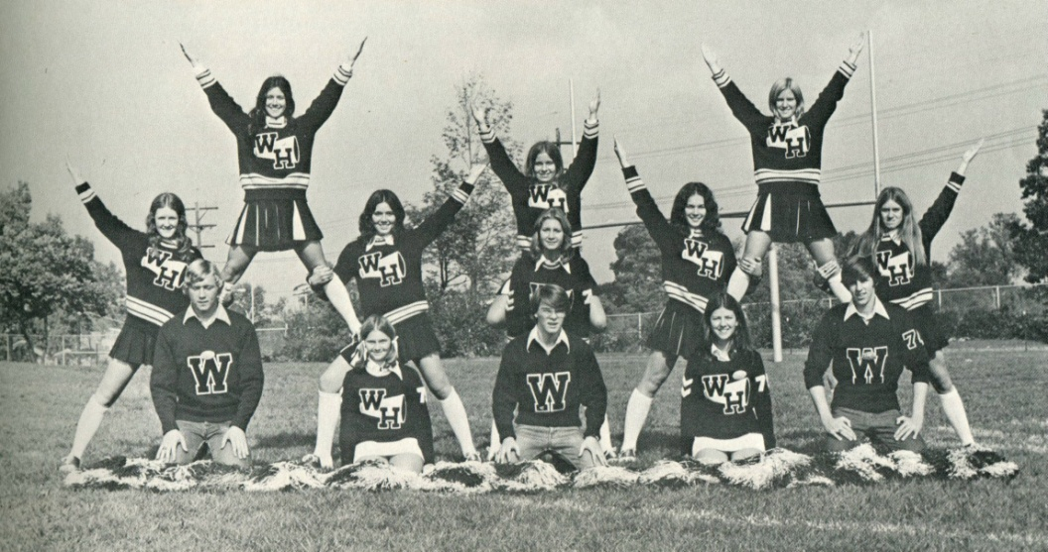
1974 Western Hills Yearbook
Thomas Outcalt

Slide 14
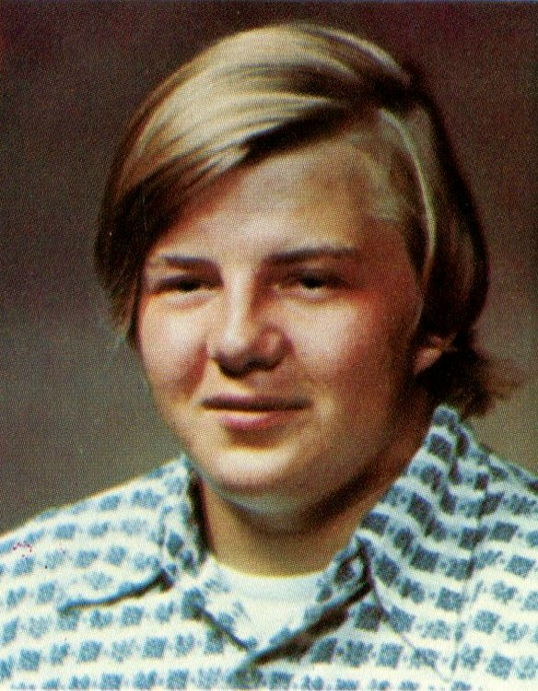
1974 Western Hills Yearbook
Harlan Scott Richardson

Slide 15
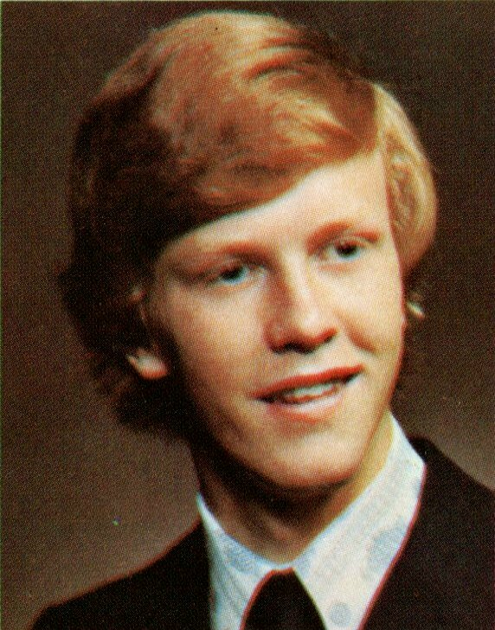
1974 Western Hills Yearbook
Douglas Vetter

Slide 16
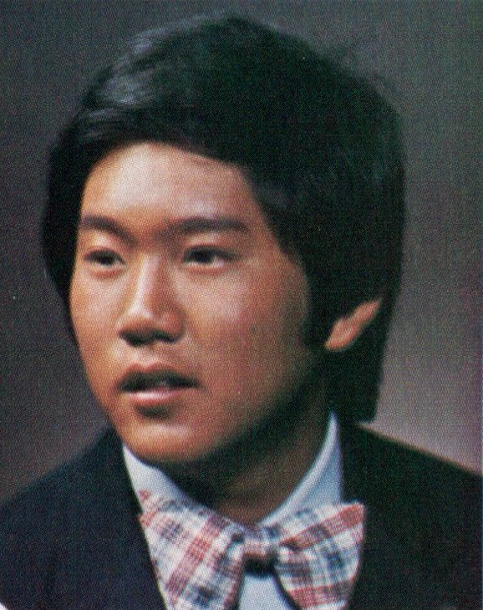
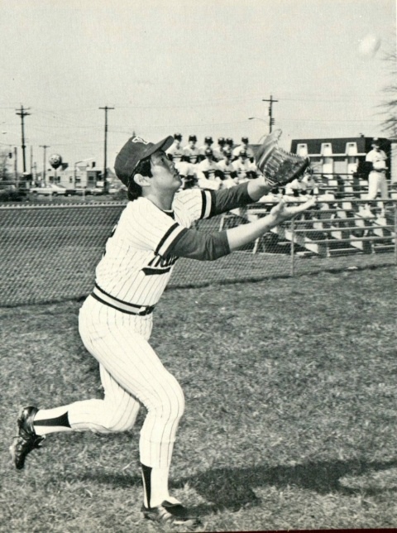
1974 Western Hills Yearbook
David Watanabe

Slide 17
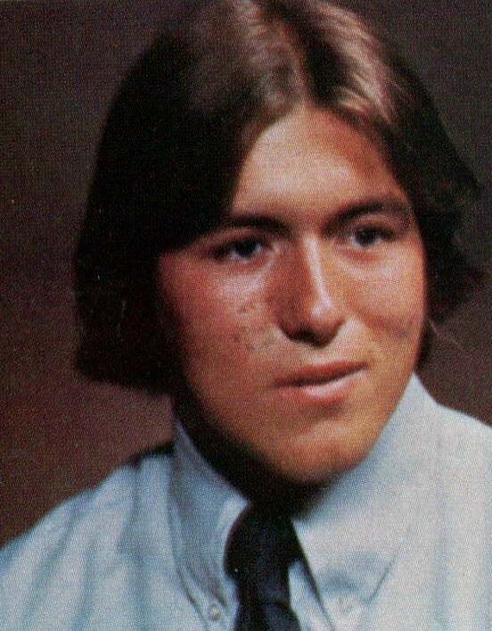
1974 Western Hills Yearbook
Kenneth Wells

Slide 18
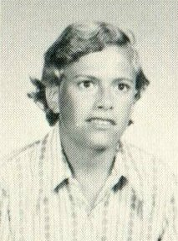
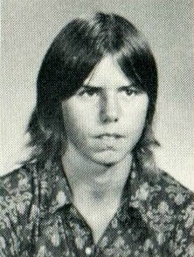
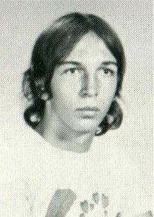
1974 Western Hills Yearbook
(Class of 1976)
Thomas Bell
Daniel Flohn
John Nare

Slide 19
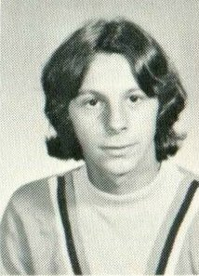
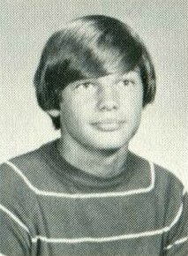
1974 Western Hills Yearbook
(Class of 1976)
Andy Quatromani
Greg Meister

Slide 20
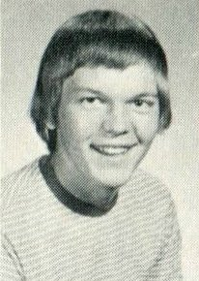
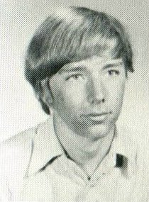
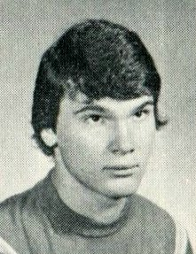
1974 Western Hills Yearbook
(Class of 1975)
Jeffrey Meister
Robert Herbers
Richard Ogden

Slide 21
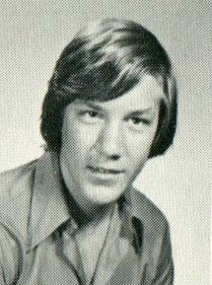
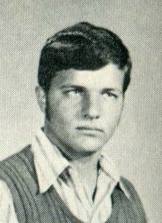
1974 Western Hills Yearbook
(Class of 1975)
Steve Laux
Brian Maxwell

Slide 22
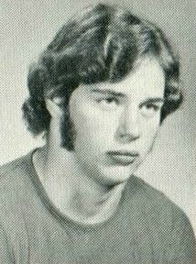
1974 Western Hills Yearbook
(Class of 1975)
Gary Keyes (# 62)

Slide 23
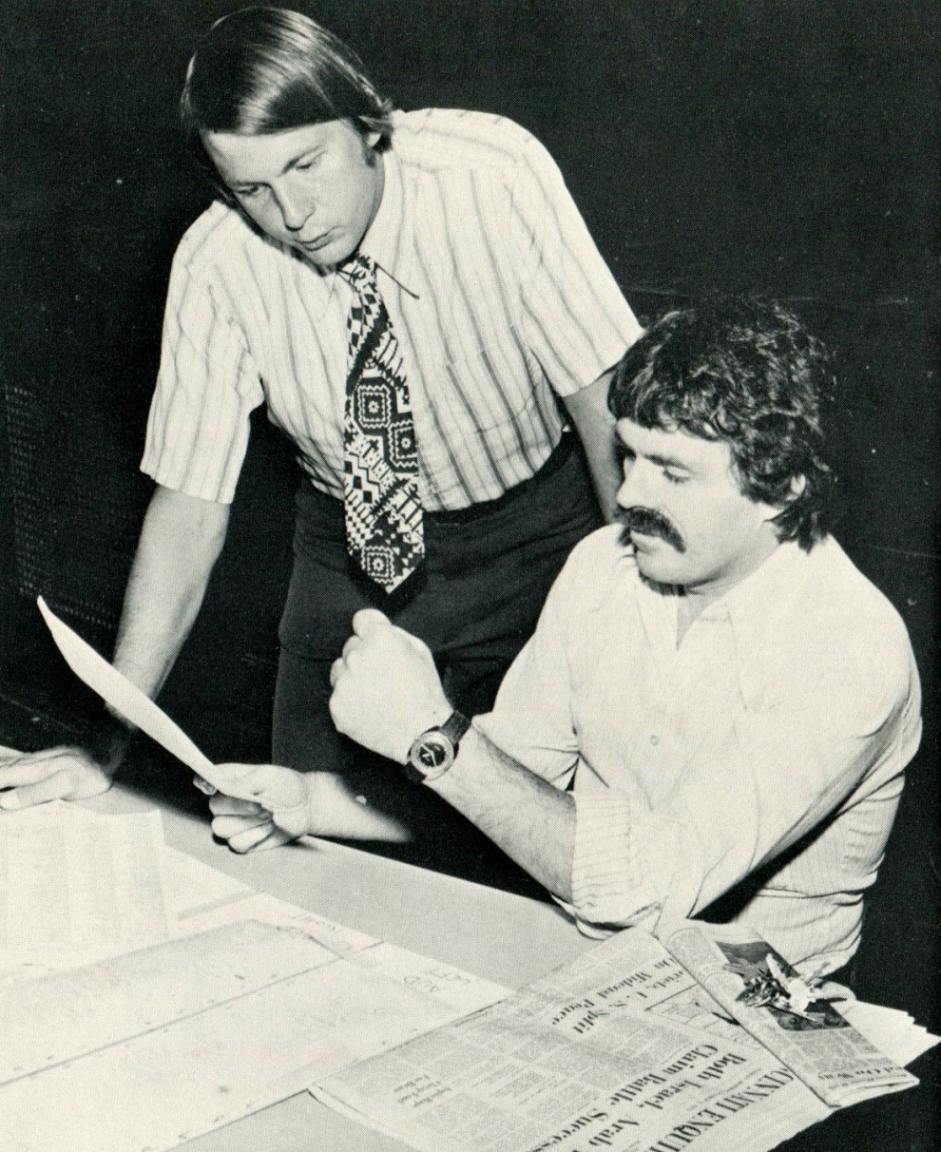
1974 Western Hills Yearbook
Ralph Griesser
(Class of 1959)

Slide 24
Thank You
For The Memories
Spectamur Agendo

