Slide 1
TRIGINTA OPTIMI
(Thirty of the Best)
Founded 1895
Class of 1973

Slide 2
1973 Western Hills Yearbook

Slide 3
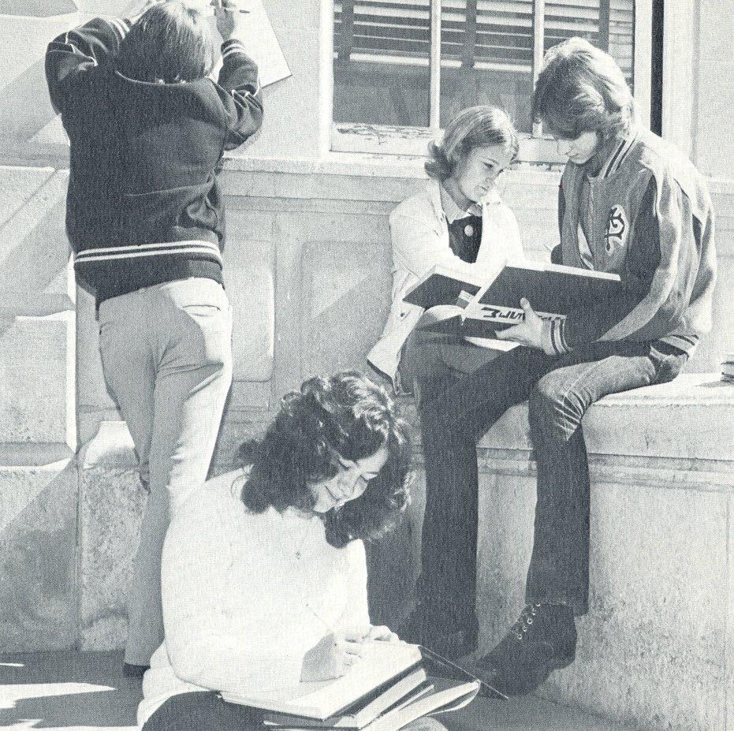
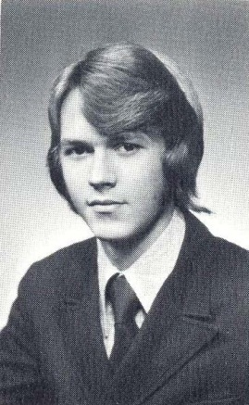
1973 Western Hills Yearbook
Greg Bumpus
(Class of 1973)
Gregory Bumpus

Slide 4
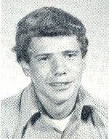
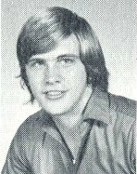
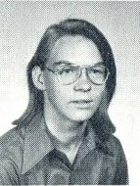
1973 Western Hills Yearbook
(Class of 1974)
Charles Arthur
Charles Cummins
James Grishaw

Slide 5
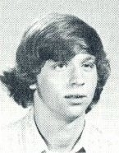
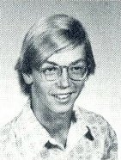
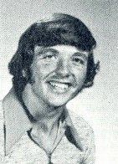
1973 Western Hills Yearbook
(Class of 1974)
Mark Groppe
Charles Gross
David Hampton

Slide 6
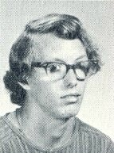
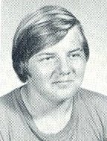
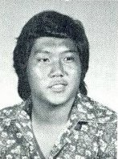
1973 Western Hills Yearbook
(Class of 1974)
David Krause
Scott Richardson
David Watanabe

Slide 7
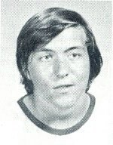
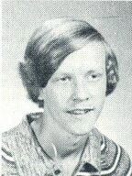
1973 Western Hills Yearbook
(Class of 1974)
Kenneth Wells
Douglas Vetter

Slide 8
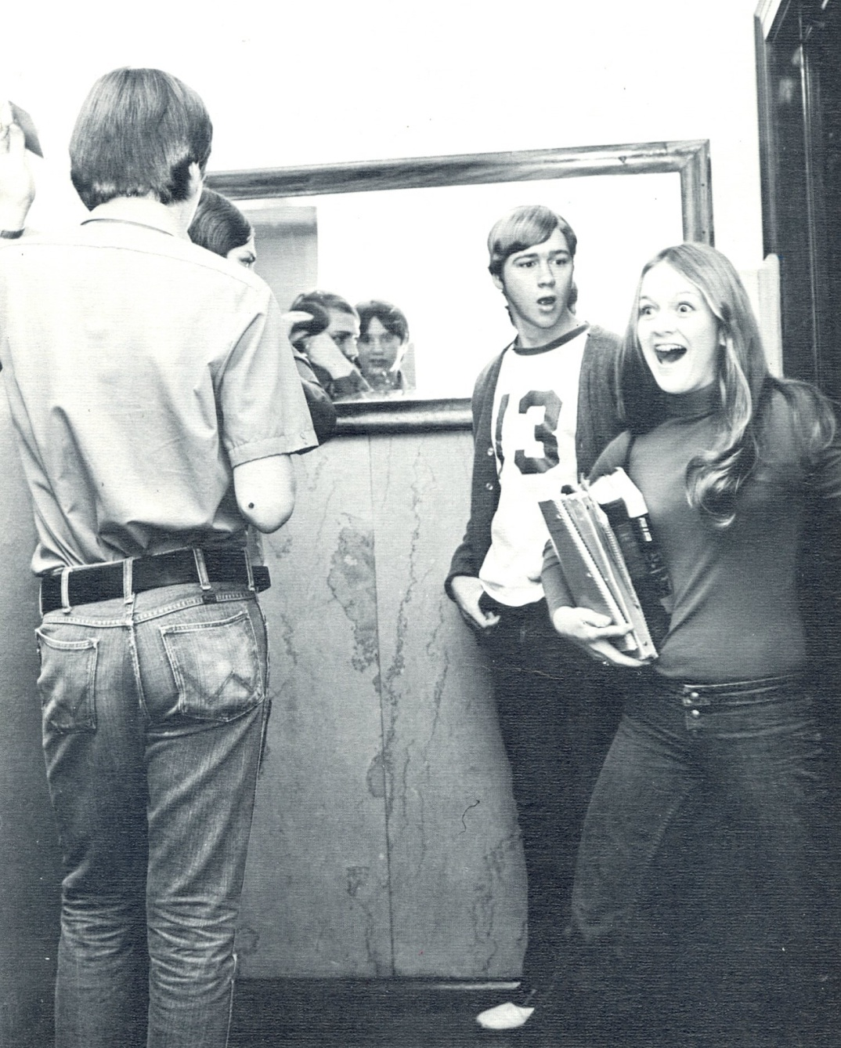
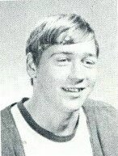
1973 Western Hills Yearbook
(Class of 1974)
[Paula Hudson]
Tom Outcalt

Slide 9
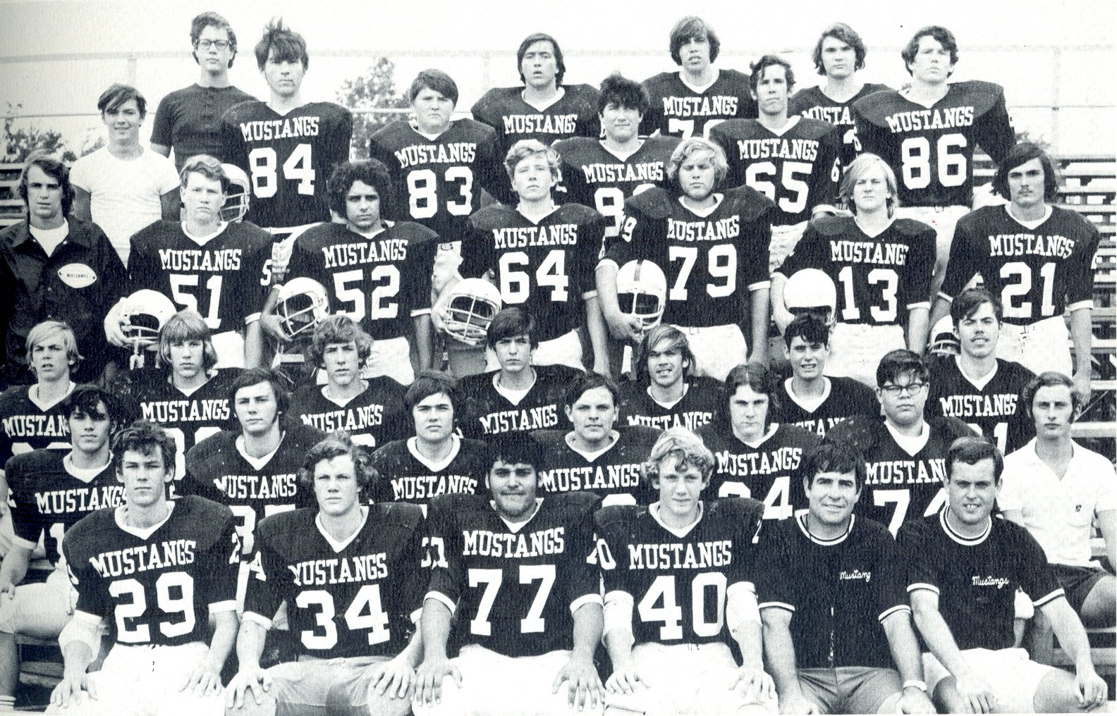
1973 Western Hills Yearbook
Charles Gross
(Class of 1974)
Kenneth Wells
(Class of 1974)
Richard Ogden
(Class of 1975)

Slide 10
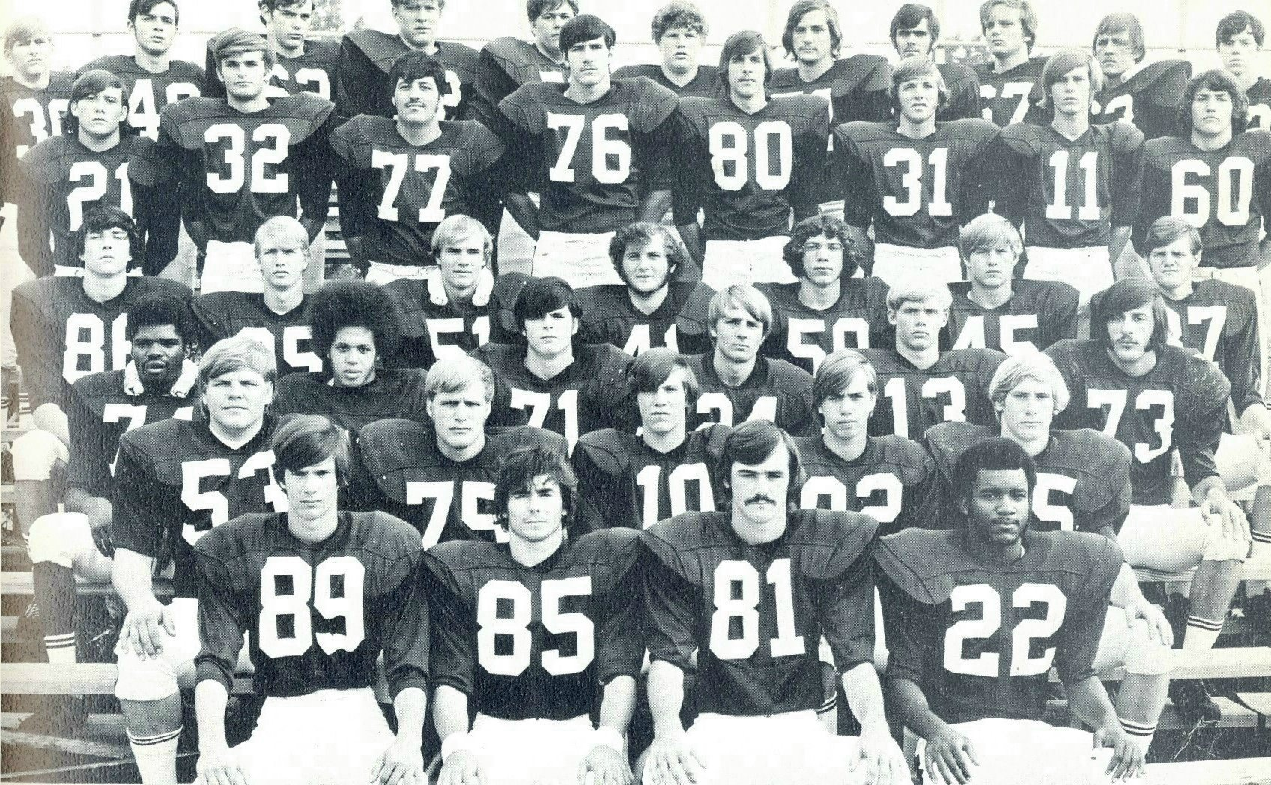
1973 Western Hills Yearbook
(Varsity Football)
Gary Keyes
(# 62)
(Class of 1975)
David Hampton
(# 31)
(Class of 1974)

Slide 11
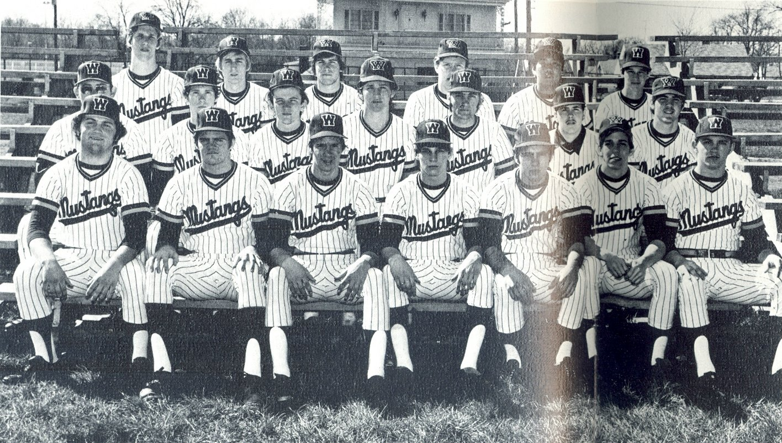
1973 Western Hills Yearbook
(Varsity Baseball)
(Class of 1974)
Mark Groppe
David Watanabe

Slide 12
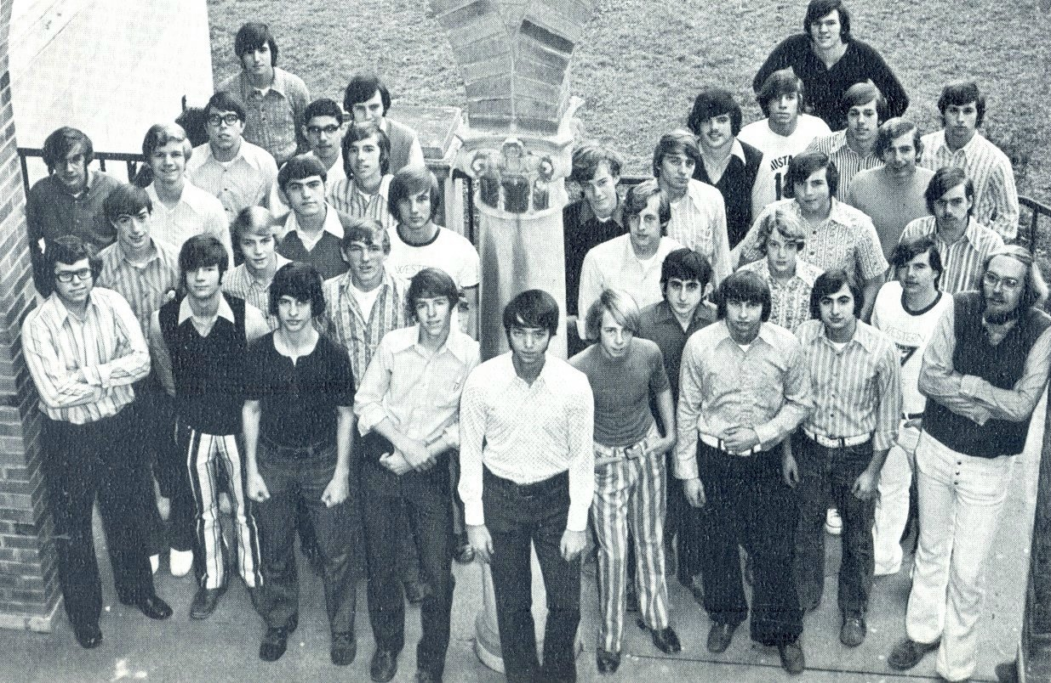
1973 Western Hills Yearbook
(Class of 1974)
Mark Groppe

Slide 13
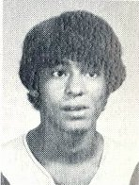
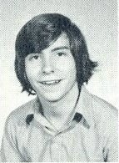
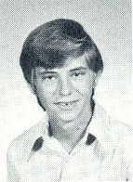
1973 Western Hills Yearbook
(Class of 1975)
John Andrews
Dan Blevins
Doug Berling

Slide 14
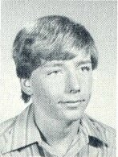
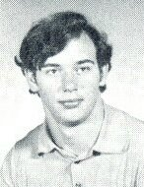
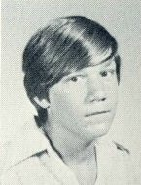
1973 Western Hills Yearbook
(Class of 1975)
Robert Herbers
Gary Keyes
Steve Laux

Slide 15
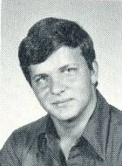
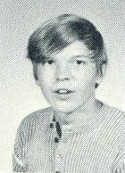
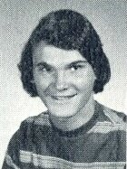
1973 Western Hills Yearbook
(Class of 1975)
Brian Maxwell
Jeff Meister
Dick Ogden

Slide 16
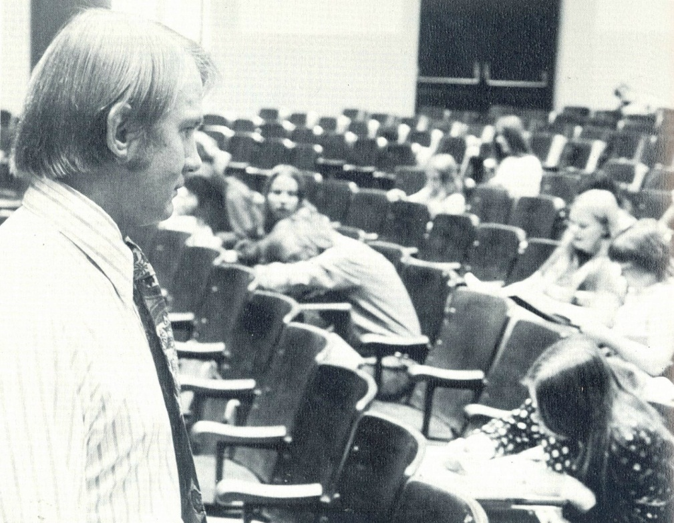
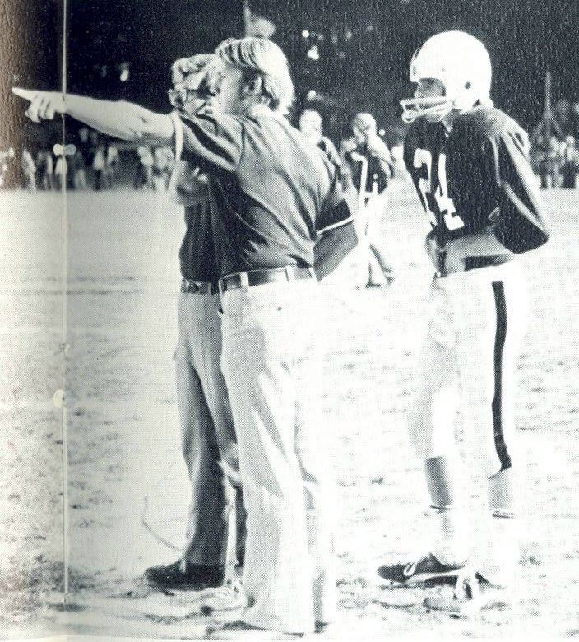
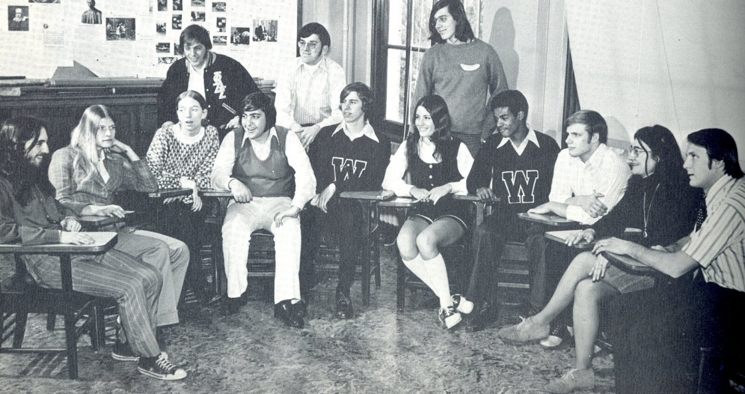
1973 Western Hills Yearbook
(Class of 1959)
Ralph Griesser

Slide 17
Thank You
For The Memories
Spectamur Agendo

