Slide 1
TRIGINTA OPTIMI
(Thirty of the Best)
Founded 1895
Class of 1966

Slide 2
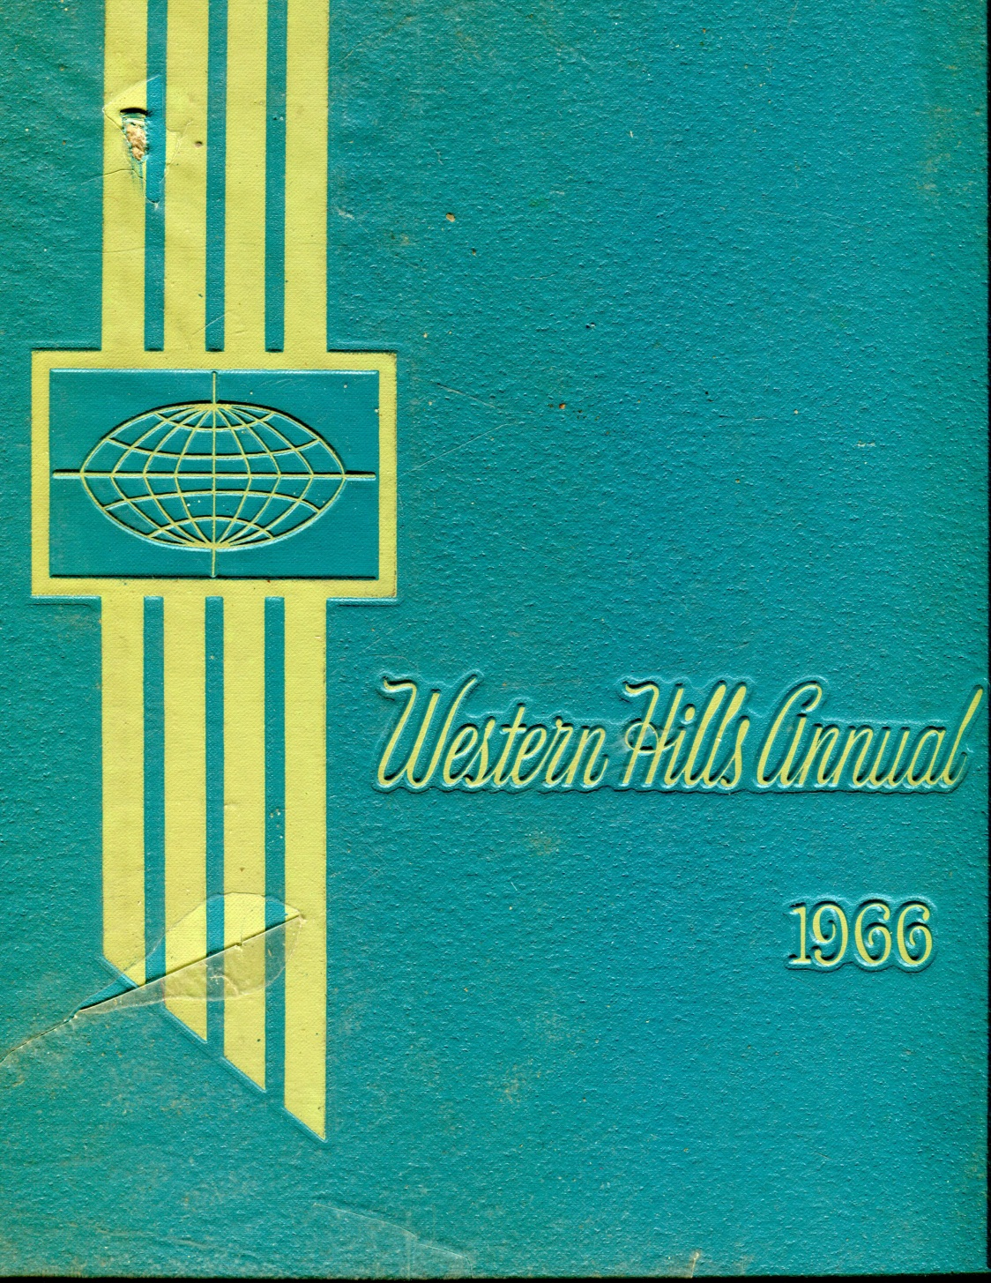

Slide 3
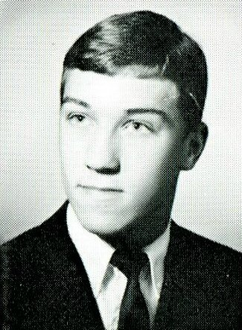
1966 Western Hills Yearbook
David Stilwell Mahlman

Slide 4
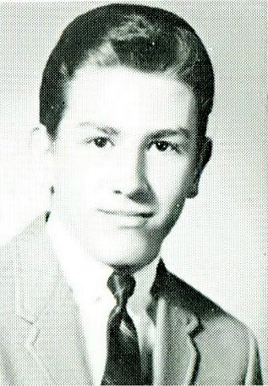
1966 Western Hills Yearbook
Brent Marlatt

Slide 5
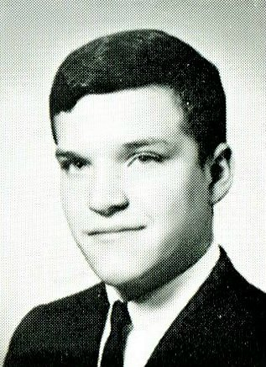
1966 Western Hills Yearbook
Timothy Earl Maxwell

Slide 6
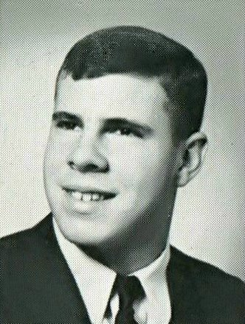
1966 Western Hills Yearbook
Robert Richter Reusing

Slide 7
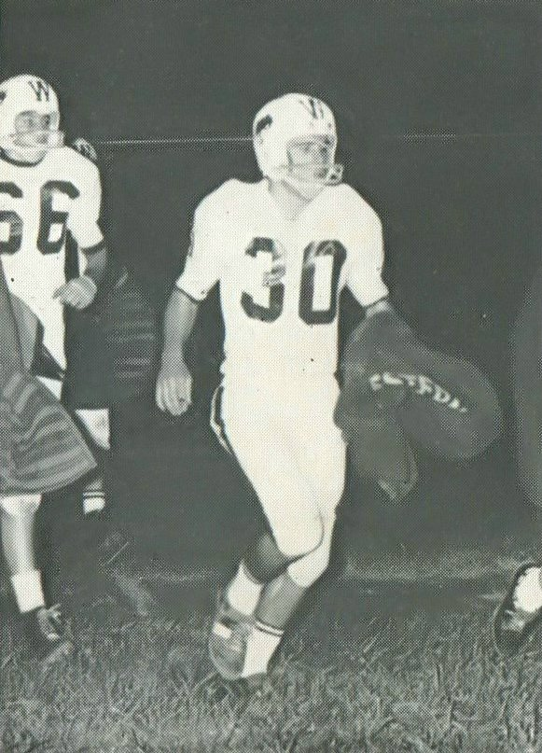
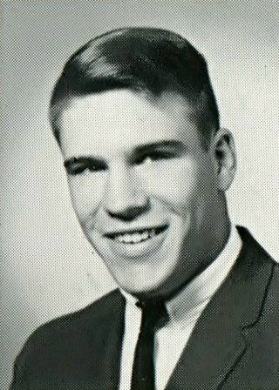
1966 Western Hills Yearbook
John Sumner Reynolds

Slide 8
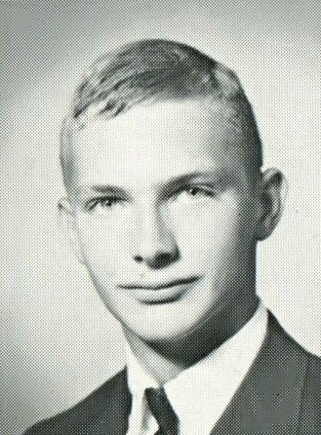
1966 Western Hills Yearbook
Robert Louis Singerman

Slide 9
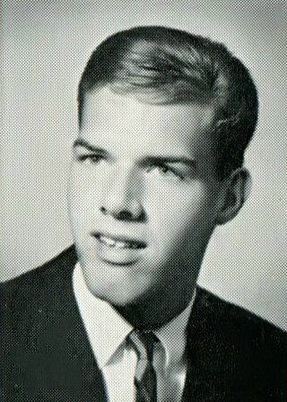
1966 Western Hills Yearbook
Rodney Everett Thomas

Slide 10
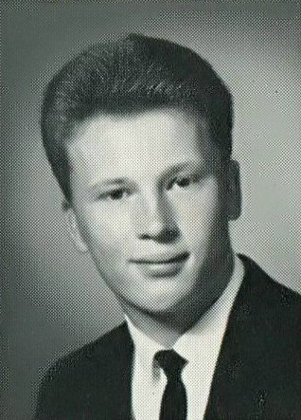
1966 Western Hills Yearbook
Robert Guy Zipfel

Slide 11
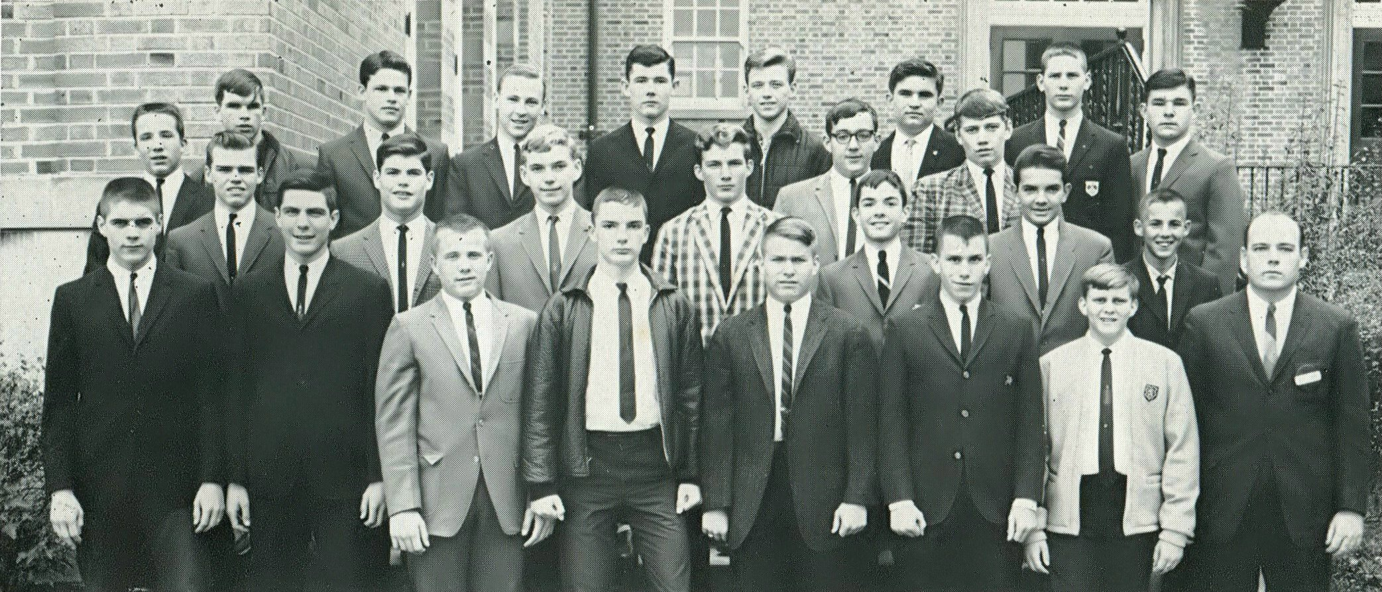
1966 Western Hills Yearbook
Leslie Harper
Timothy Maxwell
Robert Singerman

Slide 12
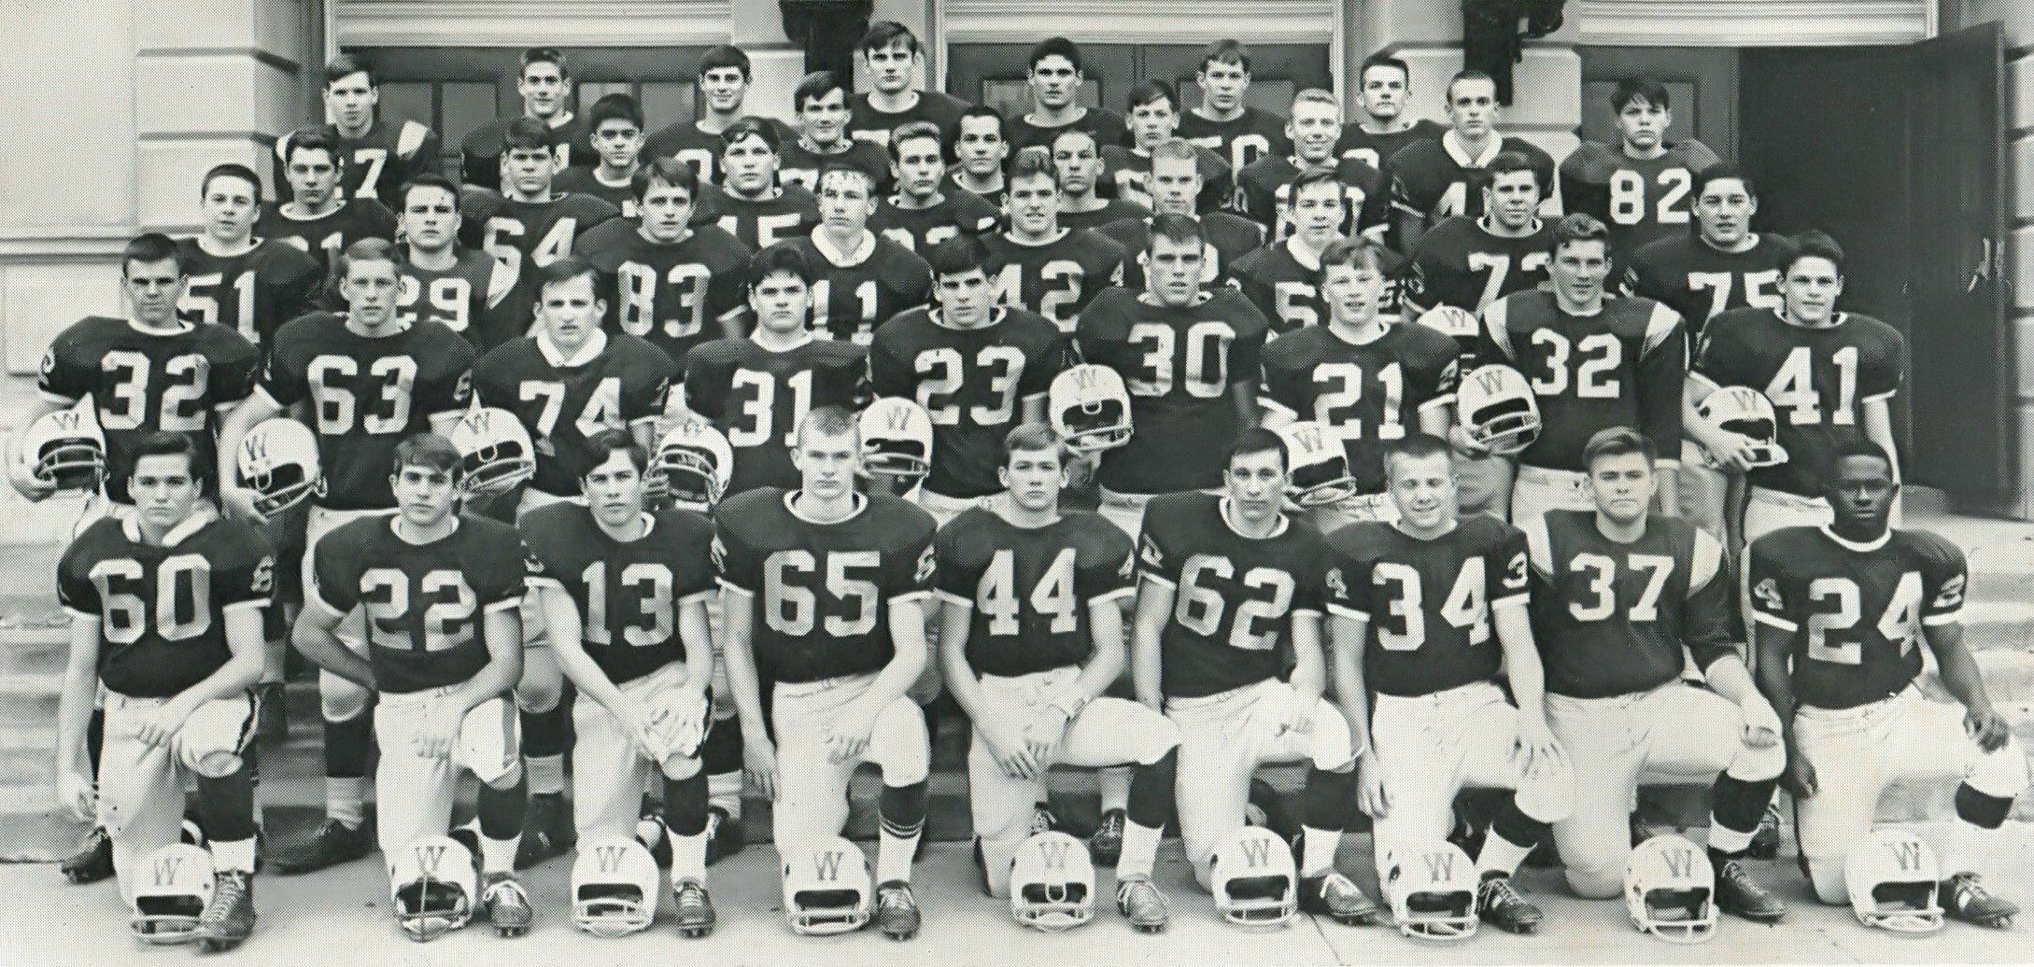
1966 Western Hills Yearbook
(Varsity Football Team)
Jack Reynolds
(# 30)
Robert Zipfel
(# 21)
Robert Reusing
(# 72)
Robert Singerman
(# 65)
Leslie Harper
(# 32)
(Class of 1968)

Slide 13
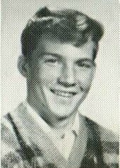
1966 Western Hills Yearbook
Leslie Harper
(# 32)
(Class of 1968)

Slide 14
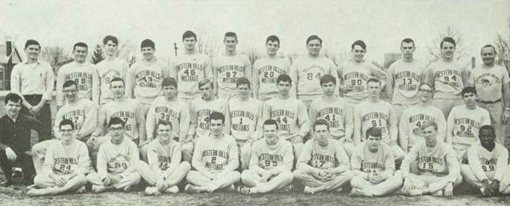
1966 Western Hills Yearbook
Richard Prather Jones
(# 90)
(Class of 1967)
Dave Allen Pawn
(# 15)
(Class of 1967)

Slide 15
Thank You
For The Memories
Spectamur Agendo

