Slide 1
TRIGINTA OPTIMI
(Thirty of the Best)
Founded 1895
Class of 1961

Slide 2
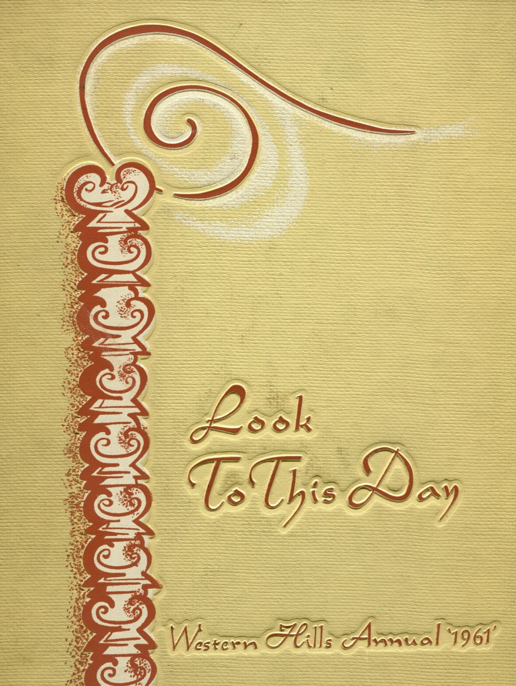

Slide 3
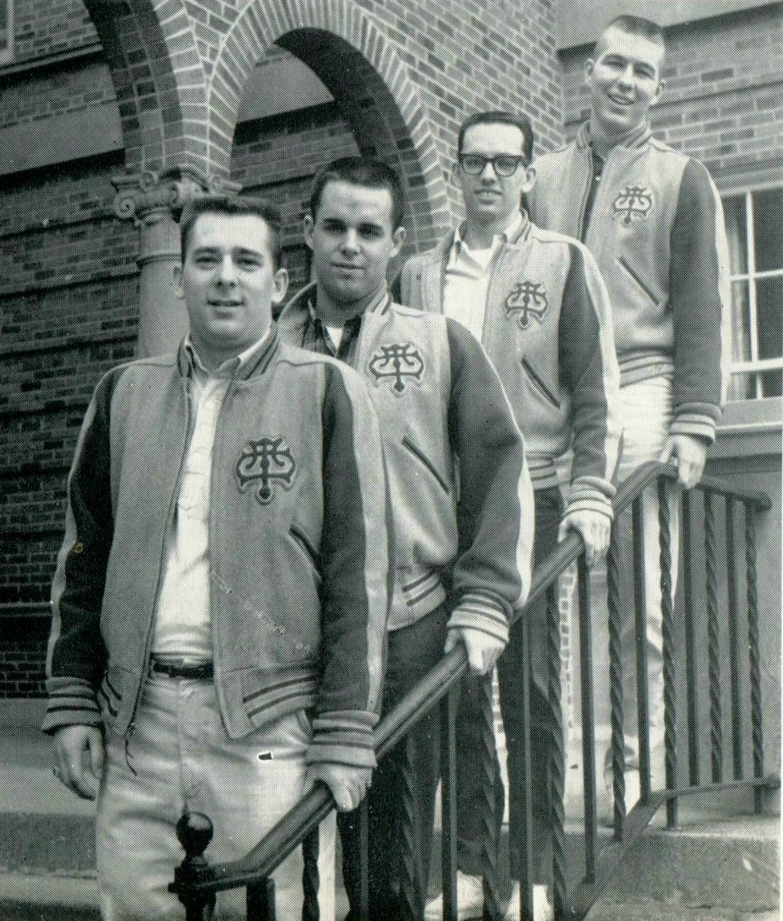
1961 Western Hills Yearbook
(T.O. Officers)
Triginta Optimi
The close of the school year left may memorable impressions on the minds of the boys in Triginta Optimi, Fellowship was shared in a number of events. The dance, Autumn Rhapsody, the hayride, the old clothes party, and the banquet were among the many projects sponsored by T.O. The victory and assurance of the trophy in the T.O., C.O.S. game added spirit to the fraternity as well as aided Muscular Dystrophy. Many individuals were engaged in school activities. Among those who gained honors were Andy Patton, Football Captain, and Stu Schott, Mr. Western Hills Runner-up.
Ken Kay, John Schiff, Michael Noyes, and Andy Patton

Slide 4
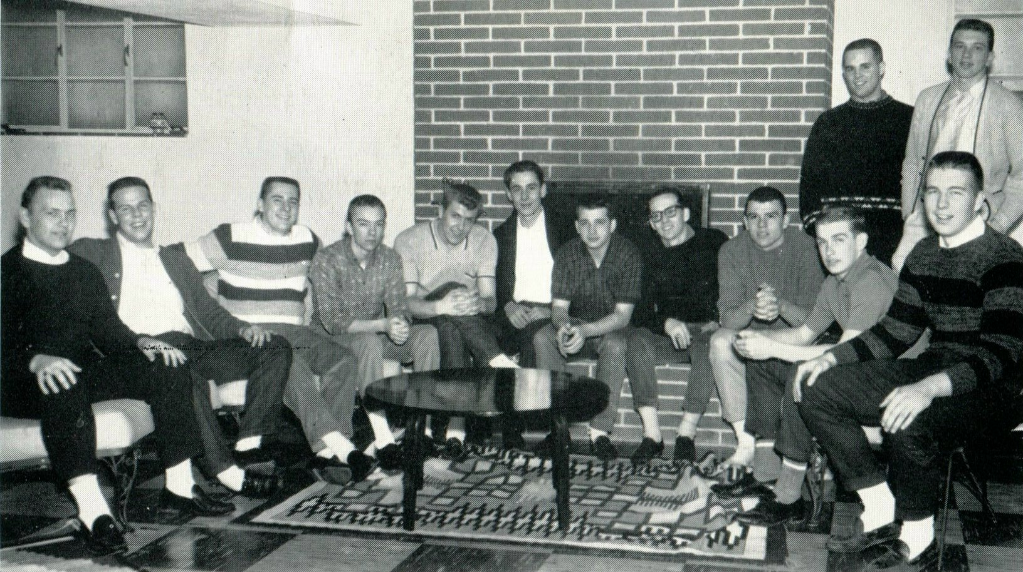
1961 Western Hills Yearbook
(T.O. Seniors)
D. Wright, E. Mahaffey, K. Kay, T. Prince, M. Bibent, D. Kugler, J. Morgeson, M. Noyes, S. Schott, J. Schiff, C. Norton, D. Thie, and A. Patton

Slide 5
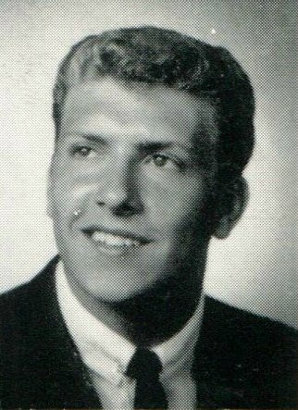
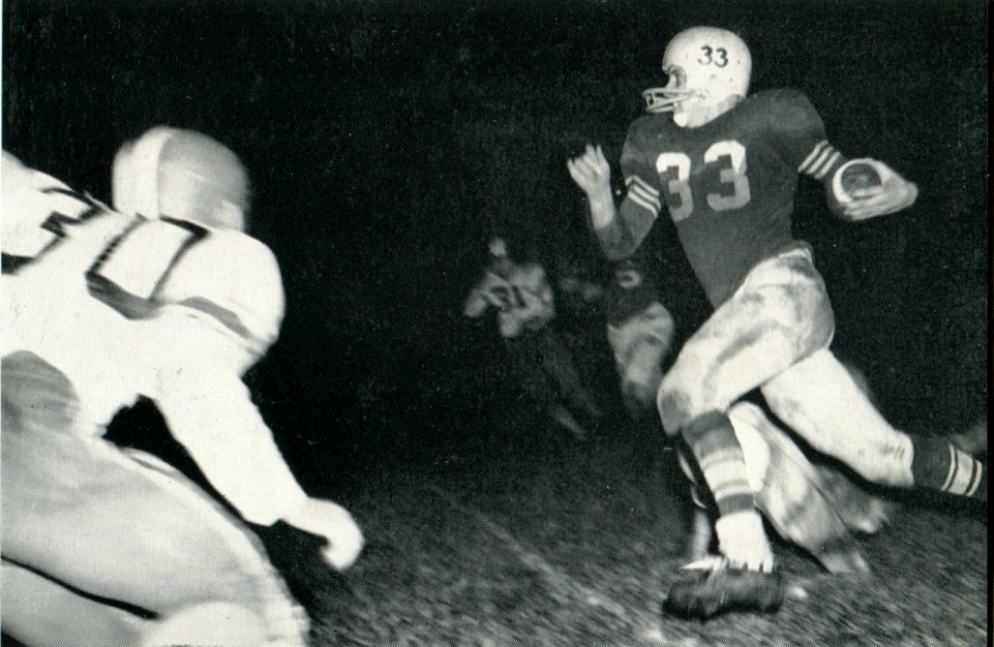
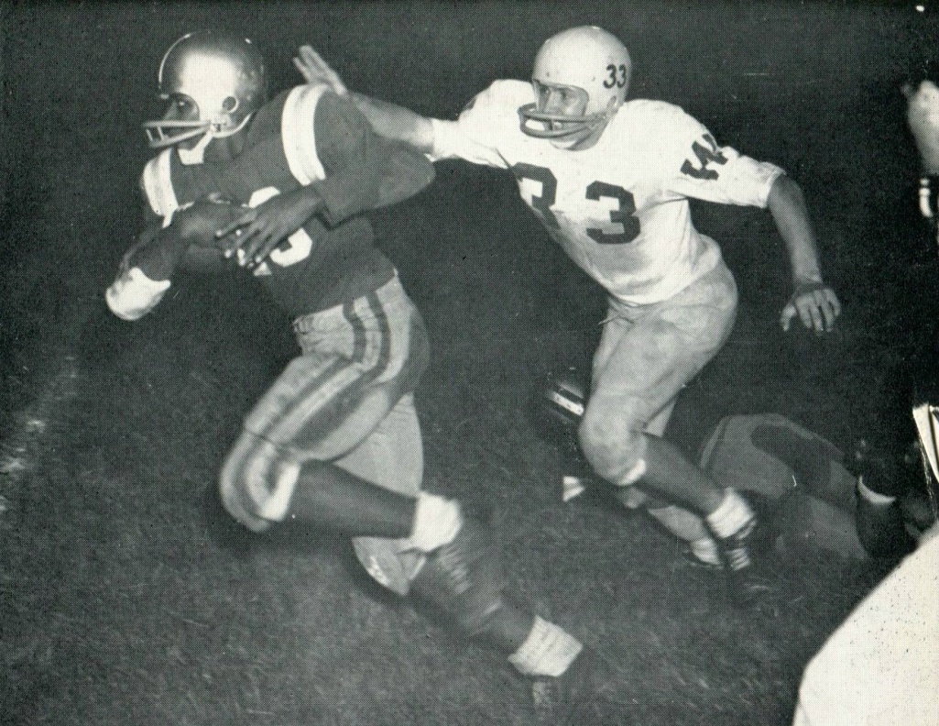
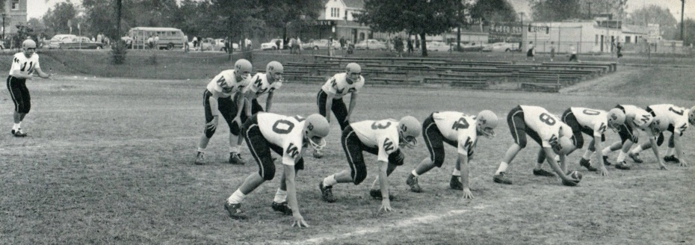
1961 Western Hills Yearbook
Maurice John Bibent

Slide 6
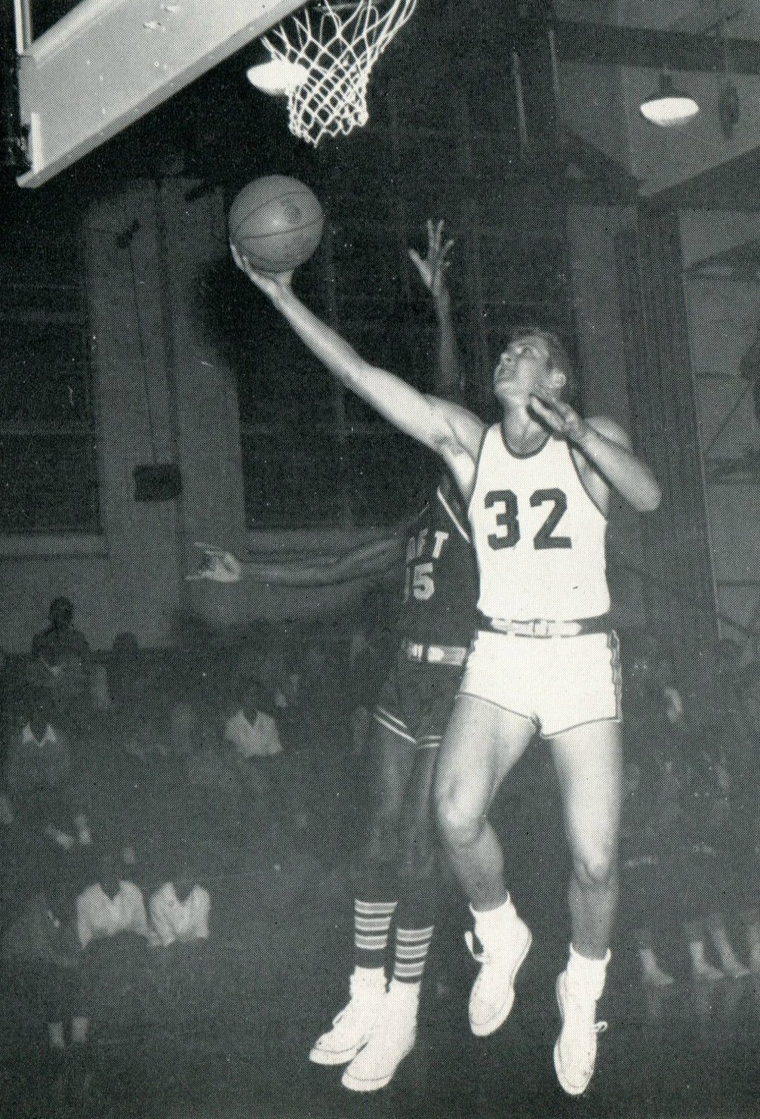
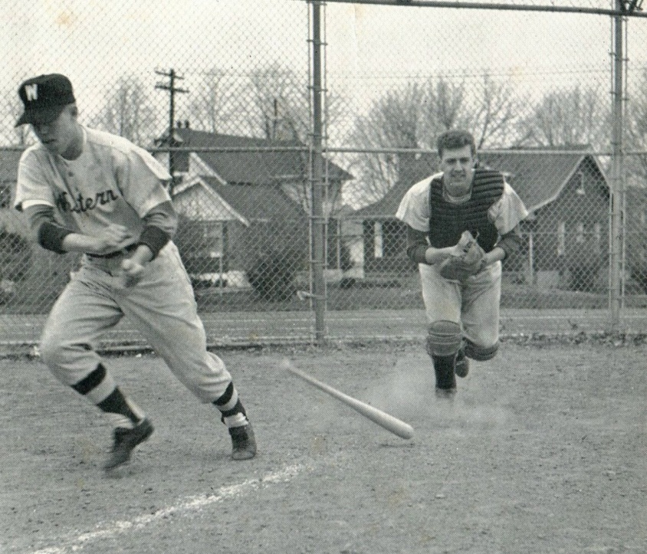
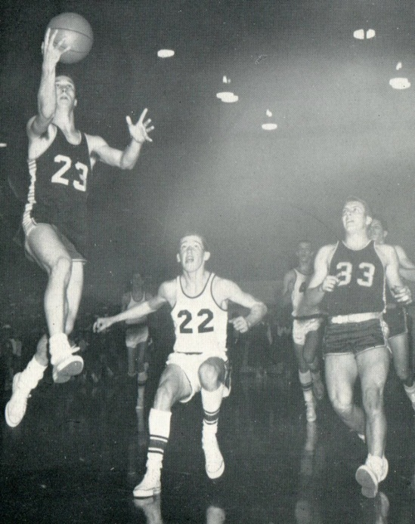
1961 Western Hills Yearbook
Maurice John Bibent
(# 32)

Slide 7
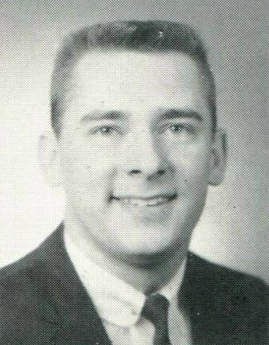
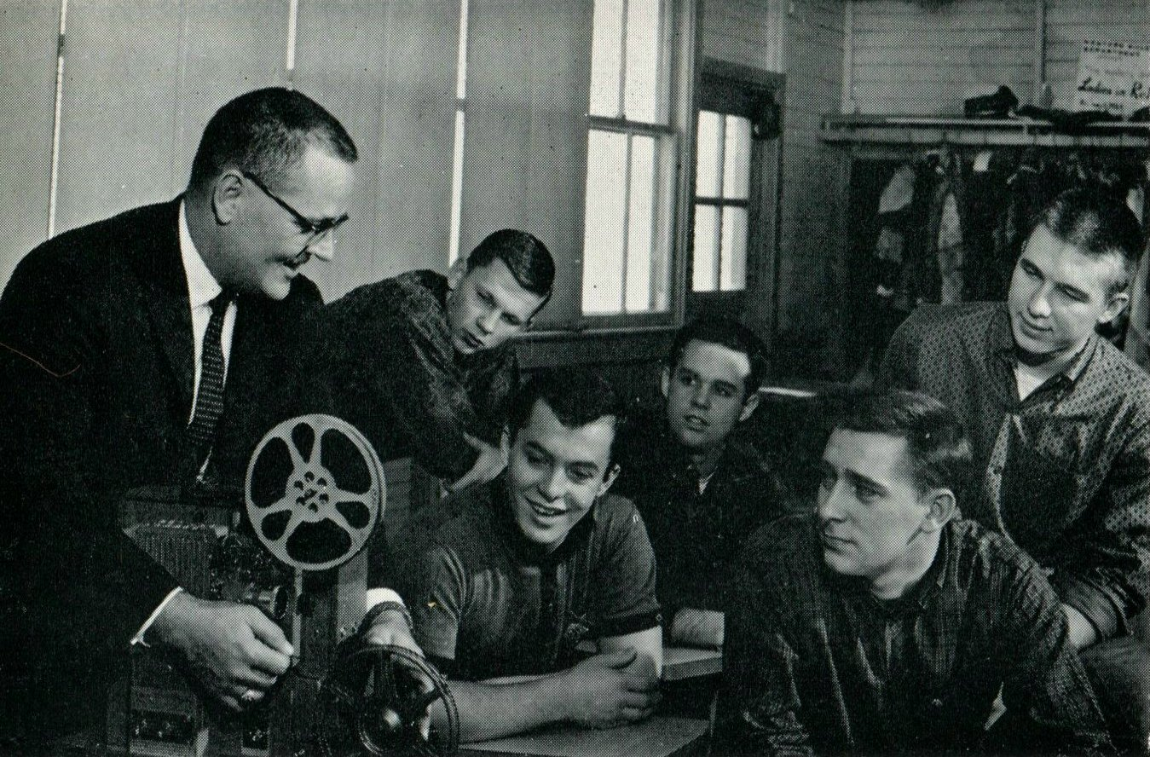
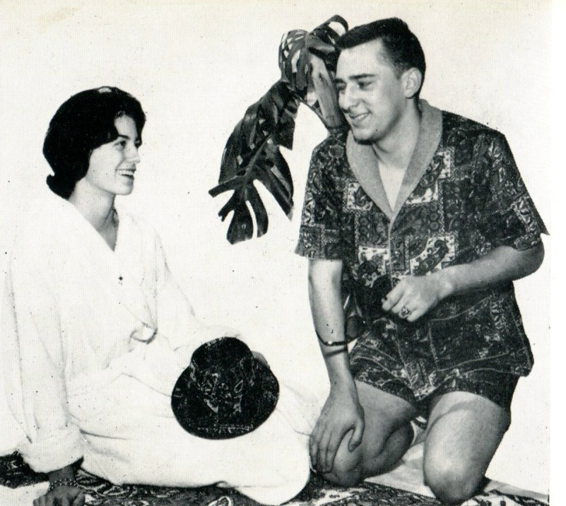
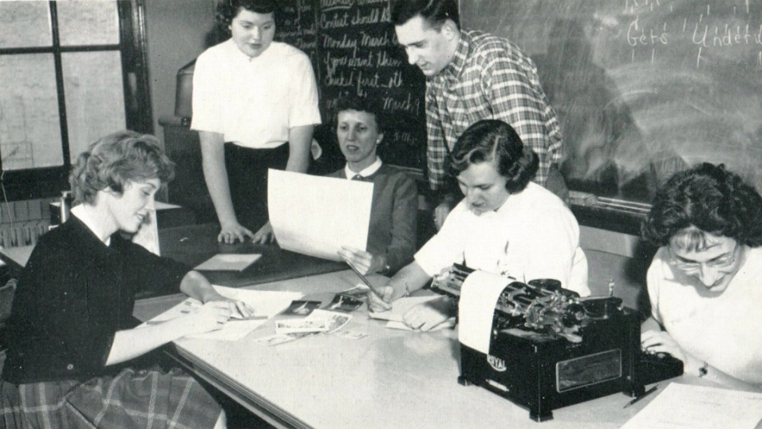
1961 Western Hills Yearbook
Kenneth Charles Kay

Slide 8
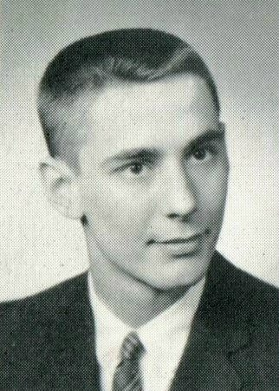
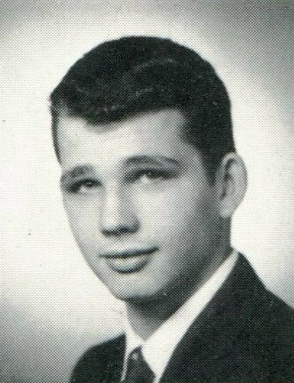
1961 Western Hills Yearbook
David Kugler
Junior Allan Morgeson

Slide 9
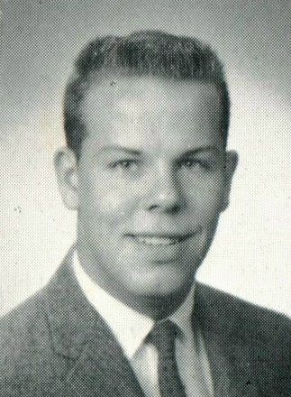
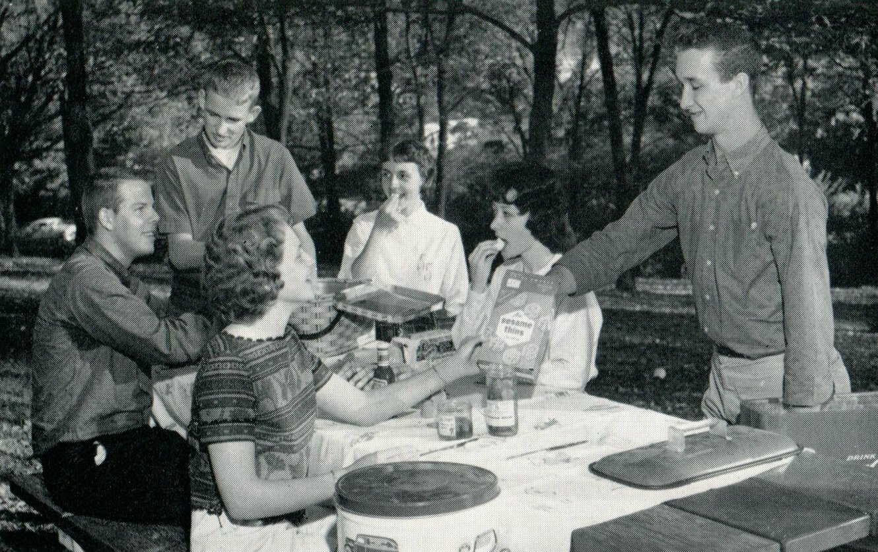
1961 Western Hills Yearbook
Edward S. Mahaffey

Slide 10
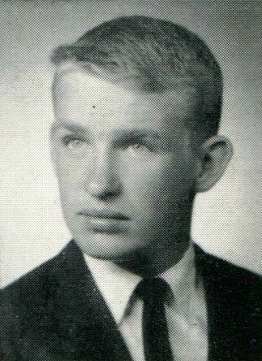
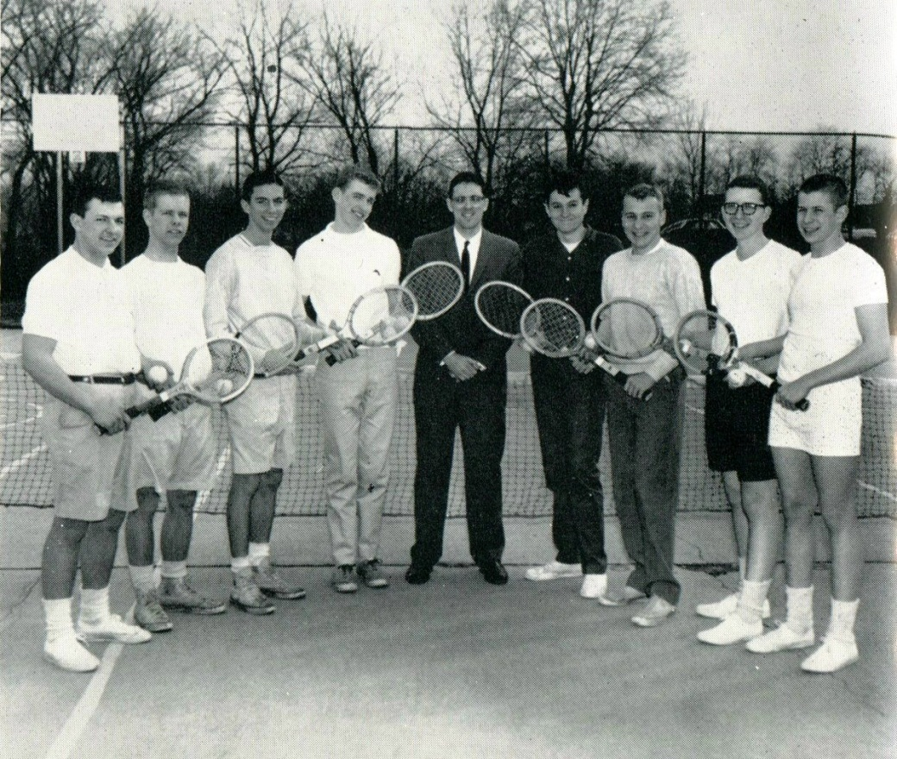
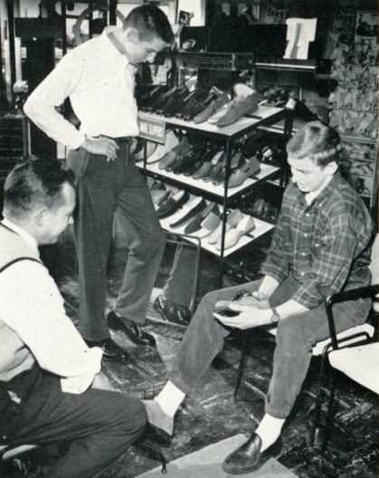
1961 Western Hills Yearbook
Charles Norton

Slide 11
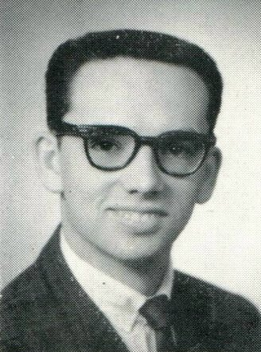
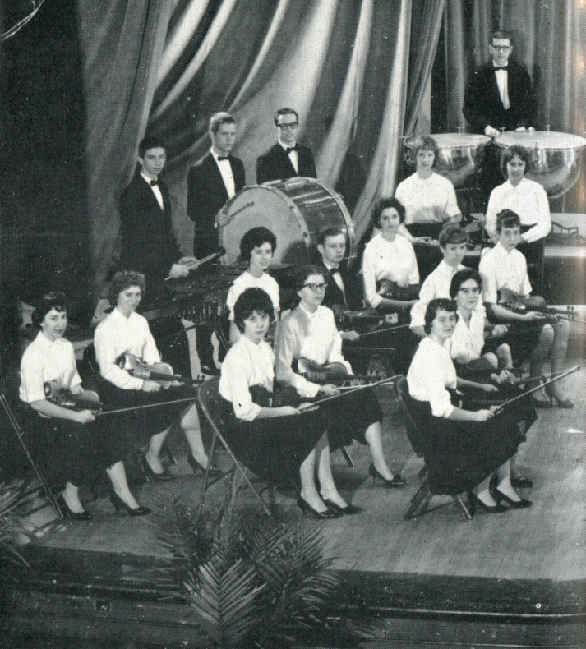
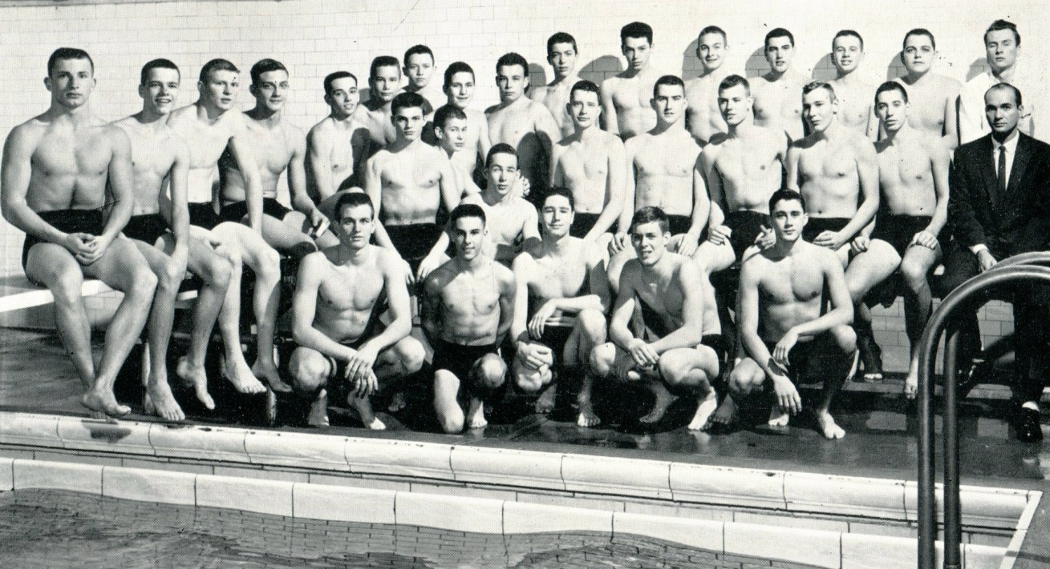
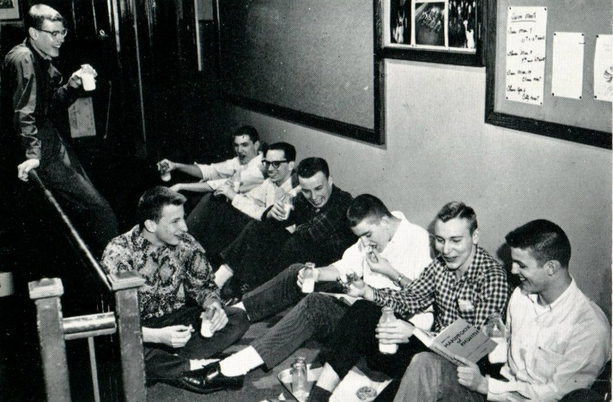
1961 Western Hills Yearbook
Michael Raymond Noyes

Slide 12
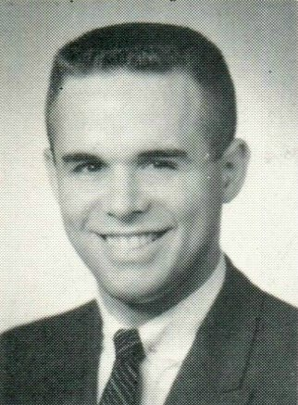
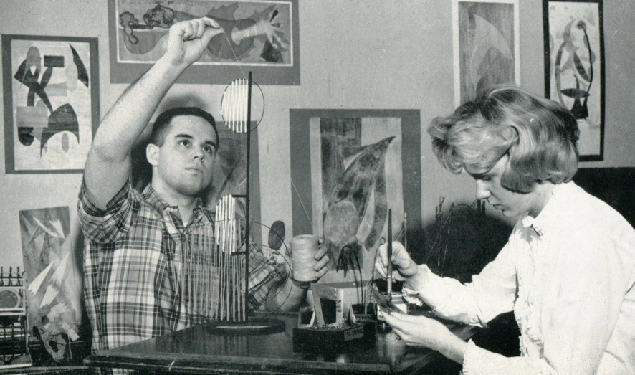
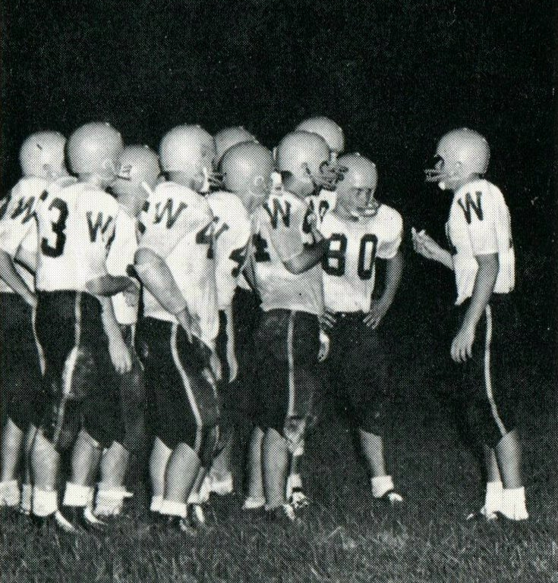
1961 Western Hills Yearbook
John Jefferson Schiff

Slide 13
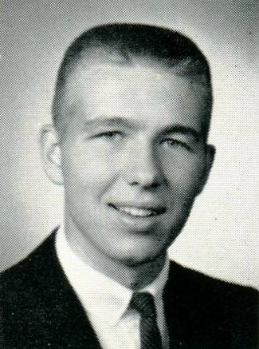
1961 Western Hills Yearbook
William Andrew Patton

Slide 14
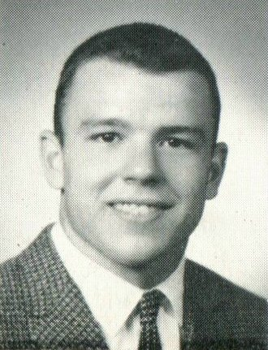
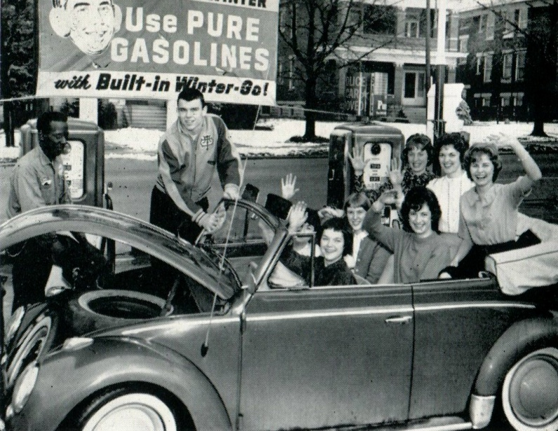
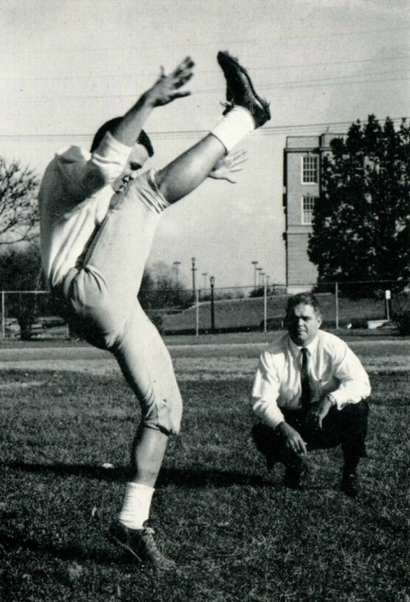
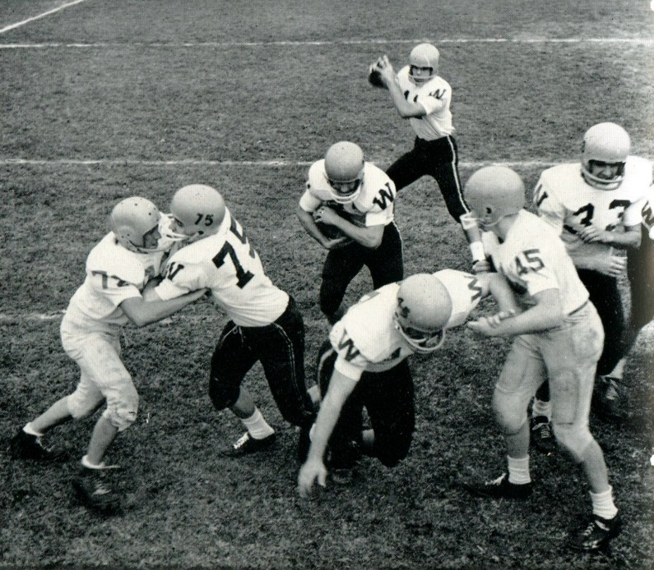
1961 Western Hills Yearbook
Stuart Christian Schott

Slide 15
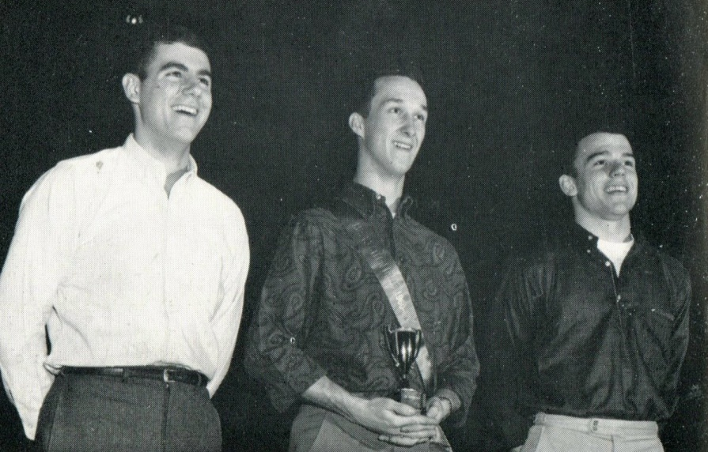
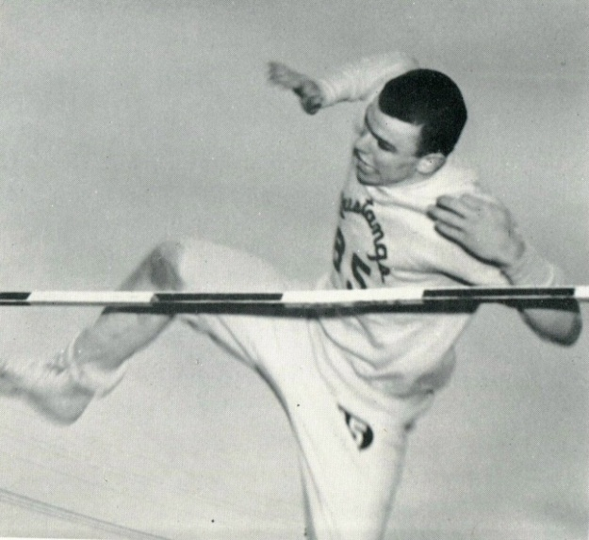
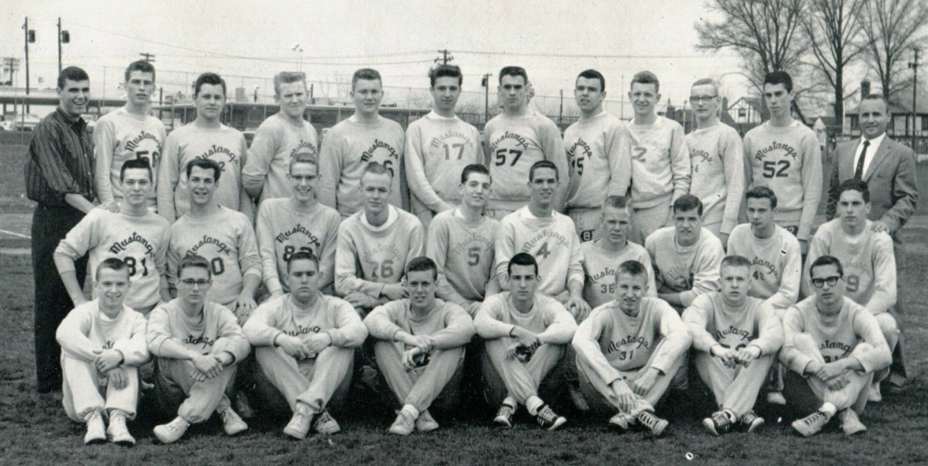
1961 Western Hills Yearbook
Stuart Schott

Slide 16
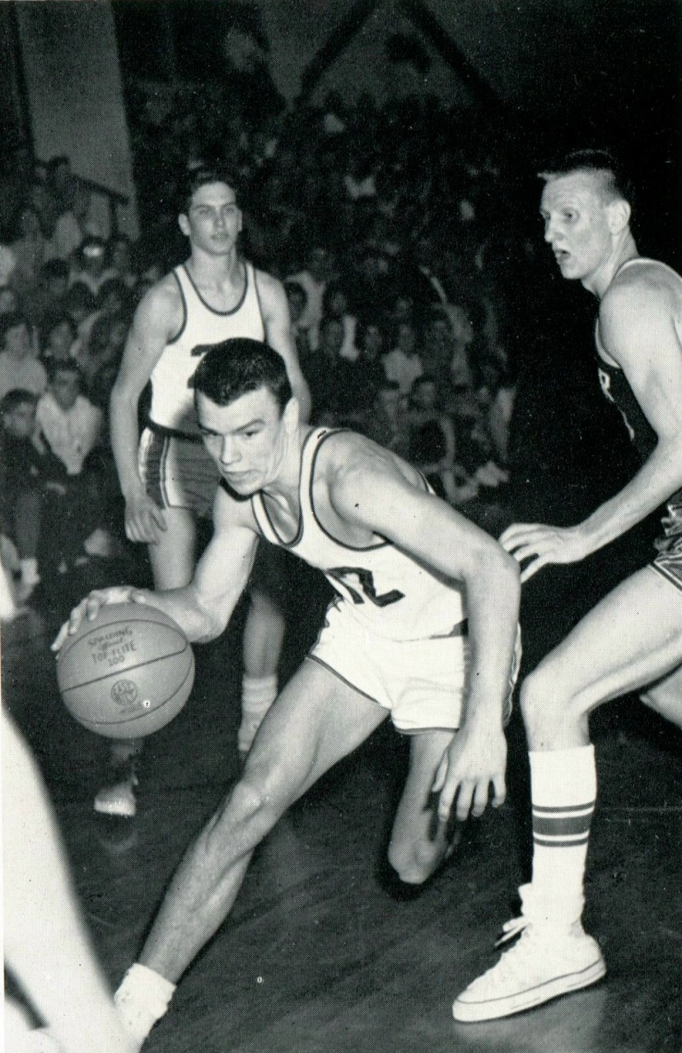
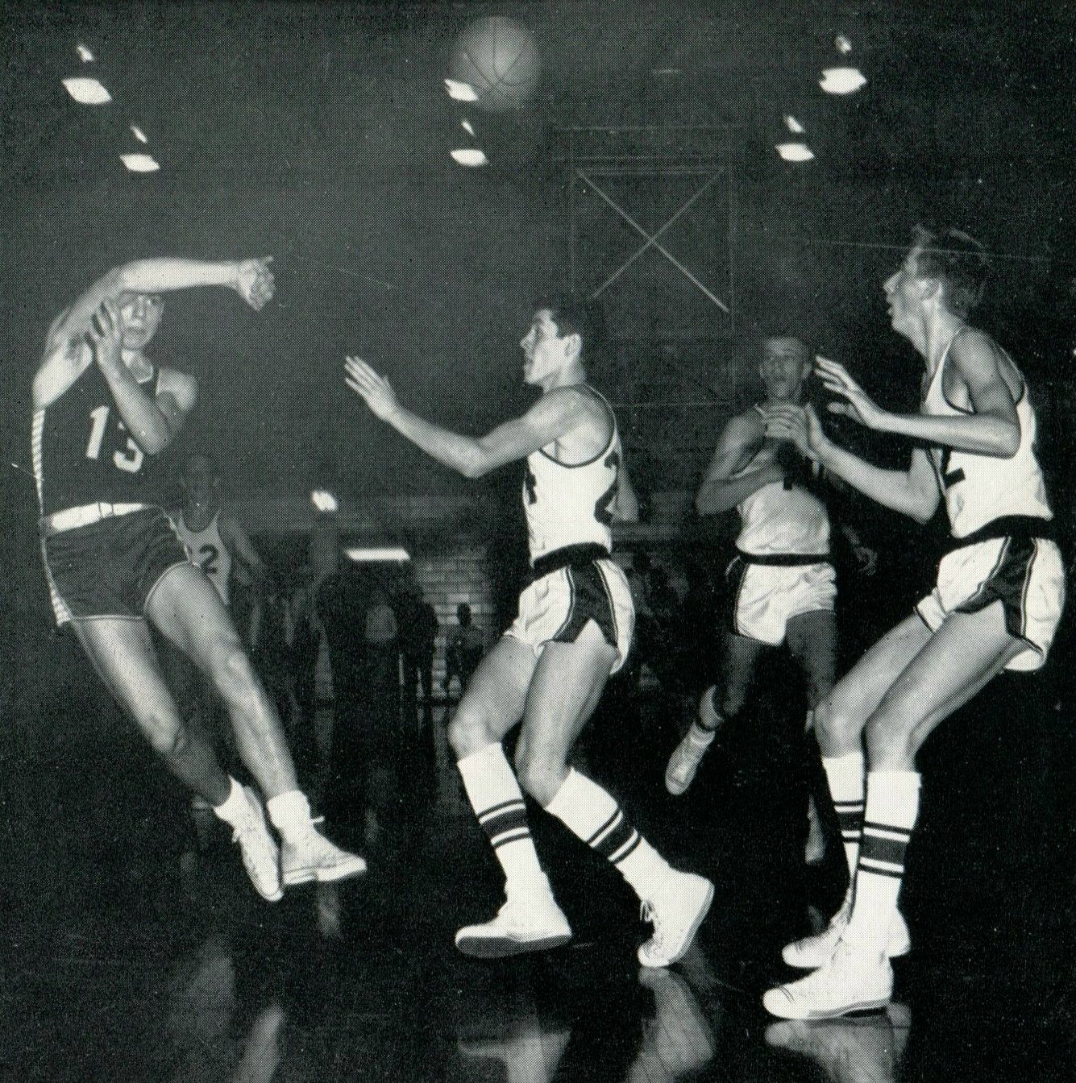
1961 Western Hills Yearbook
Stuart Christian Schott
(# 13)

Slide 17
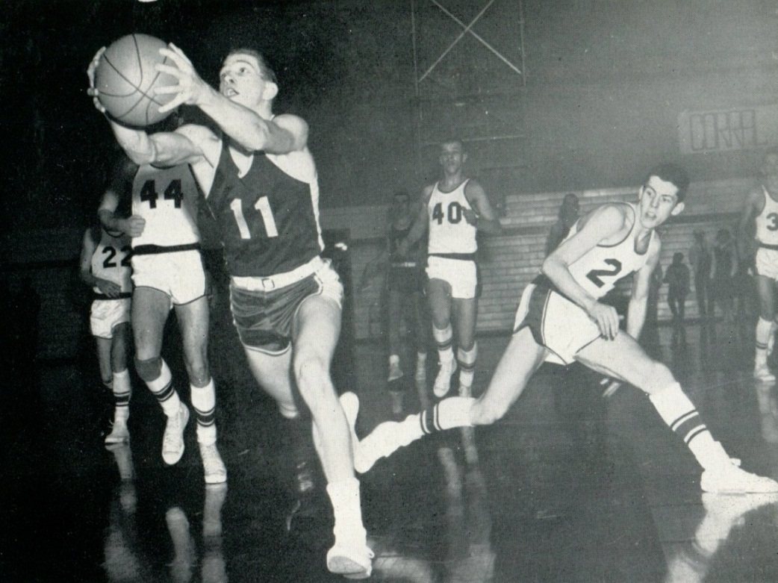
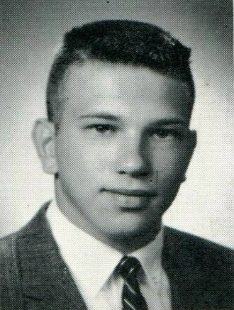
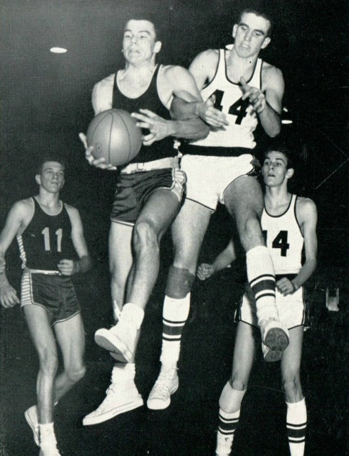
1961 Western Hills Yearbook
David William Thie
(# 11)

Slide 18
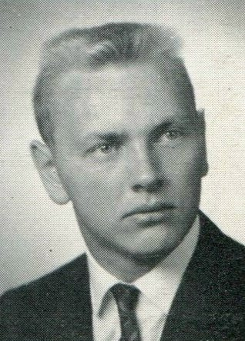
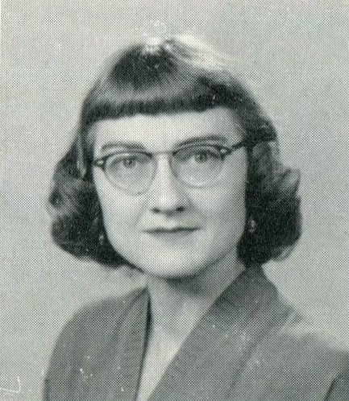
1961 Western Hills Yearbook
David Allen Wright
Mrs. Jean Spickard
(Honorary T.O.)

Slide 19
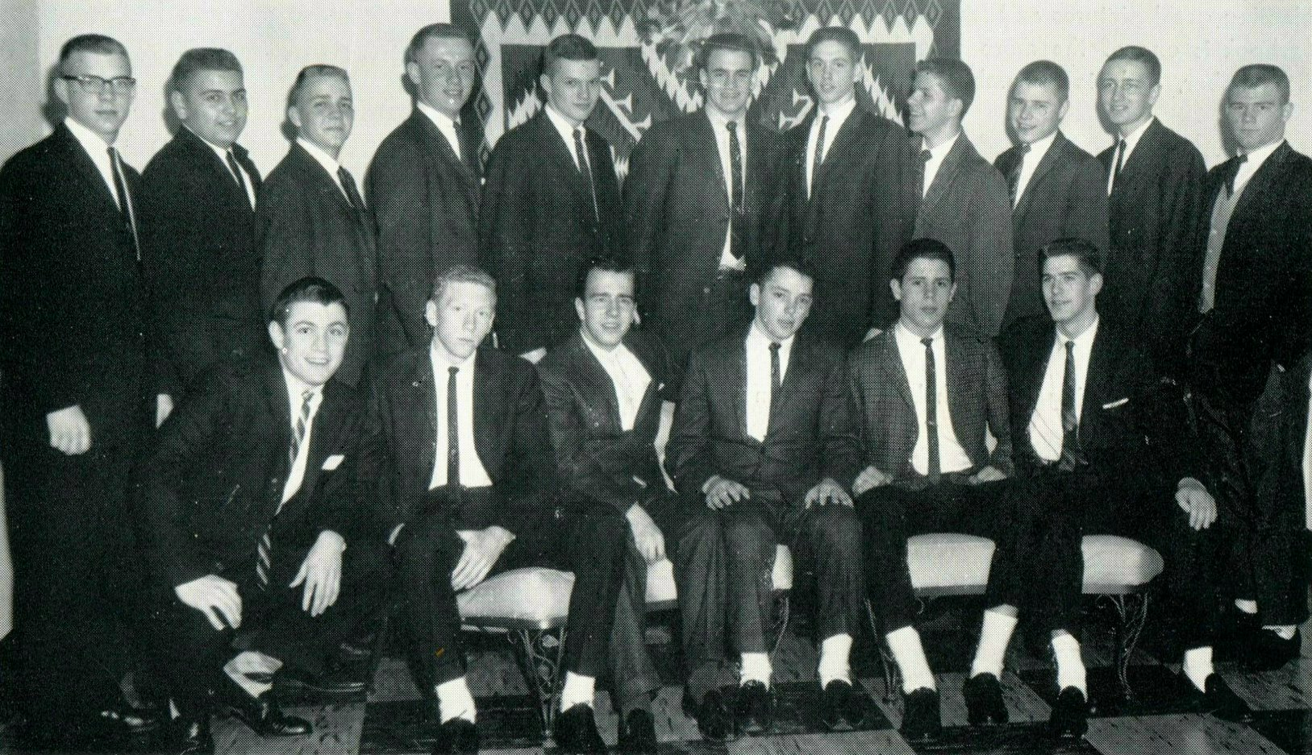
1961 Western Hills Yearbook
(T.O. Sophomores and Juniors)
First Row: J. Hardy, D. McElroy, D. Lantry, R. Niemes, J. Hartman, T. Dennie
Second Row: D. Hoffman, L. Wright, L. Bauer, G. Koppenhoefer, L. Swartz, C. Rothenbush,
T. Lange, C. Griener, N. Bauer, D. Patton, S. Schmidt

Slide 20
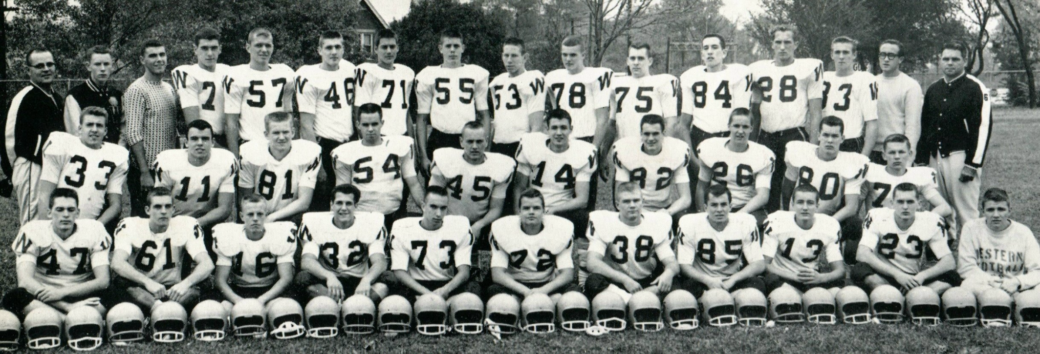
1961 Western Hills Yearbook
(Varsity Football)
Jim Hartman
(Class of 1962)
(# 55)
Larry Swartz
(Class of 1962)
(# 78)
Maury Bibent
(# 33)
Stu Schott
(# 11)
Key Kay
(# 75)
Dick Hauck
James Hardy
(Class of 1962)
(# 14)
Ed Schmidt
(Class of 1962)
(# 38)
Chuck Rothenbush
(Class of 1962)
(# 82)
Richard Patton
(Class of 1962)
(# 13)
John Schiff
(# 54)
David Wright
(# 45)

Slide 21
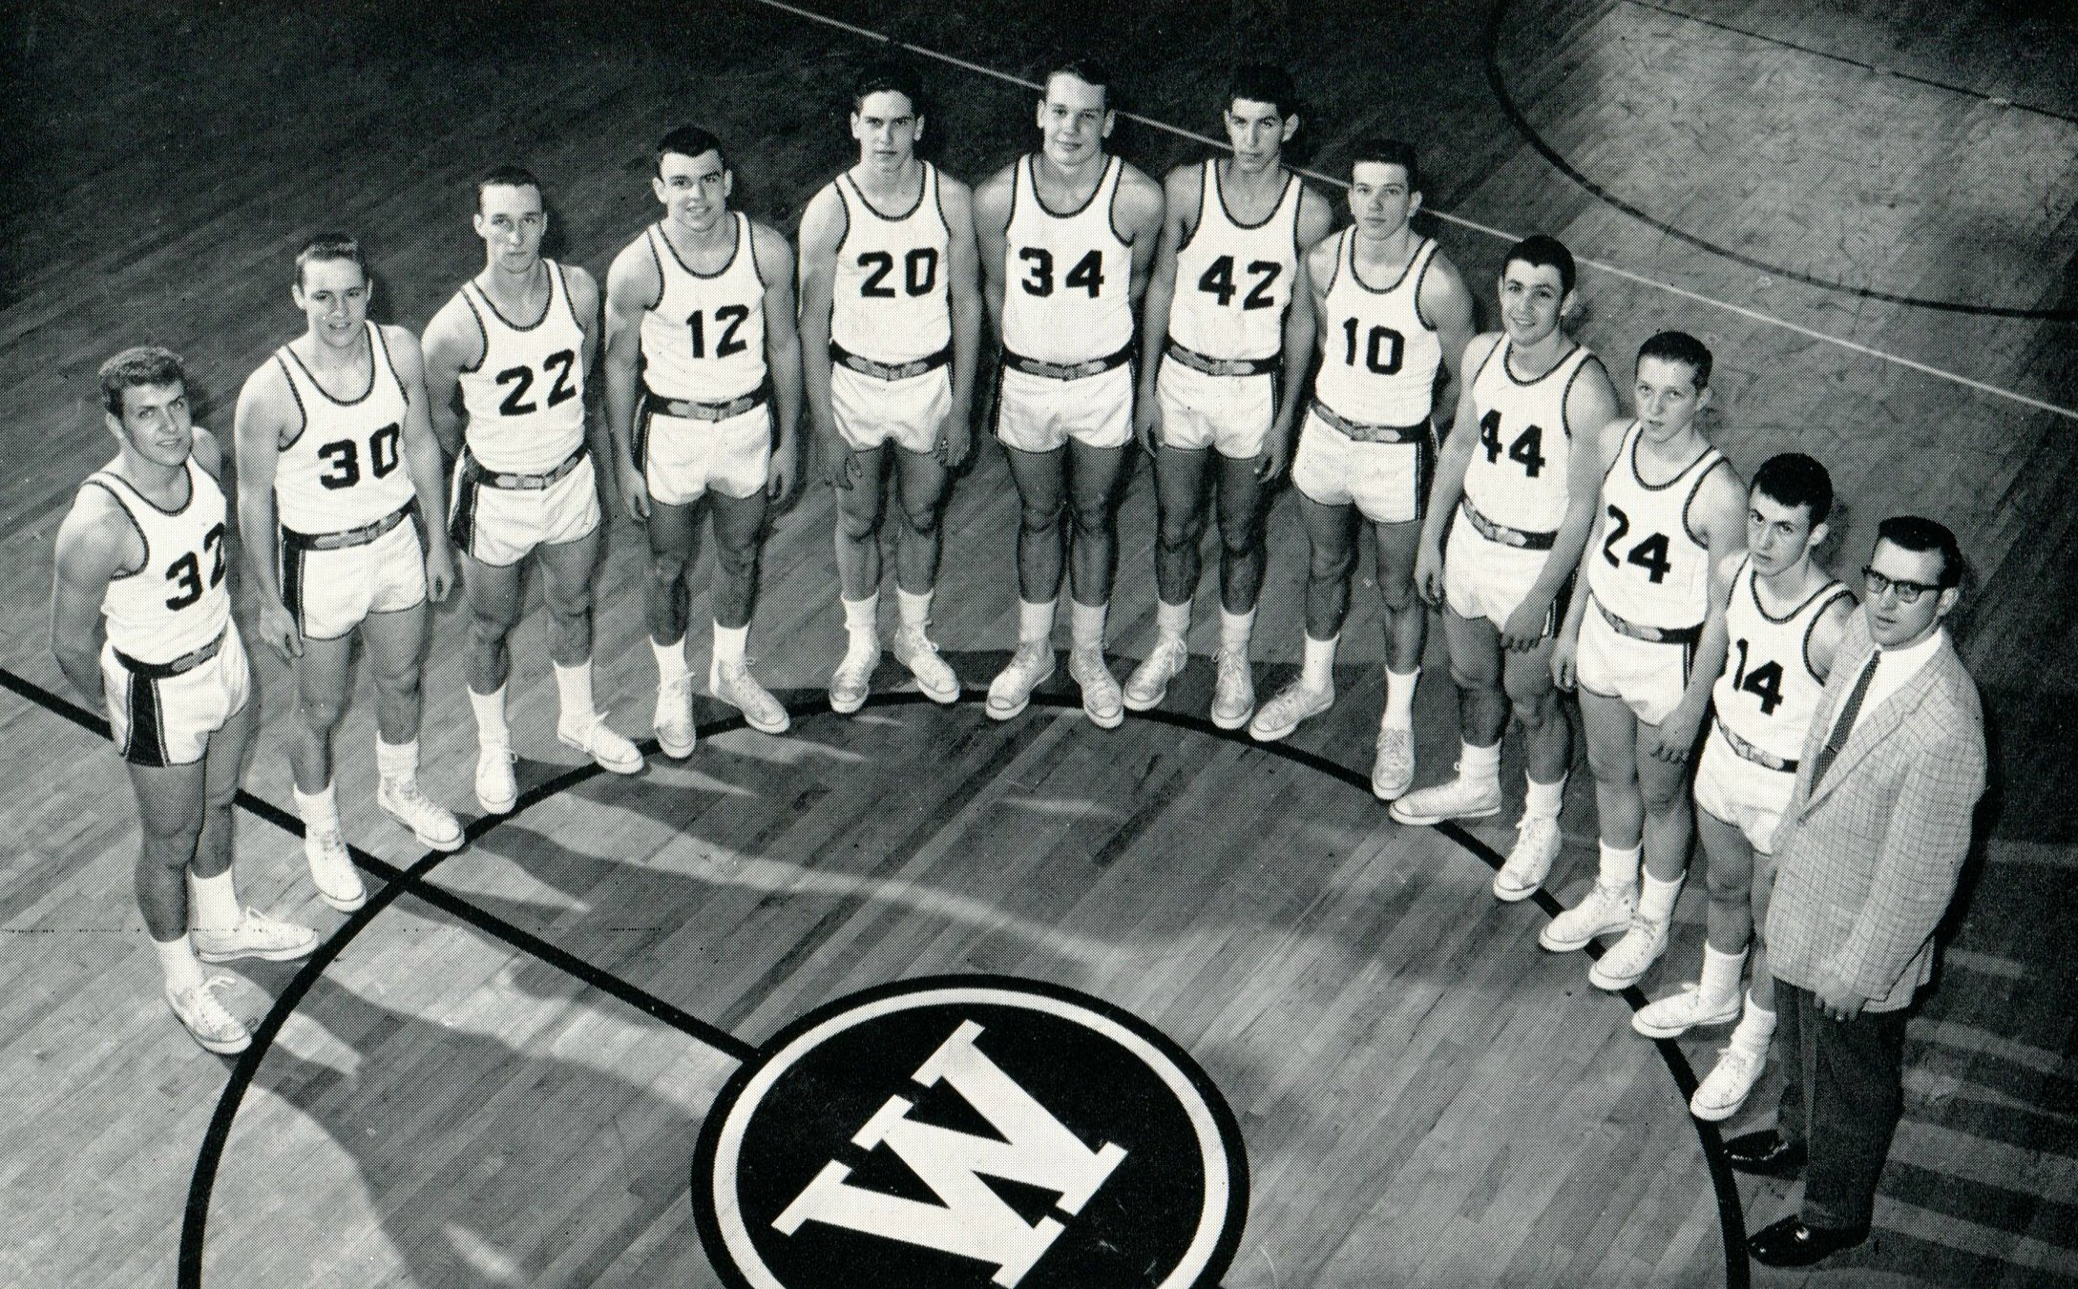
1961 Western Hills Yearbook
(Varsity Basketball)
Maury Bibent
(# 32)
Stu Schott
(# 12)
David Thie
(# 10)
Jim Hardy
(Class of 1962)
(# 44)

Slide 22
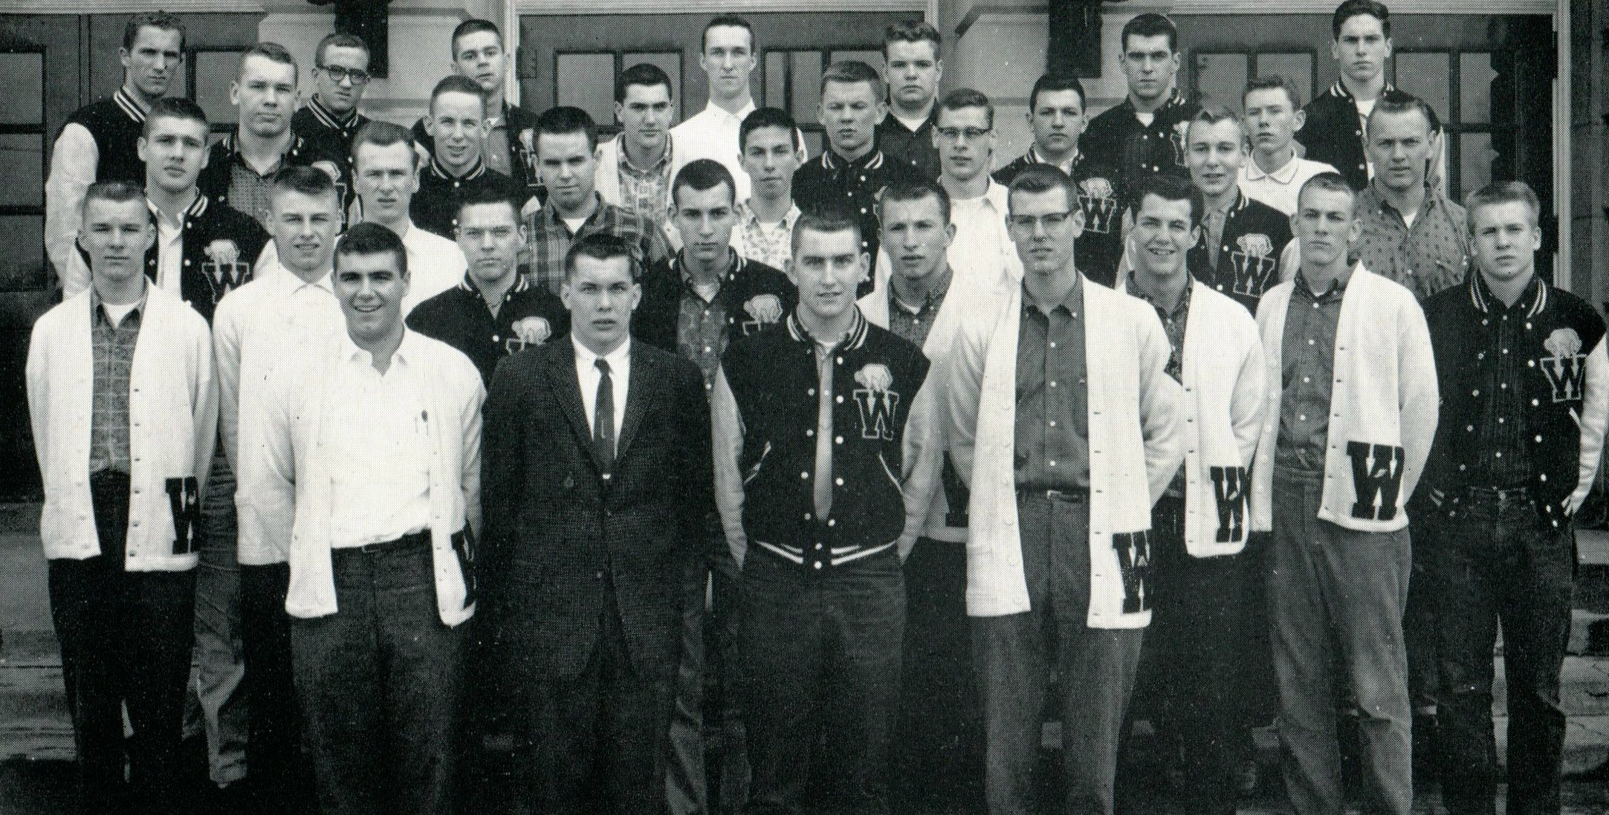
1961 Western Hills Yearbook
(Maroon W Club)
John Schiff
David Wright

Slide 23
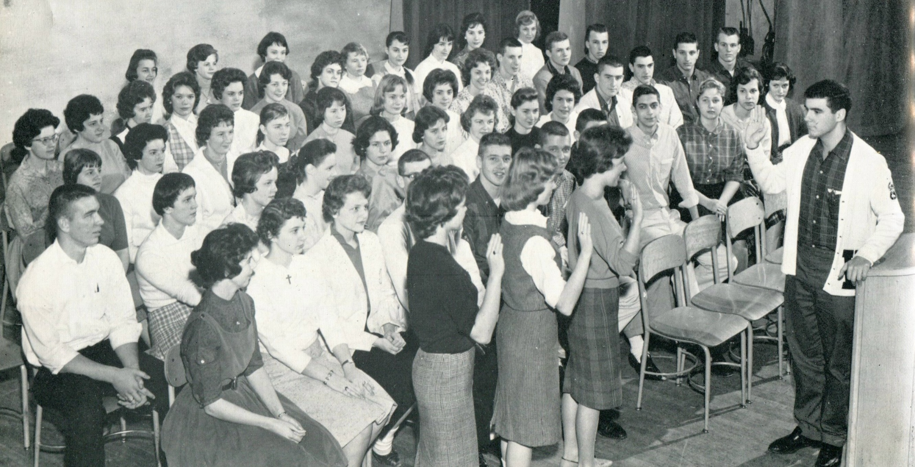
1961 Western Hills Yearbook
Larry Swartz
(Class of 1962)
Andy Patton

Slide 24
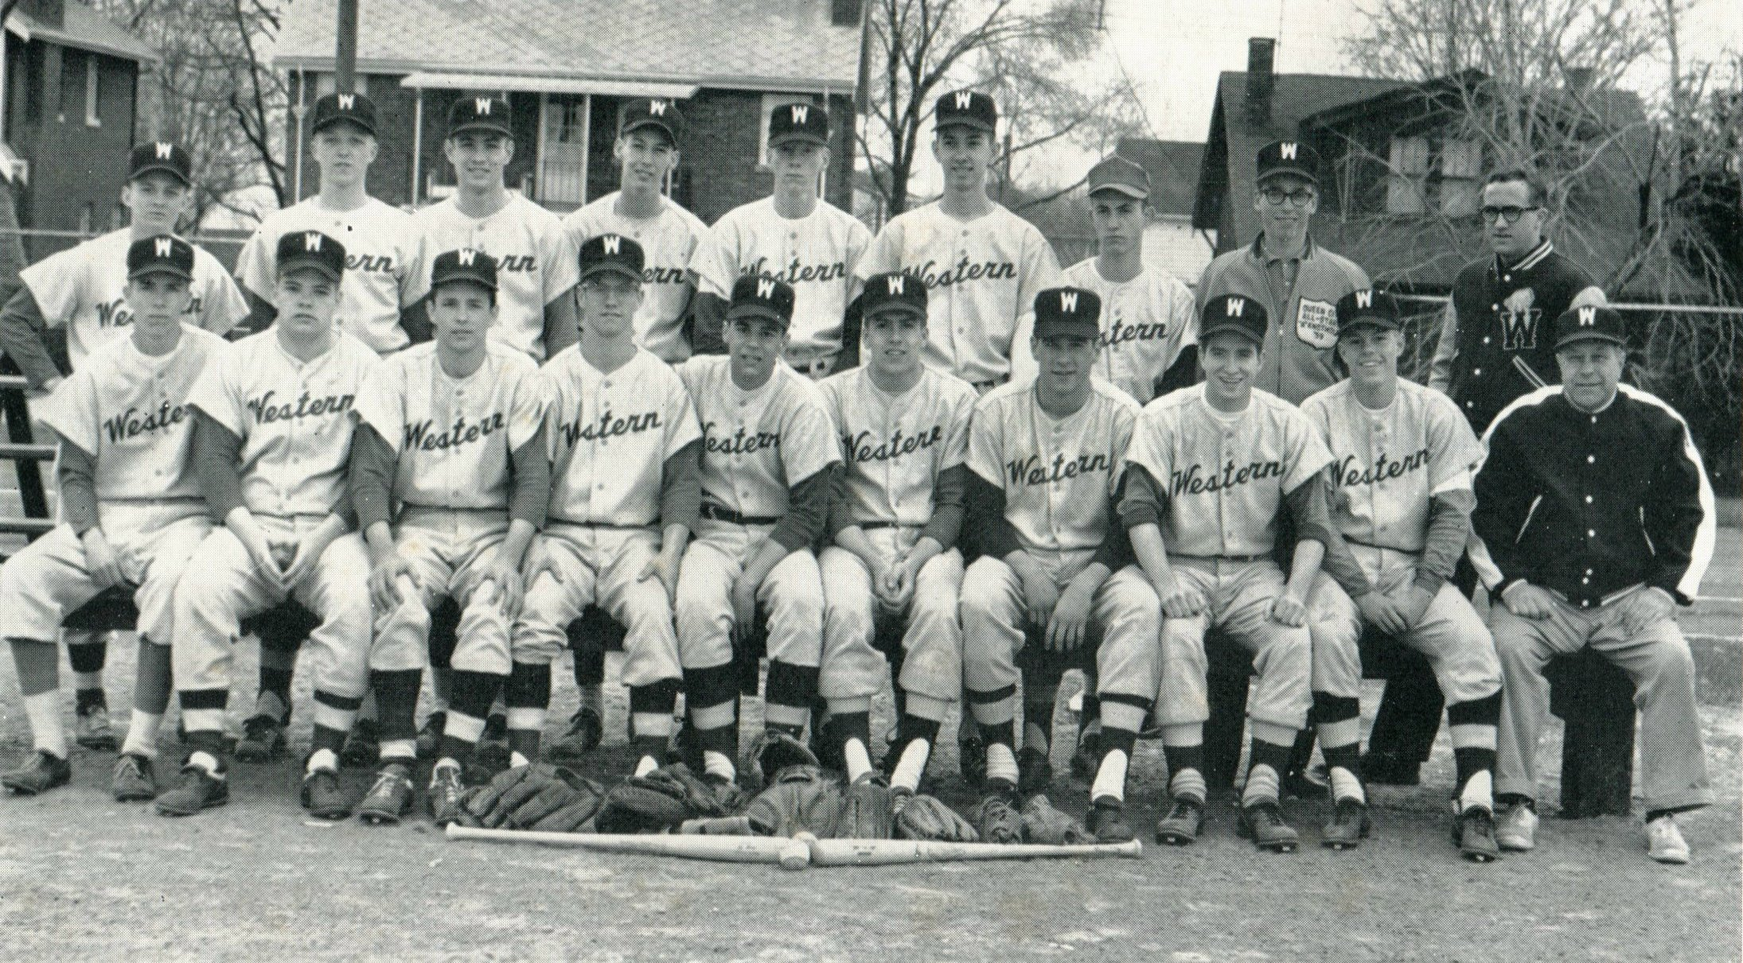
1961 Western Hills Yearbook
Jim Hardy
(Class of 1962)
Dave McElroy
(Class of 1962)
Maury Bibent

Slide 25
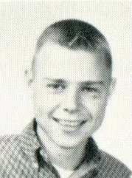
1961 Western Hills Yearbook
(Class of 1962)
Nicholas Bauer
Terry Dinnie
James Hardy
David McElroy
Richard Patton

Slide 26
1961 Western Hills Yearbook
(Class of 1962)
James F. Hartman

Slide 27
1961 Western Hills Yearbook
(Class of 1962)
Larry Jeggle

Slide 28
1961 Western Hills Yearbook
(Class of 1962)
Dennis Lantry

Slide 29
1961 Western Hills Yearbook
(Class of 1962)
Roy Niemes

Slide 30
1961 Western Hills Yearbook
(Class of 1962)
Frank Barth

Slide 31
1961 Western Hills Yearbook
(Class of 1962)
Chuck Rothenbush
(# 57)

Slide 32
1961 Western Hills Yearbook
(Class of 1962)
Ed Schmidt

Slide 33
1961 Western Hills Yearbook
Ed Schmidt
(Class of 1962)
Greg Koppenhoeffer
(Class of 1963)
Jack Saatkamp
(Class of 1963)

Slide 34
1961 Western Hills Yearbook
(Class of 1963)
Lou Bauer
Daniel Hoffman
Jack Saatkamp
Larry Wright

Slide 35
1961 Western Hills Yearbook
(Class of 1963)
Paul Tuerck

Slide 36
1961 Western Hills Yearbook
(Class of 1963)
Tom Lange
(# 45)

Slide 37
1961 Western Hills Yearbook
(Reserve Football)
(Class of 1963)
Larry Wright
(# 79)
Daniel Hoffman
(# 55)
Greg
Koppenhoeffer
Lou Bauer
(# 78)
Dick Hauck
(Class of 1947)

Slide 38
1961 Western Hills Yearbook
(Class of 1963)
Charles Greiner

Slide 39
1961 Western Hills Yearbook
(Class of 1964)
Mark Bailey
Ken Cain
James Haft
Richard Hopper
Norman Hughes
Jim Kespohl

Slide 40
1961 Western Hills Yearbook
(Class of 1964)
John Noyes
Michael Sullivan
Steve Vogel
Al Widman
Gene Wilson

Slide 41
1961 Western Hills Yearbook
(Class of 1965)
Dan Schenck
Bob Wray

Slide 42
1961 Western Hills Yearbook
(Class of 1966)
Bob Marlatt
Tim Maxwell
Robert Zipfel

Slide 43
1961 Western Hills Yearbook
(Class of 1947)
Dick Hauck

Slide 44
1961 Western Hills Yearbook
(Class of 1934)
John J. Schiff, Sr.
(Center)

Slide 45
Thank You
For The Memories
Spectamur Agendo

