Slide 1
TRIGINTA OPTIMI
(Thirty of the Best)
Founded 1895
Class of 1956

Slide 2
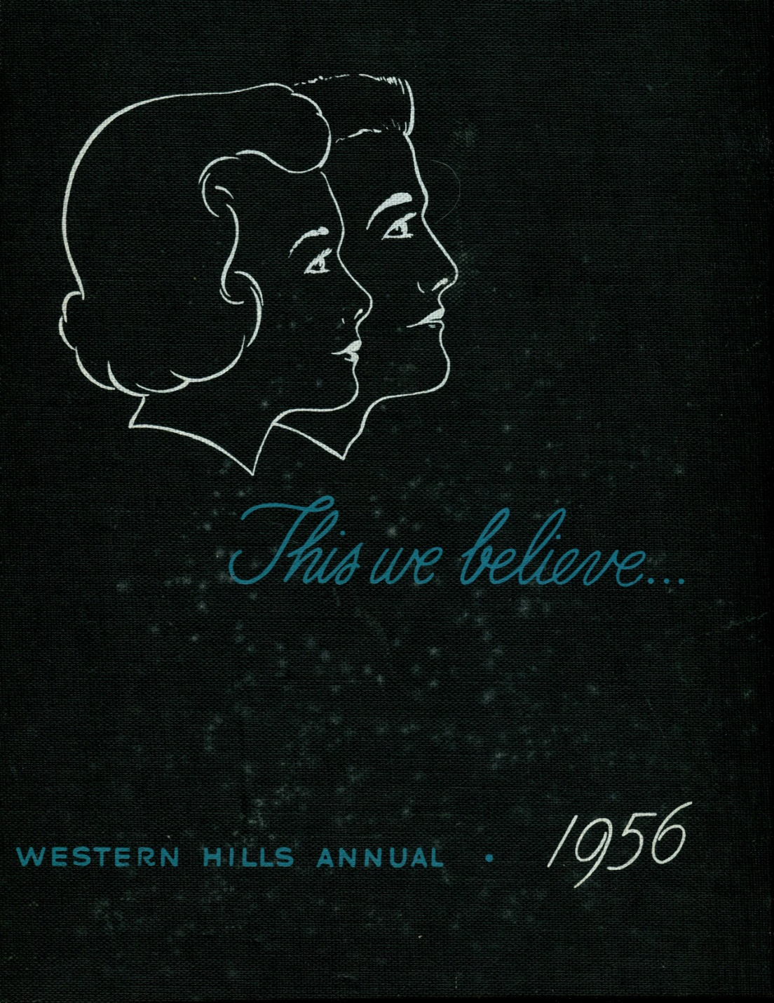

Slide 3
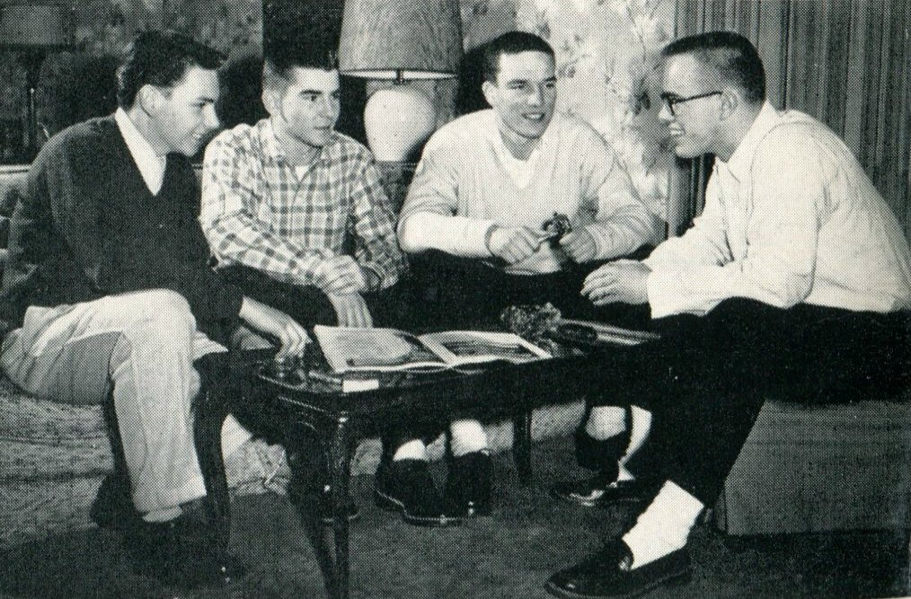
1956 Western Hills Yearbook
T.O. Officers
Claude Lowther, Ralph Bolino, Paul Maxwell, and Edward Molloy

Slide 4
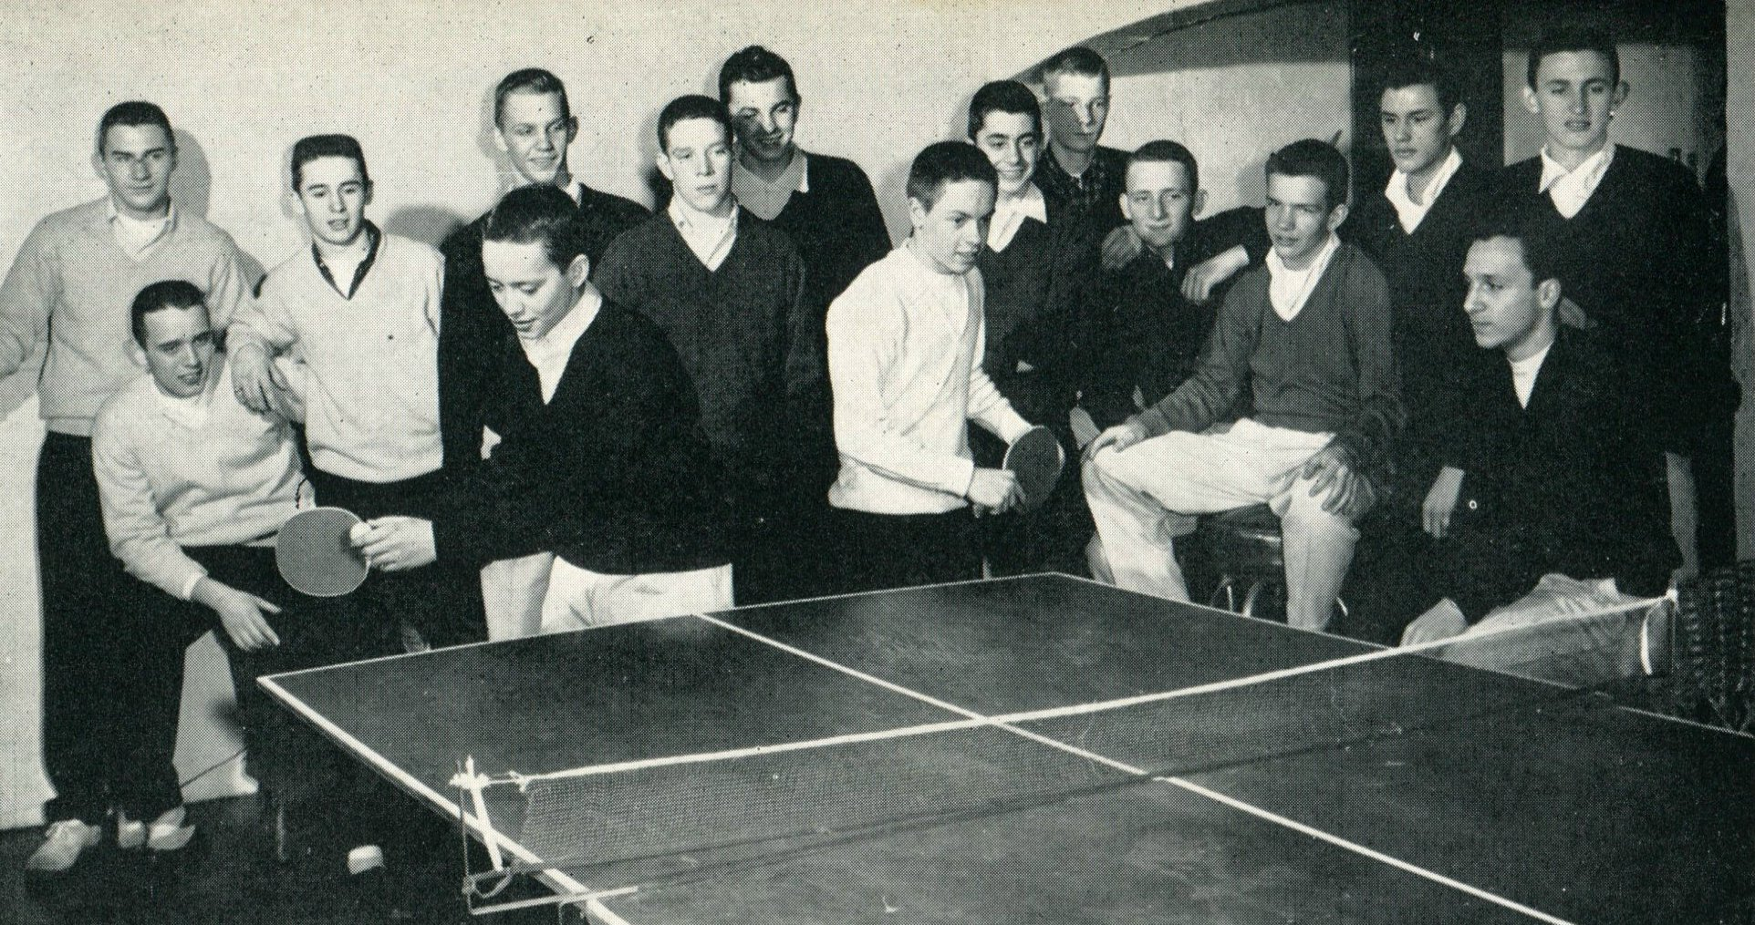
1956 Western Hills Yearbook
Foreground: R. Fischback, D. Eicher, M. Lemert, T. Murphy, D Haynes, J. Lemen,
S. Maxwell, D. Albert, D. Ekardt, J. Kiewit, S. Gibson, C. Haft, G. Redman, P. Romelli, J. Seeger

Slide 5
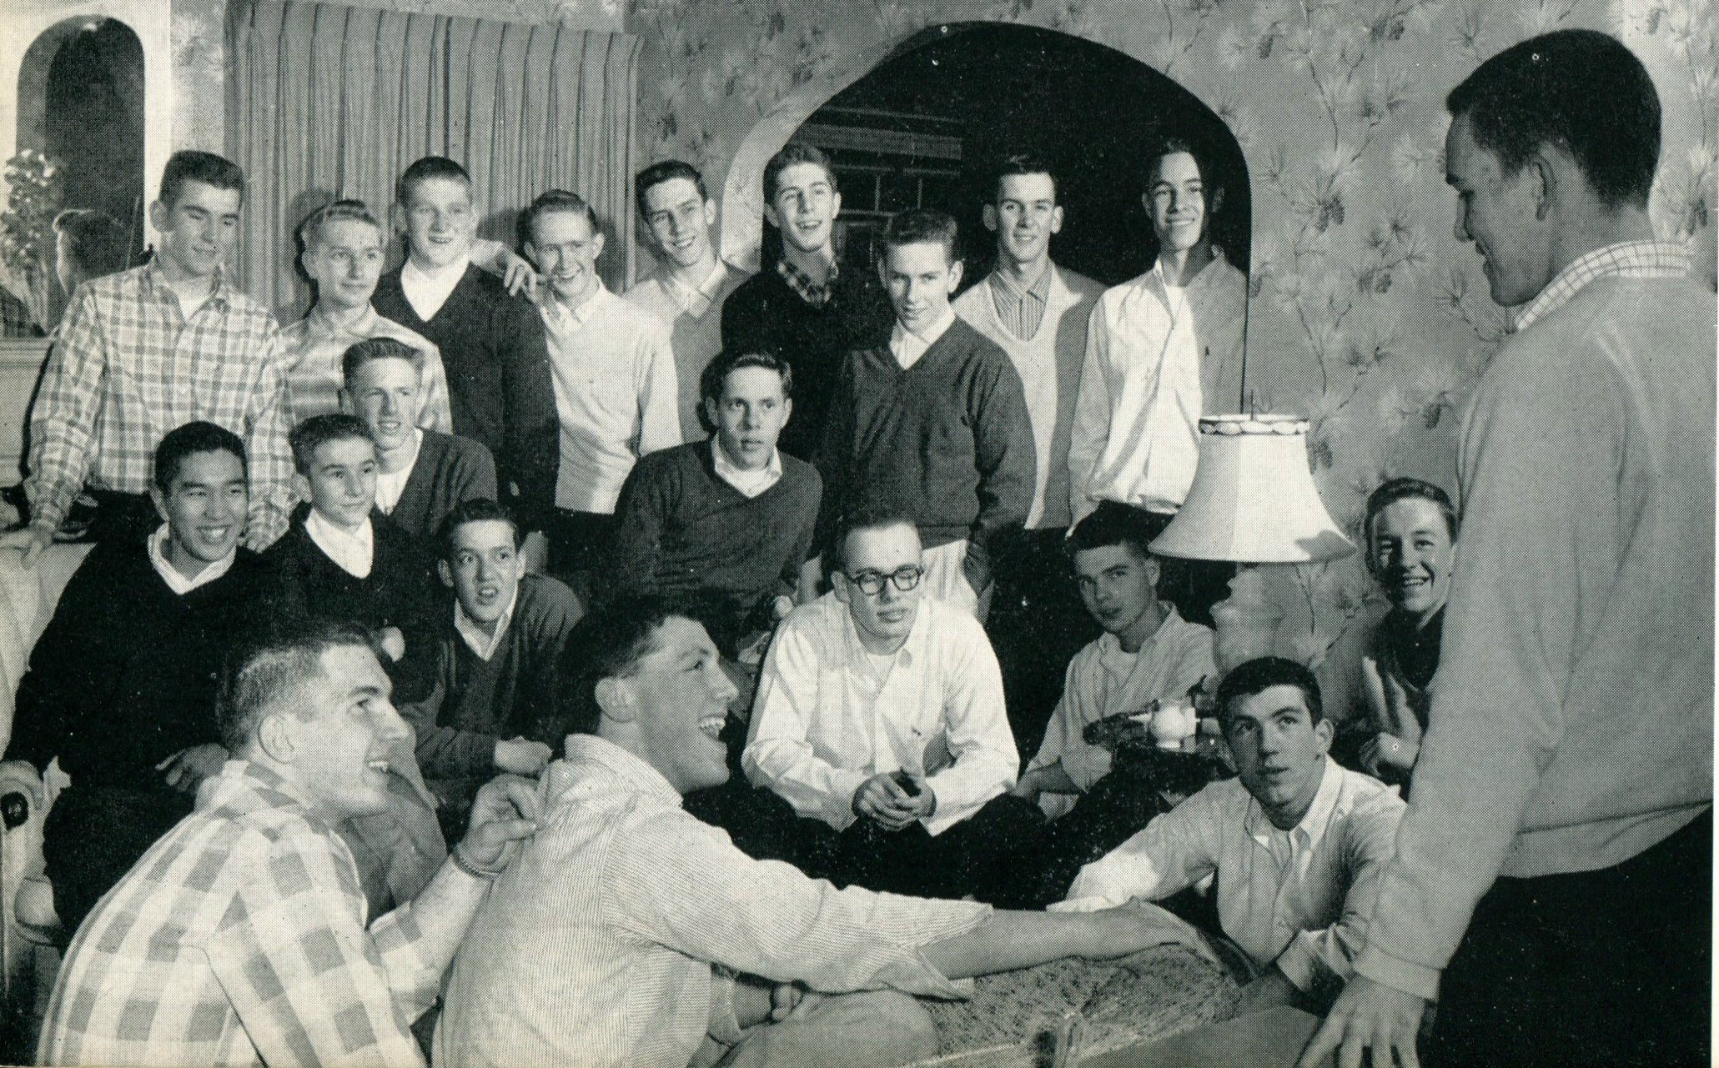
1956 Western Hills Yearbook
Foreground: L. Smith, C. Schwandner, P. Maxwell, B. Shimizu, D. Disser, D. Phillips, E. Lutz, J. Bailey,
E. Molloy, A. Colburn, M. Streibig, B. Lowe, R. Bolino, J. Lammert, M. McMillan, D. Heepke, D. Busch,
B. Czerwinski, C. Lowther, J. Hamlin, and G. Sampson

Slide 6
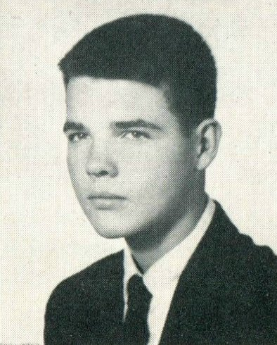
1956 Western Hills Yearbook
Arthur Colburn
(Only Senior T.O. of the Class of 1956)

Slide 7
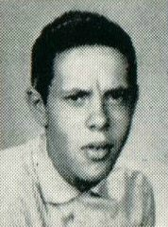
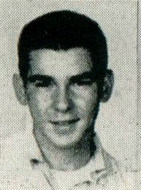
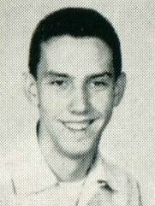
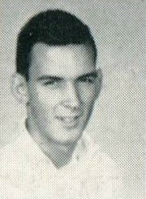
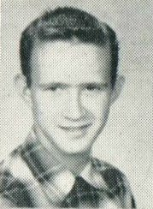
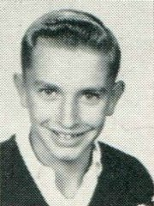
1956 Western Hills Yearbook
(Class of 1957)
Jerrold Franklin Bailey
Ralph Bolino
Douglas Owen Busch
Jeffry Hamlin
David Edward Heepke
Joseph Milton Lammert

Slide 8
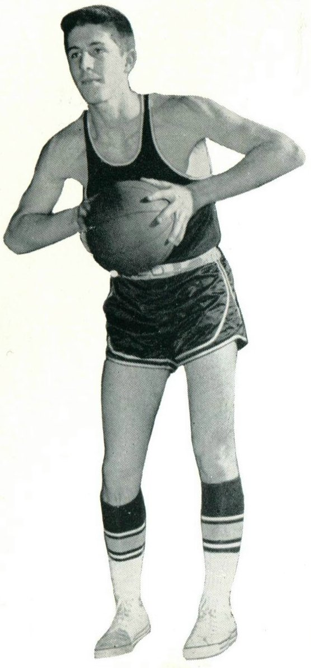
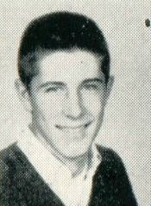
1956 Western Hills Yearbook
(Class of 1957)
Robert Eugene Czerwinski

Slide 9
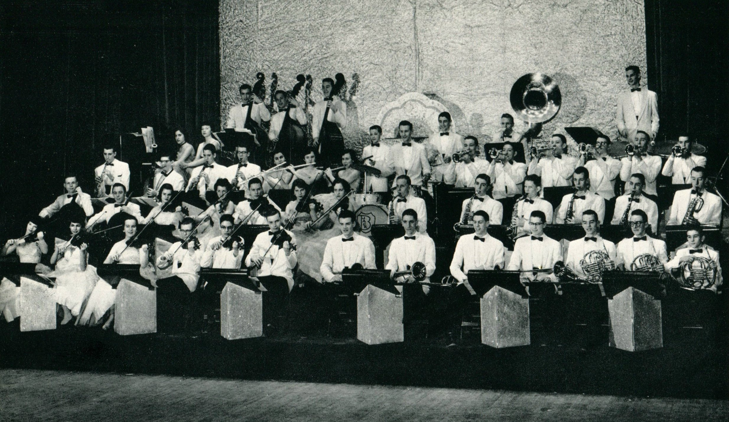
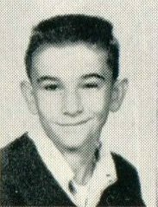
1956 Western Hills Yearbook
(Class of 1957)
David Samuel Disser

Slide 10
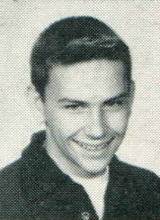
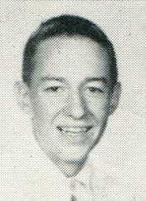
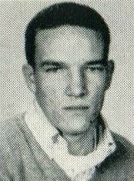
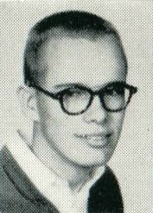
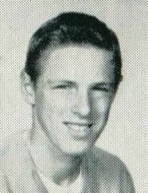
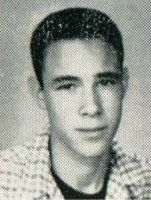
1956 Western Hills Yearbook
(Class of 1957)
Robert Loew
Claude William Lowther
Paul Vernon Maxwell
John Edward Molloy
Donald Phillips
George Willey Sampson

Slide 11
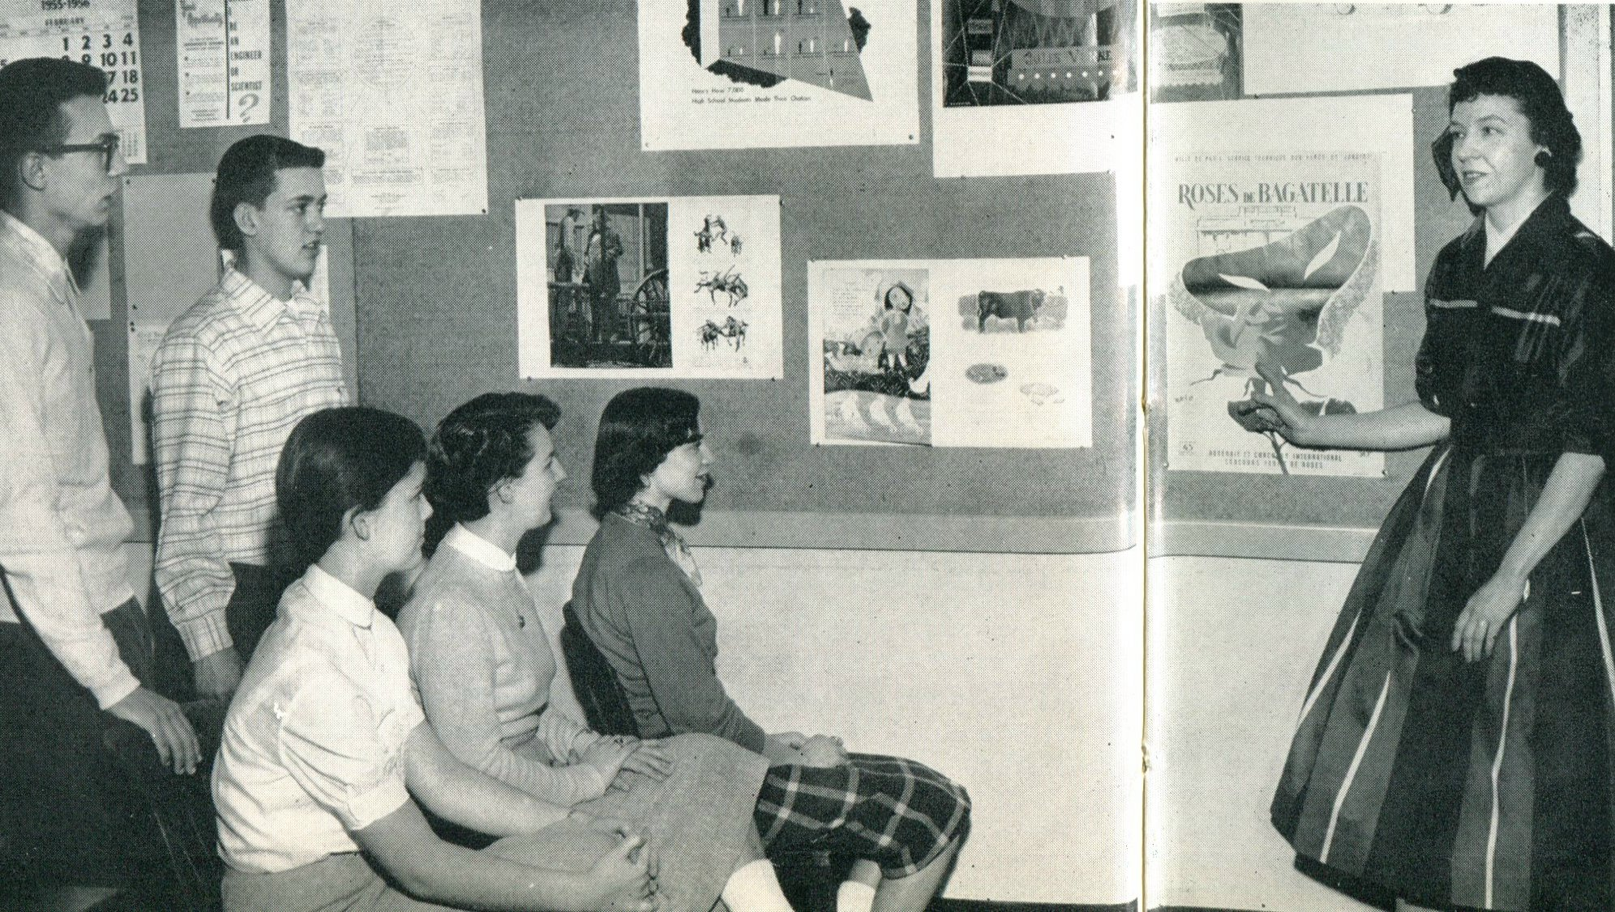
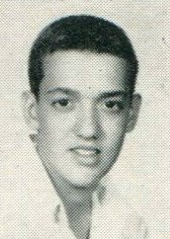
1956 Western Hills Yearbook
(Class of 1957)
Ellis Edward Lutz

Slide 12
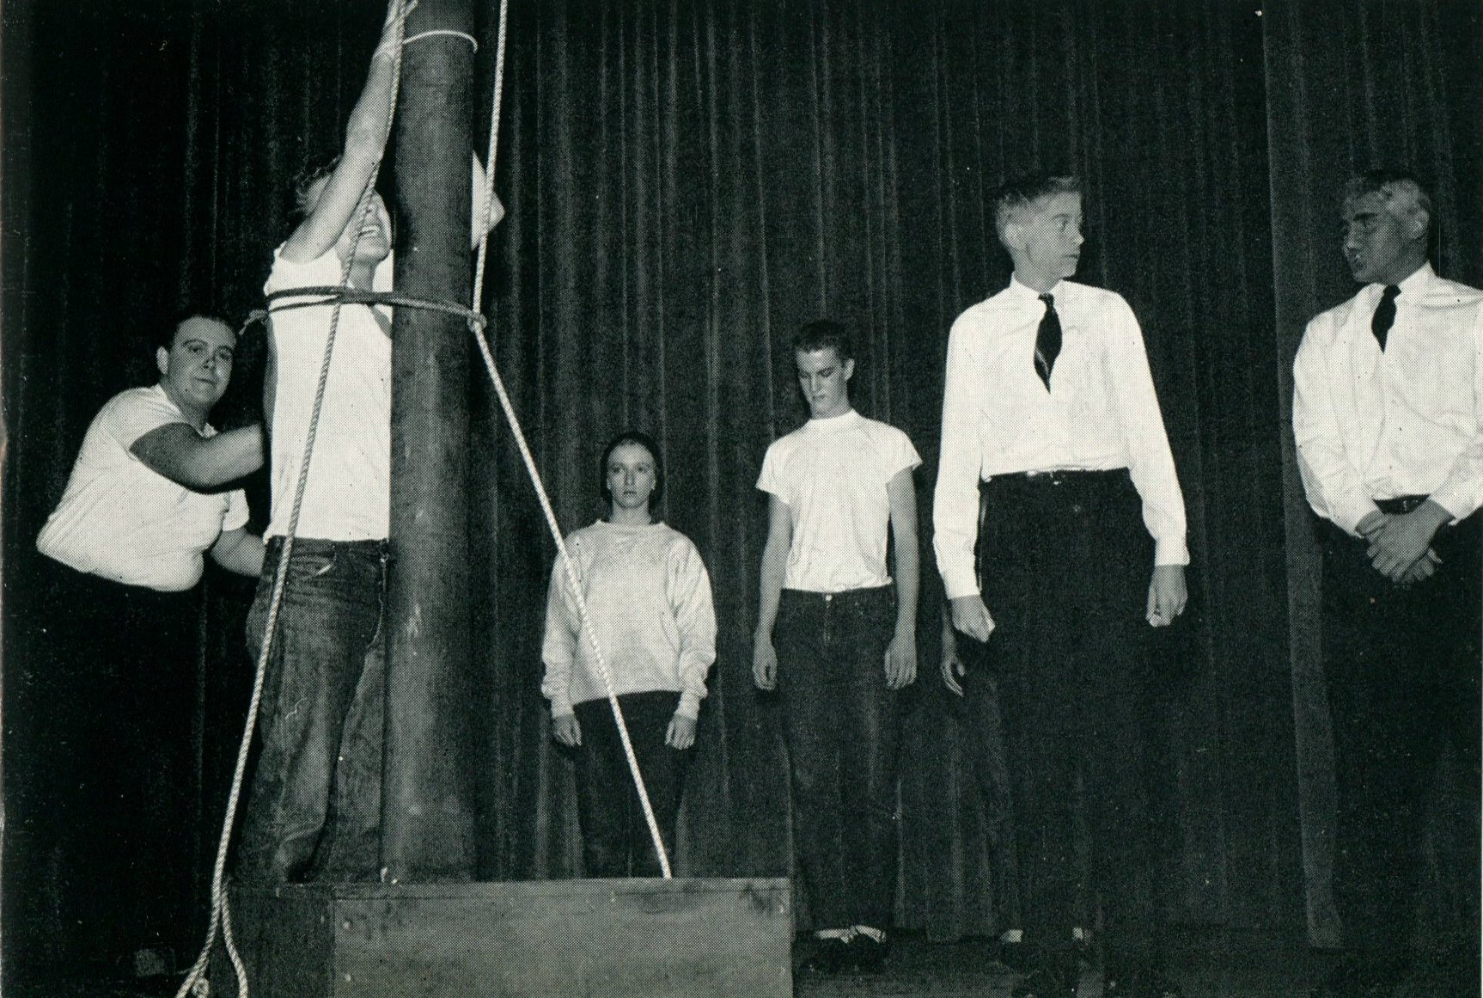
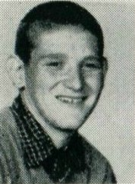
1956 Western Hills Yearbook
(Class of 1957)
Michael Moore McMillan

Slide 13
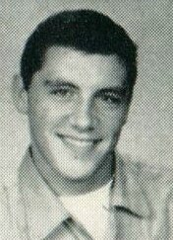
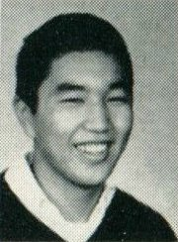
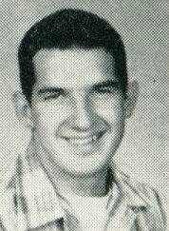
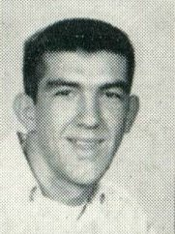
1956 Western Hills Yearbook
(Class of 1957)
Clifford Omar Schwandner
Robert Tad Shimizu
Leroy Joseph Smith
Wayne Charles Streibig

Slide 14
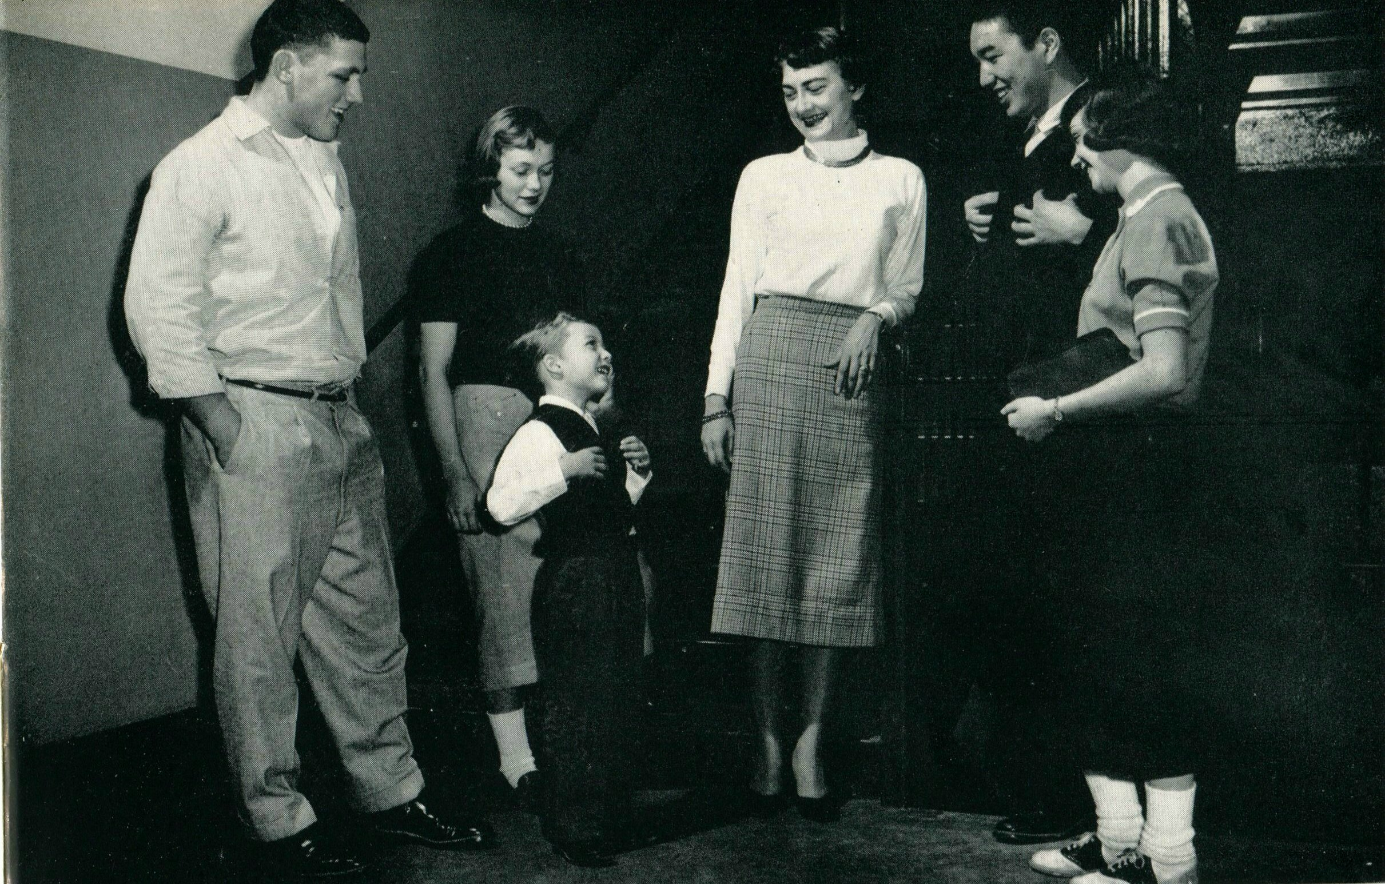
1956 Western Hills Yearbook
(Class of 1957)
Clifford Omar Schwandner
Jean Spickard
(Honorary T.O. , Class of 1961)
Robert Tad Shimizu

Slide 15
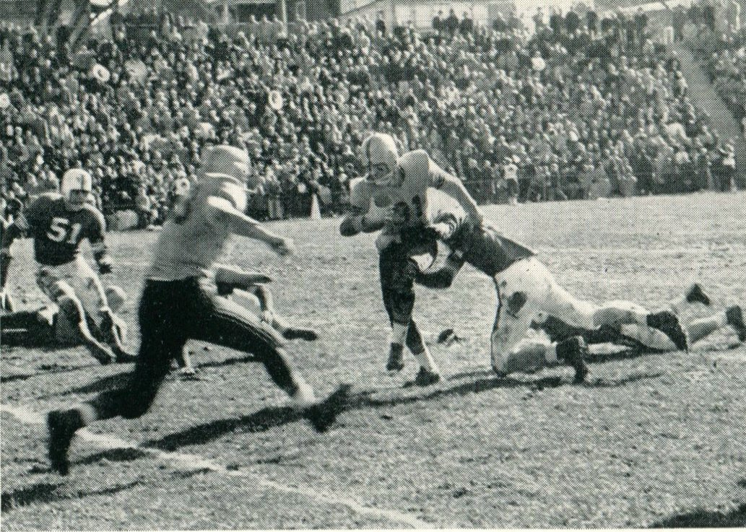
1956 Western Hills Yearbook
(Class of 1957)
Wayne Charles Streibig
(Number 31)

Slide 16
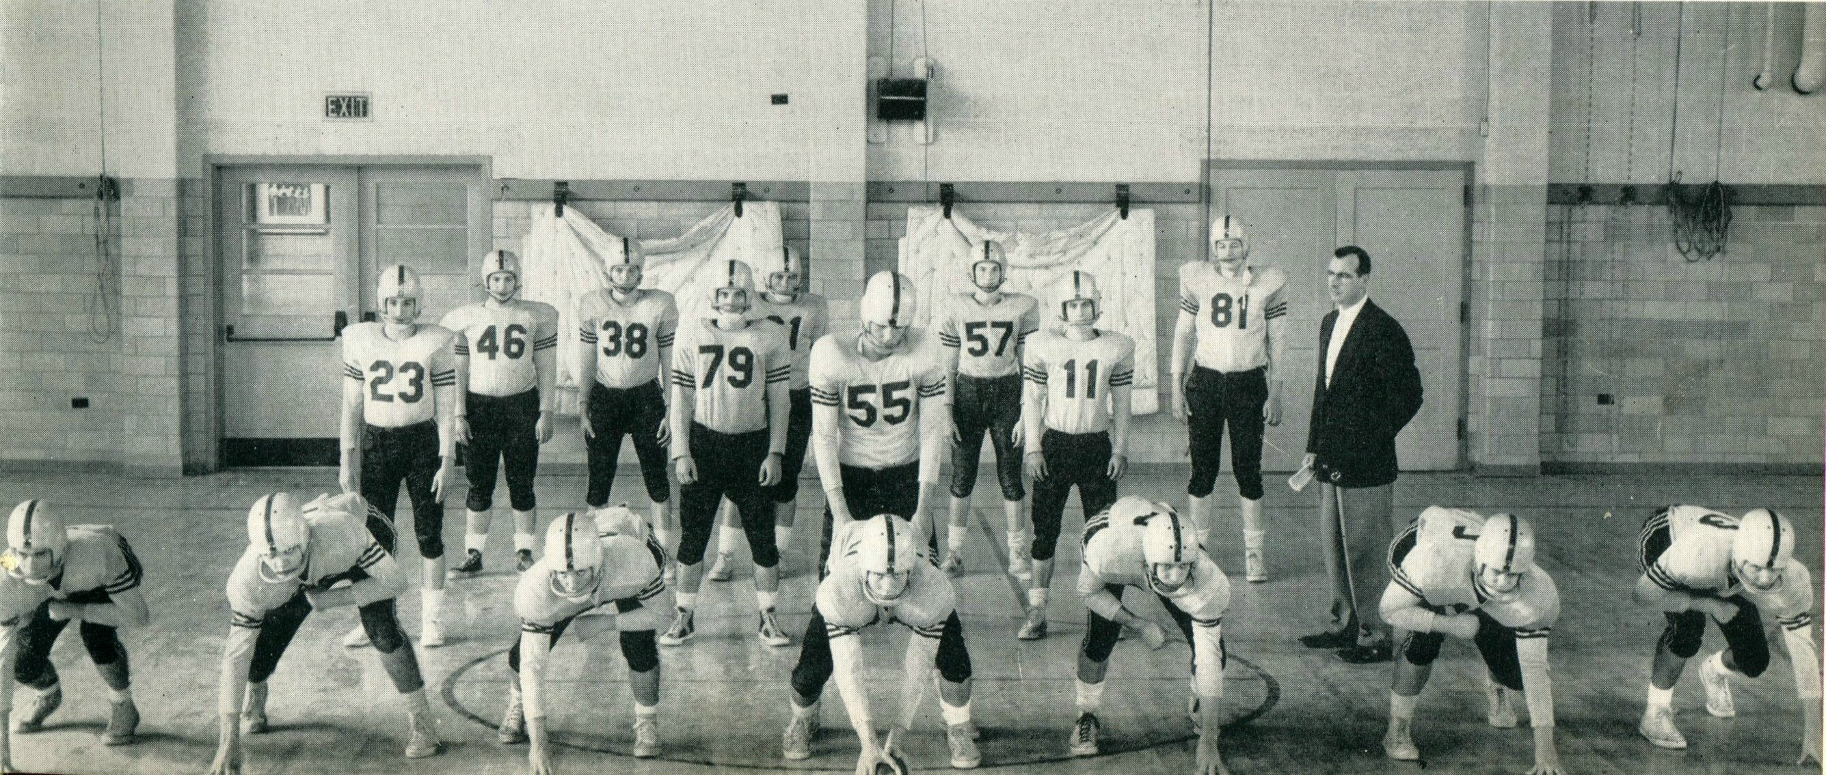
1956 Western Hills Yearbook
Clifford Omar Schwandner

Slide 17
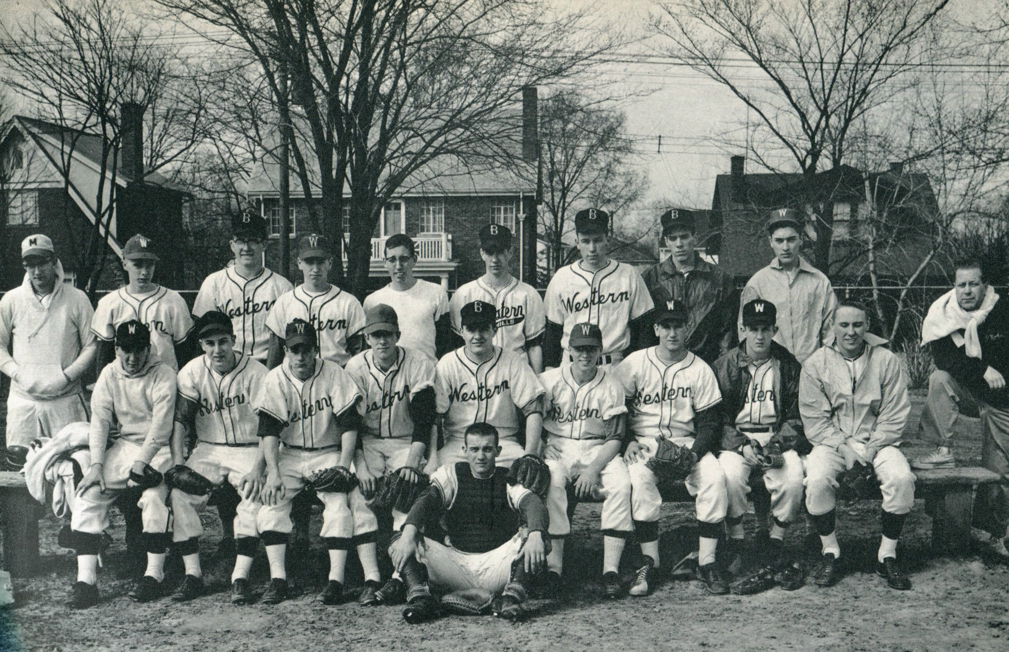
1956 Western Hills Yearbook
Robert Czerwinski
(Class of 1957)
Bill Fox
(Class of 1960)

Slide 18
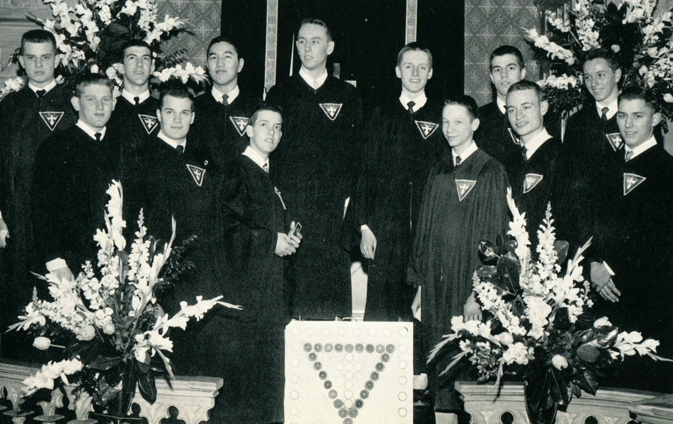
1956 Western Hills Yearbook
Michael McMillan, Wayne Streibig, and Robert Shimizu
(Left to Right)

Slide 19
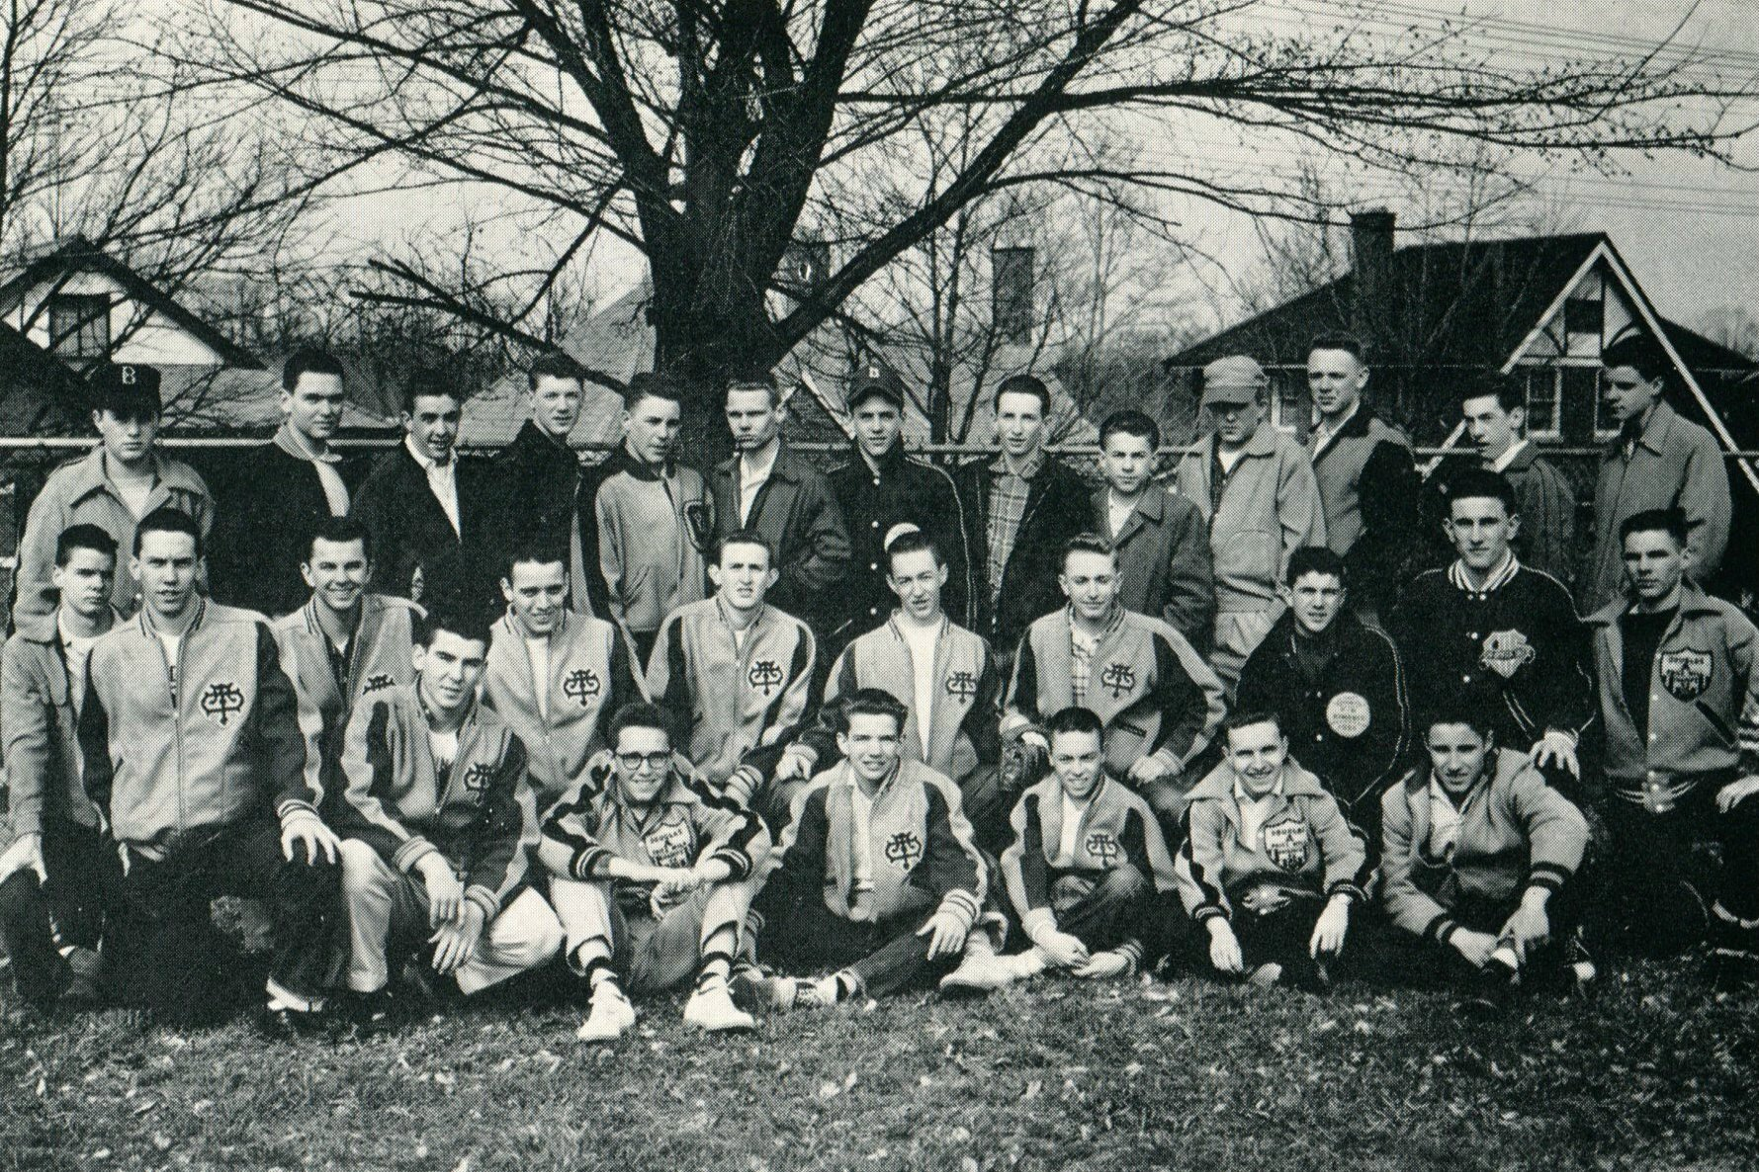
1956 Western Hills Yearbook
(Reserve Baseball)
First Row: D. Busch, R. Bolino, C. Haft, and D. Eicher
Second Row: D. Albert, T. Murphy, J. Seegar, R. Loew, and J. Lammert,

Slide 20
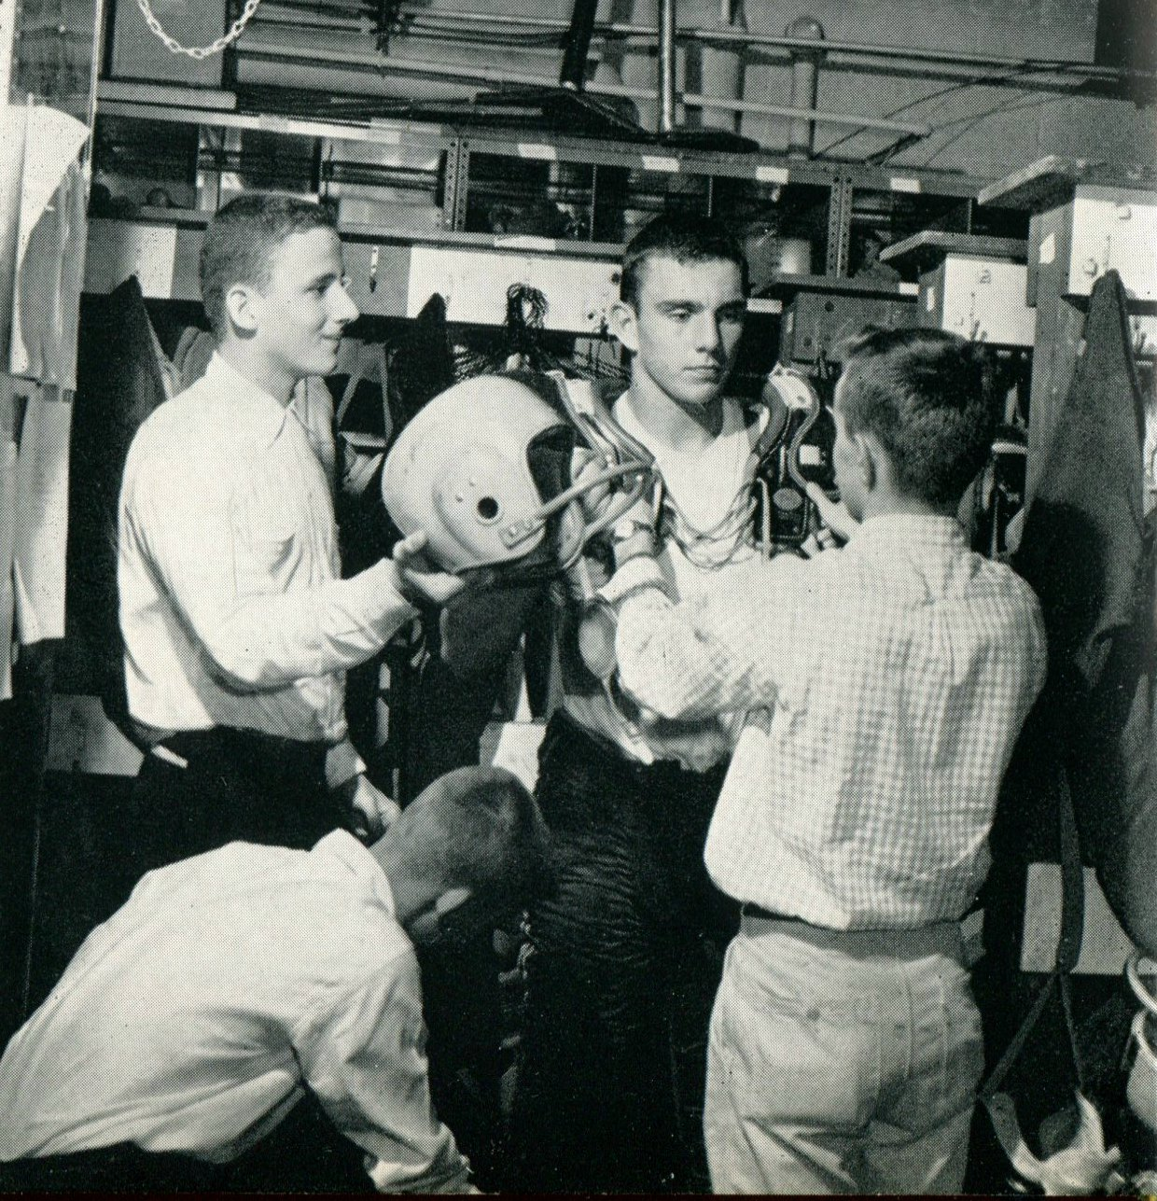
1956 Western Hills Yearbook
Richard Gibson
(Class of 1958)
Douglas Bunce
(Class of 1959)

Slide 21
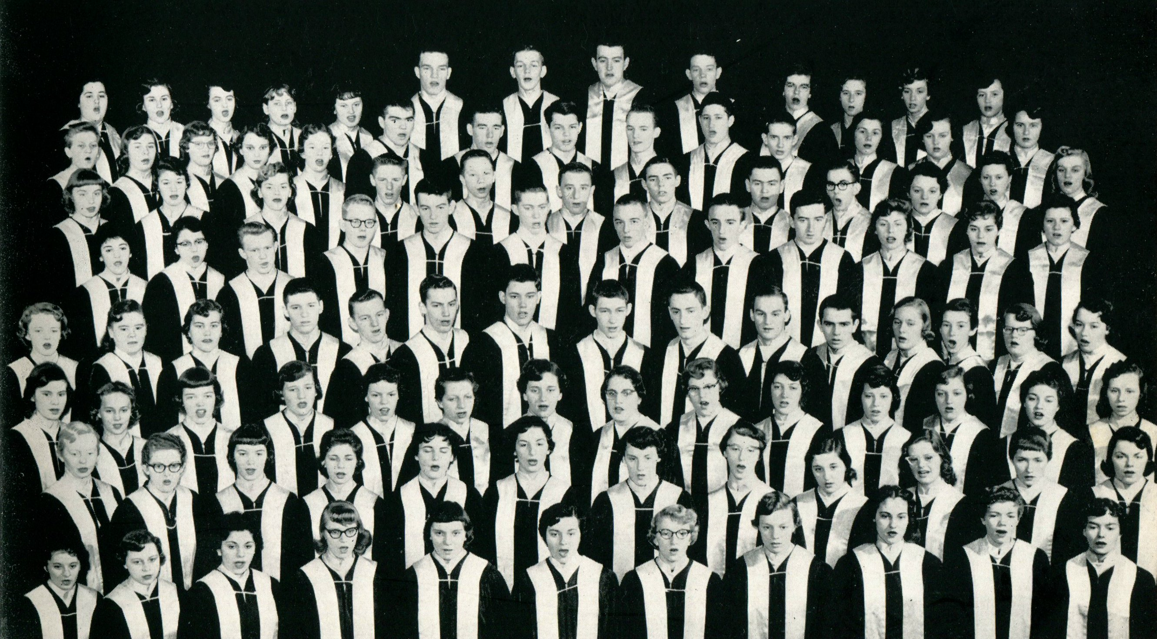
1956 Western Hills Yearbook
Paul Vernon Maxwell
(Class of 1957)
Scott Jesse Maxwell
(Class of 1958)

Slide 22
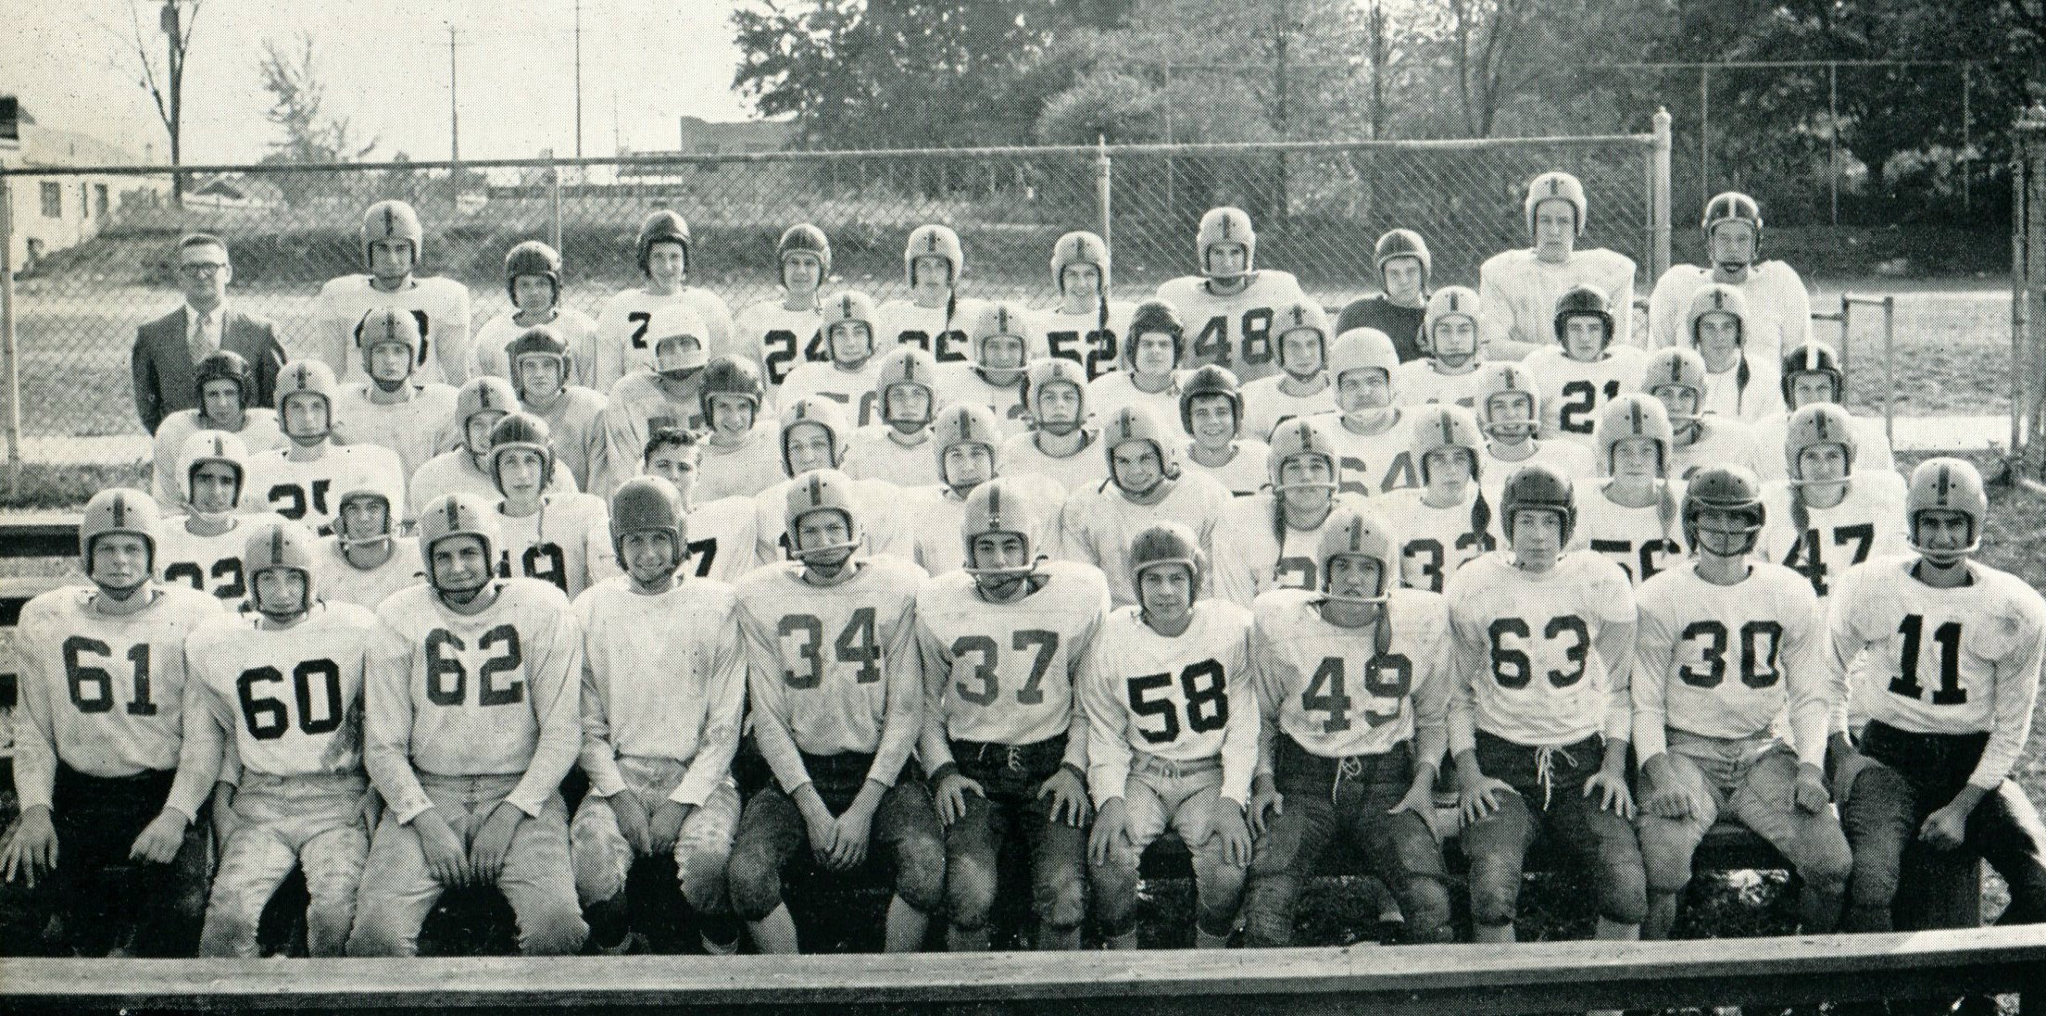
1956 Western Hills Yearbook
(Reserve Football)
Dennis Ekardt
(Class of 1958)
(# 37)
Jack Kiewit
(Class of 1958)
(# 56)

Slide 23
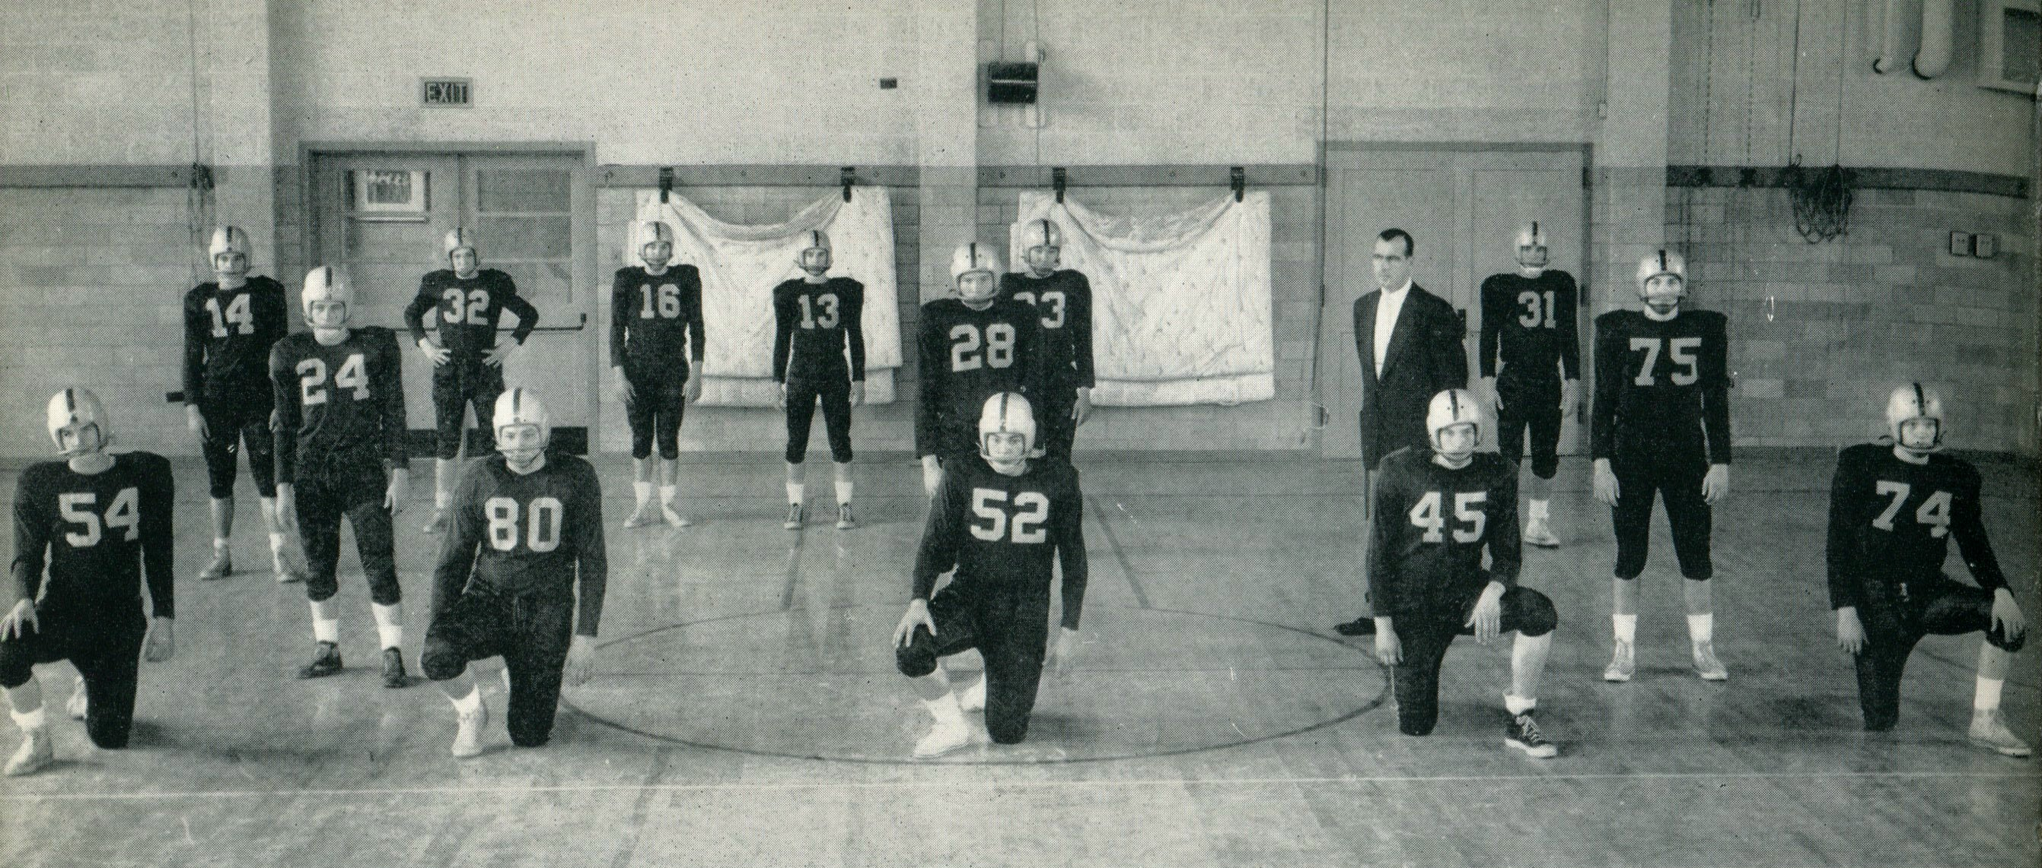
1956 Western Hills Yearbook
(Defensive Football Team)
Michael Lemert, Wayne Streibig, Robert Shimizu, and Jim Lemen (# 74)

Slide 24
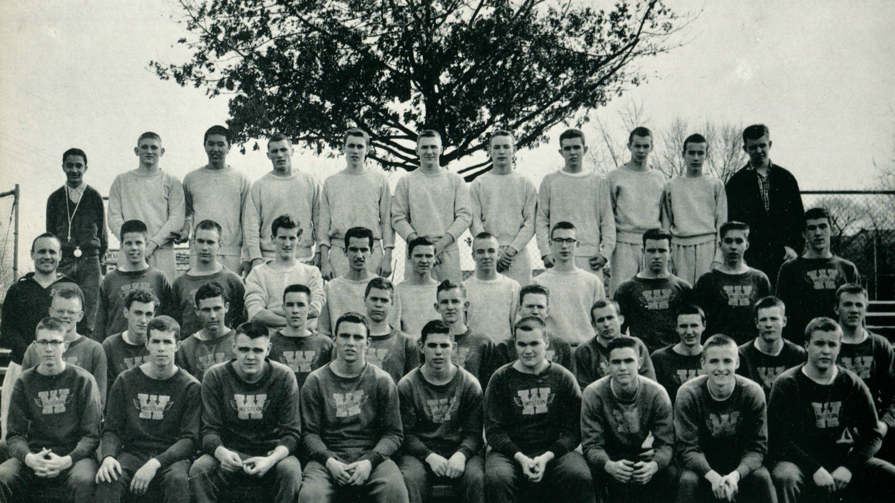
1956 Western Hills Yearbook
(Track Team)
Michael McMillan
(Class of 1957)
Robert Schmizu
(Class of 1957)

Slide 25
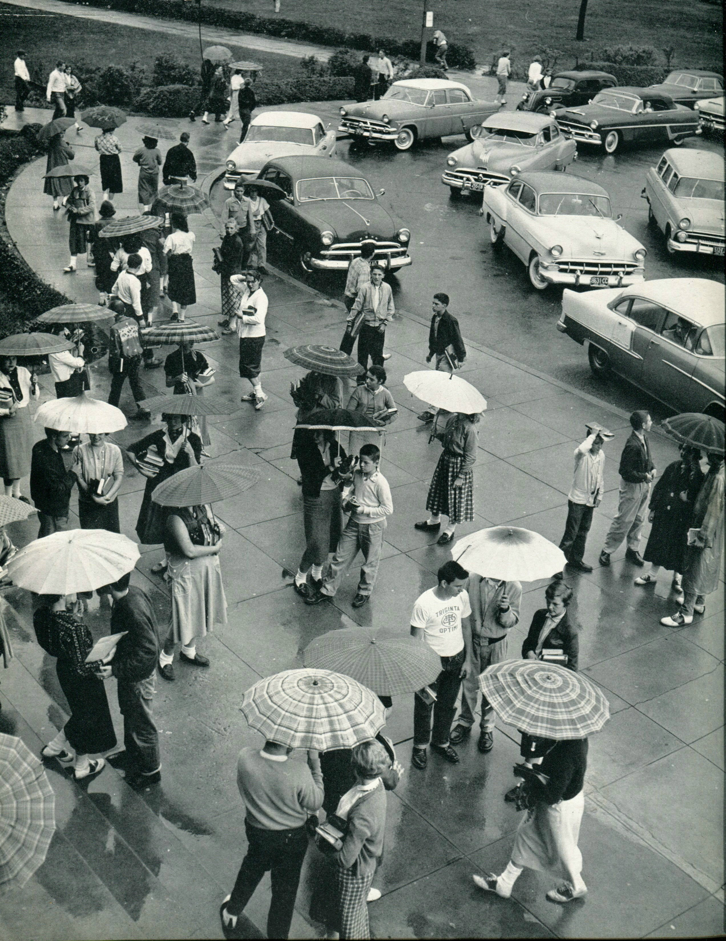
1956 Western Hills Yearbook
Unknown T.O.

Slide 26
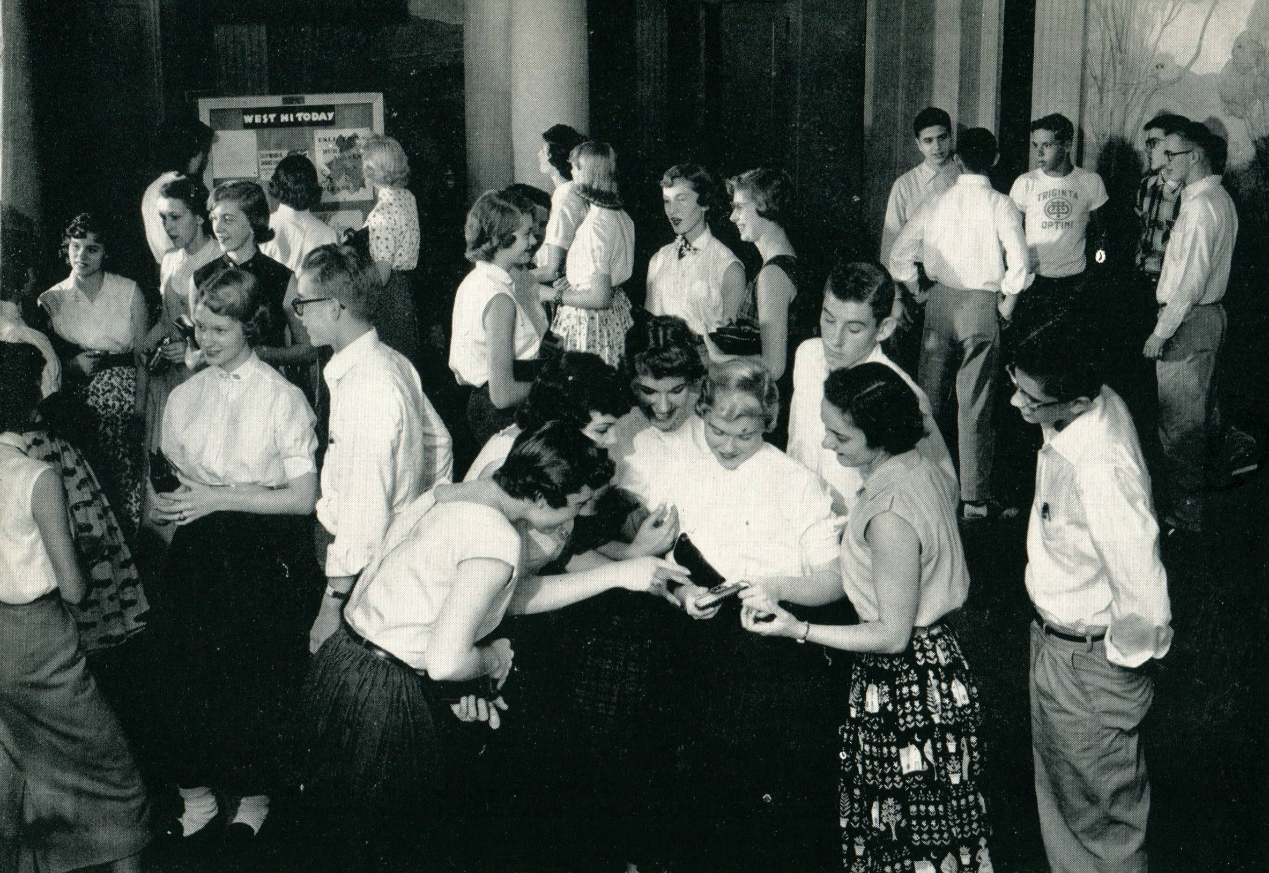
1956 Western Hills Yearbook
Unknown T.O.

Slide 27
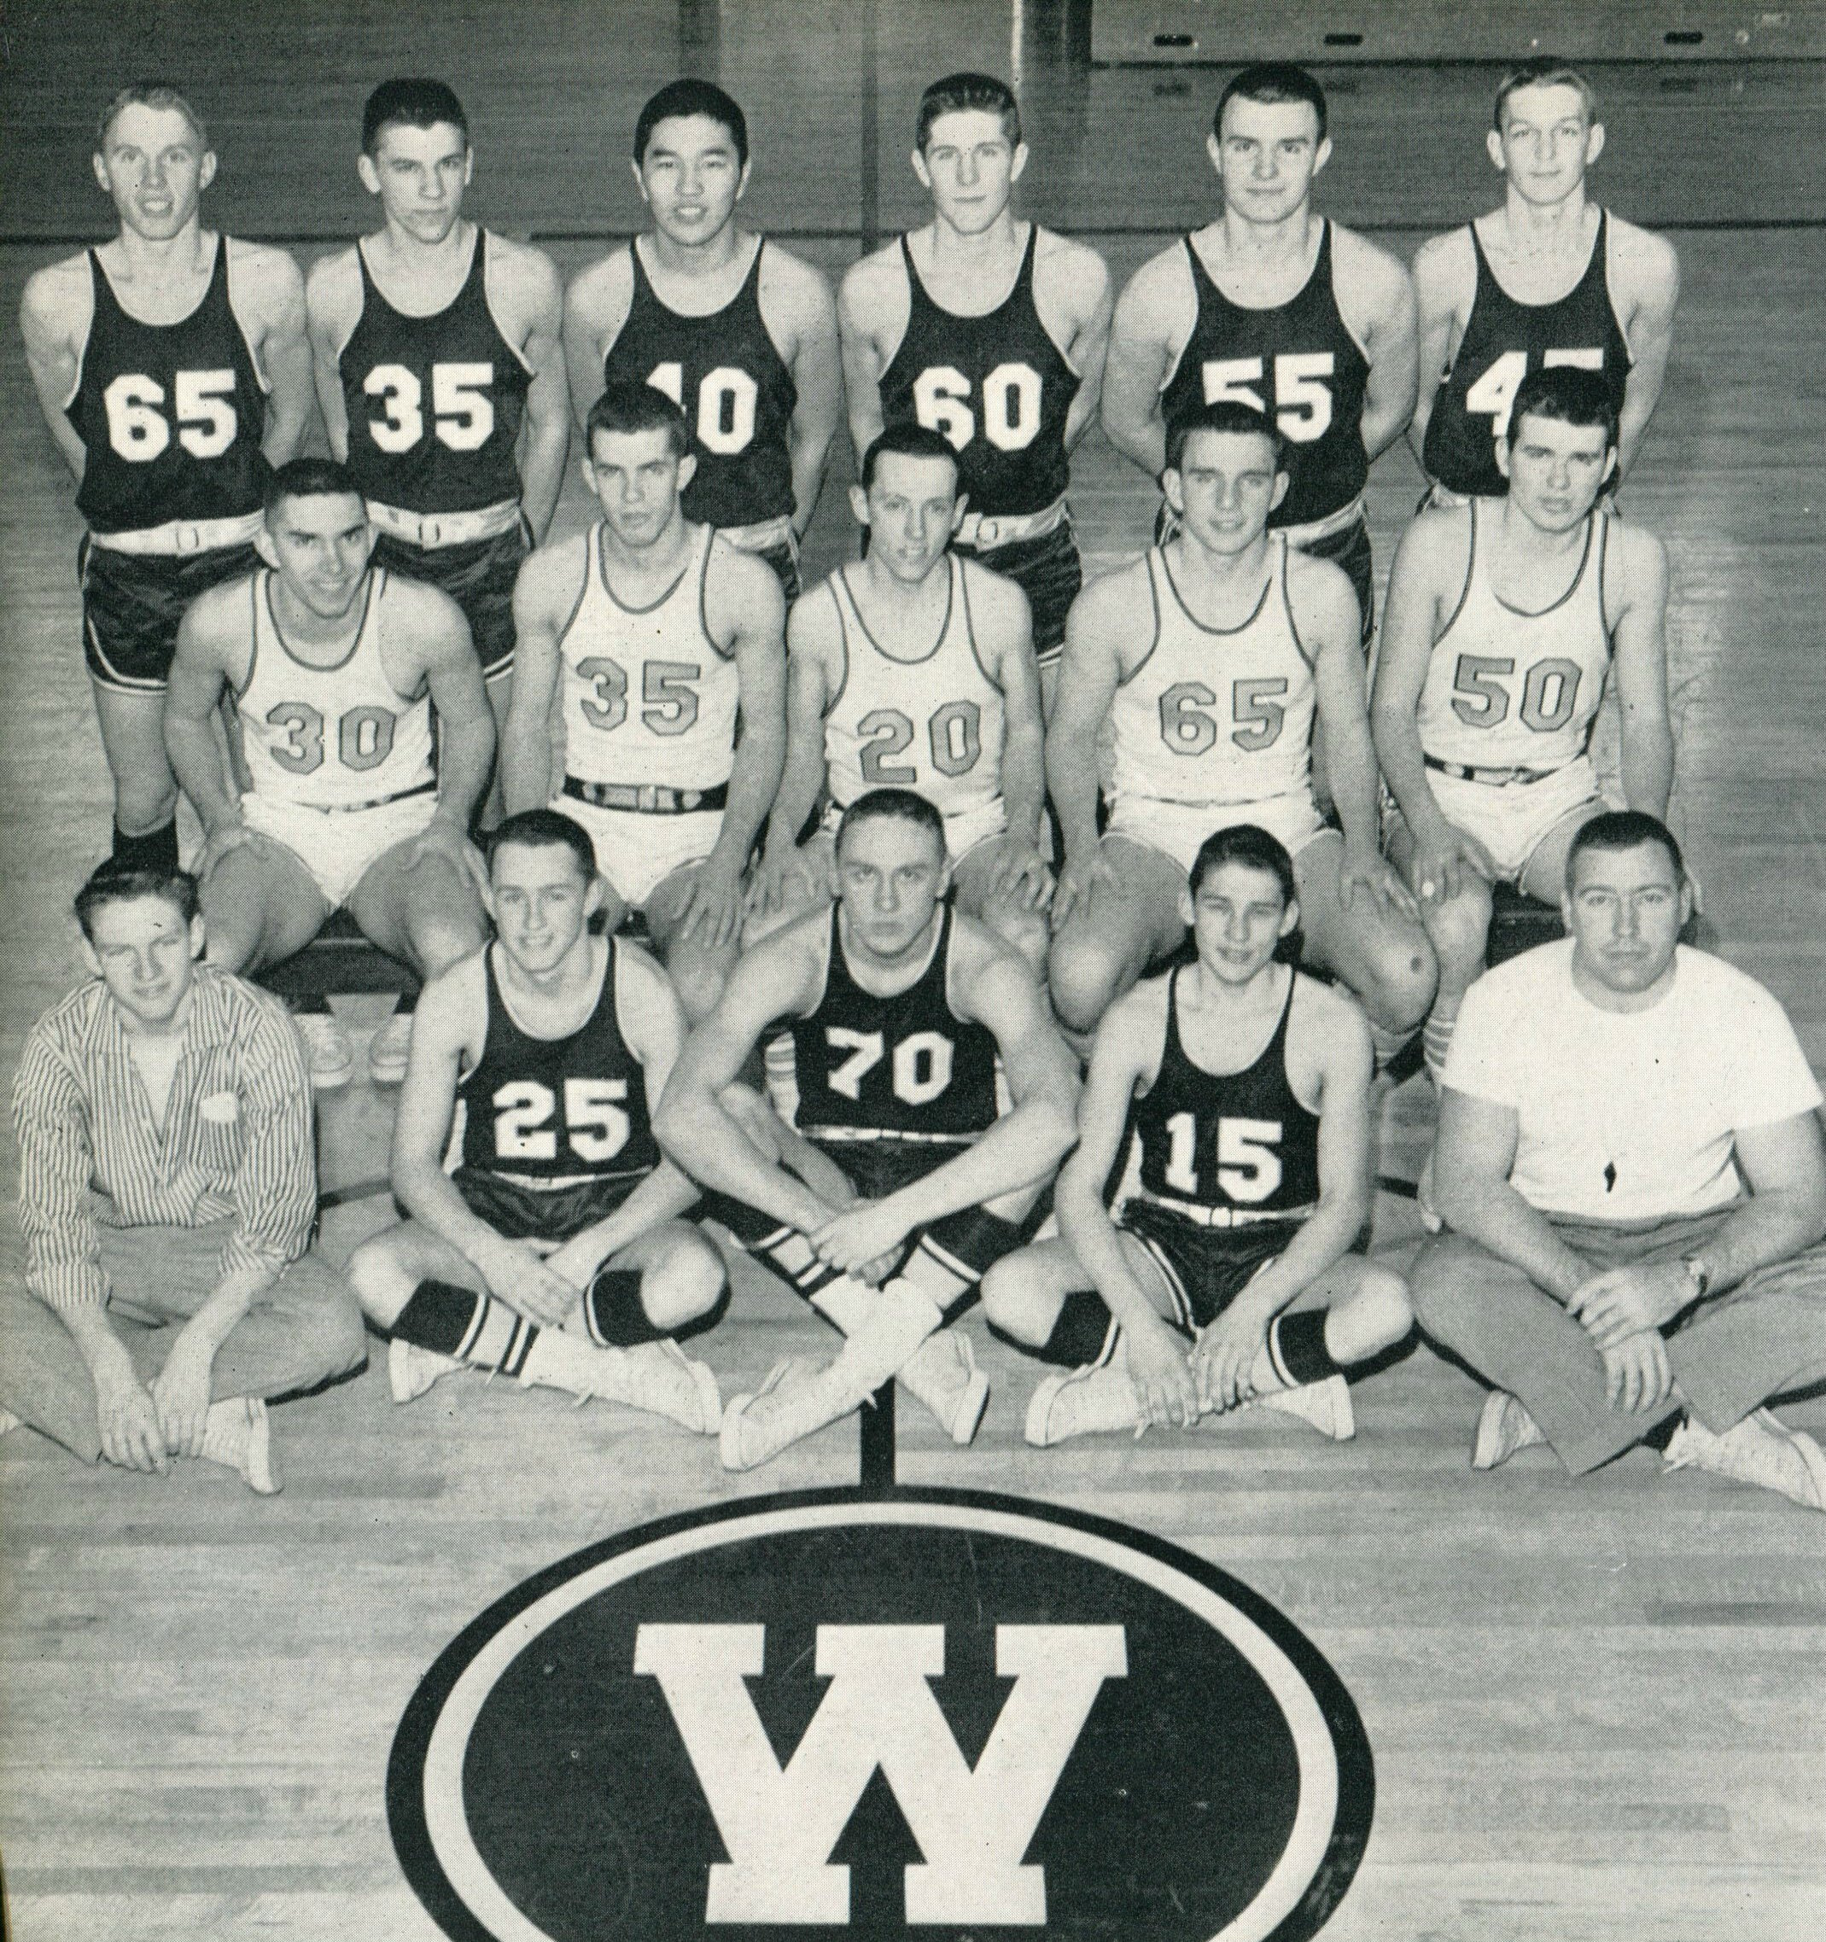
1956 Western Hills Yearbook
Robert Shimizu
(Class of 1957)
# 40)
Robert Czerwinski
(Class of 1957)
(# 60)

Slide 28
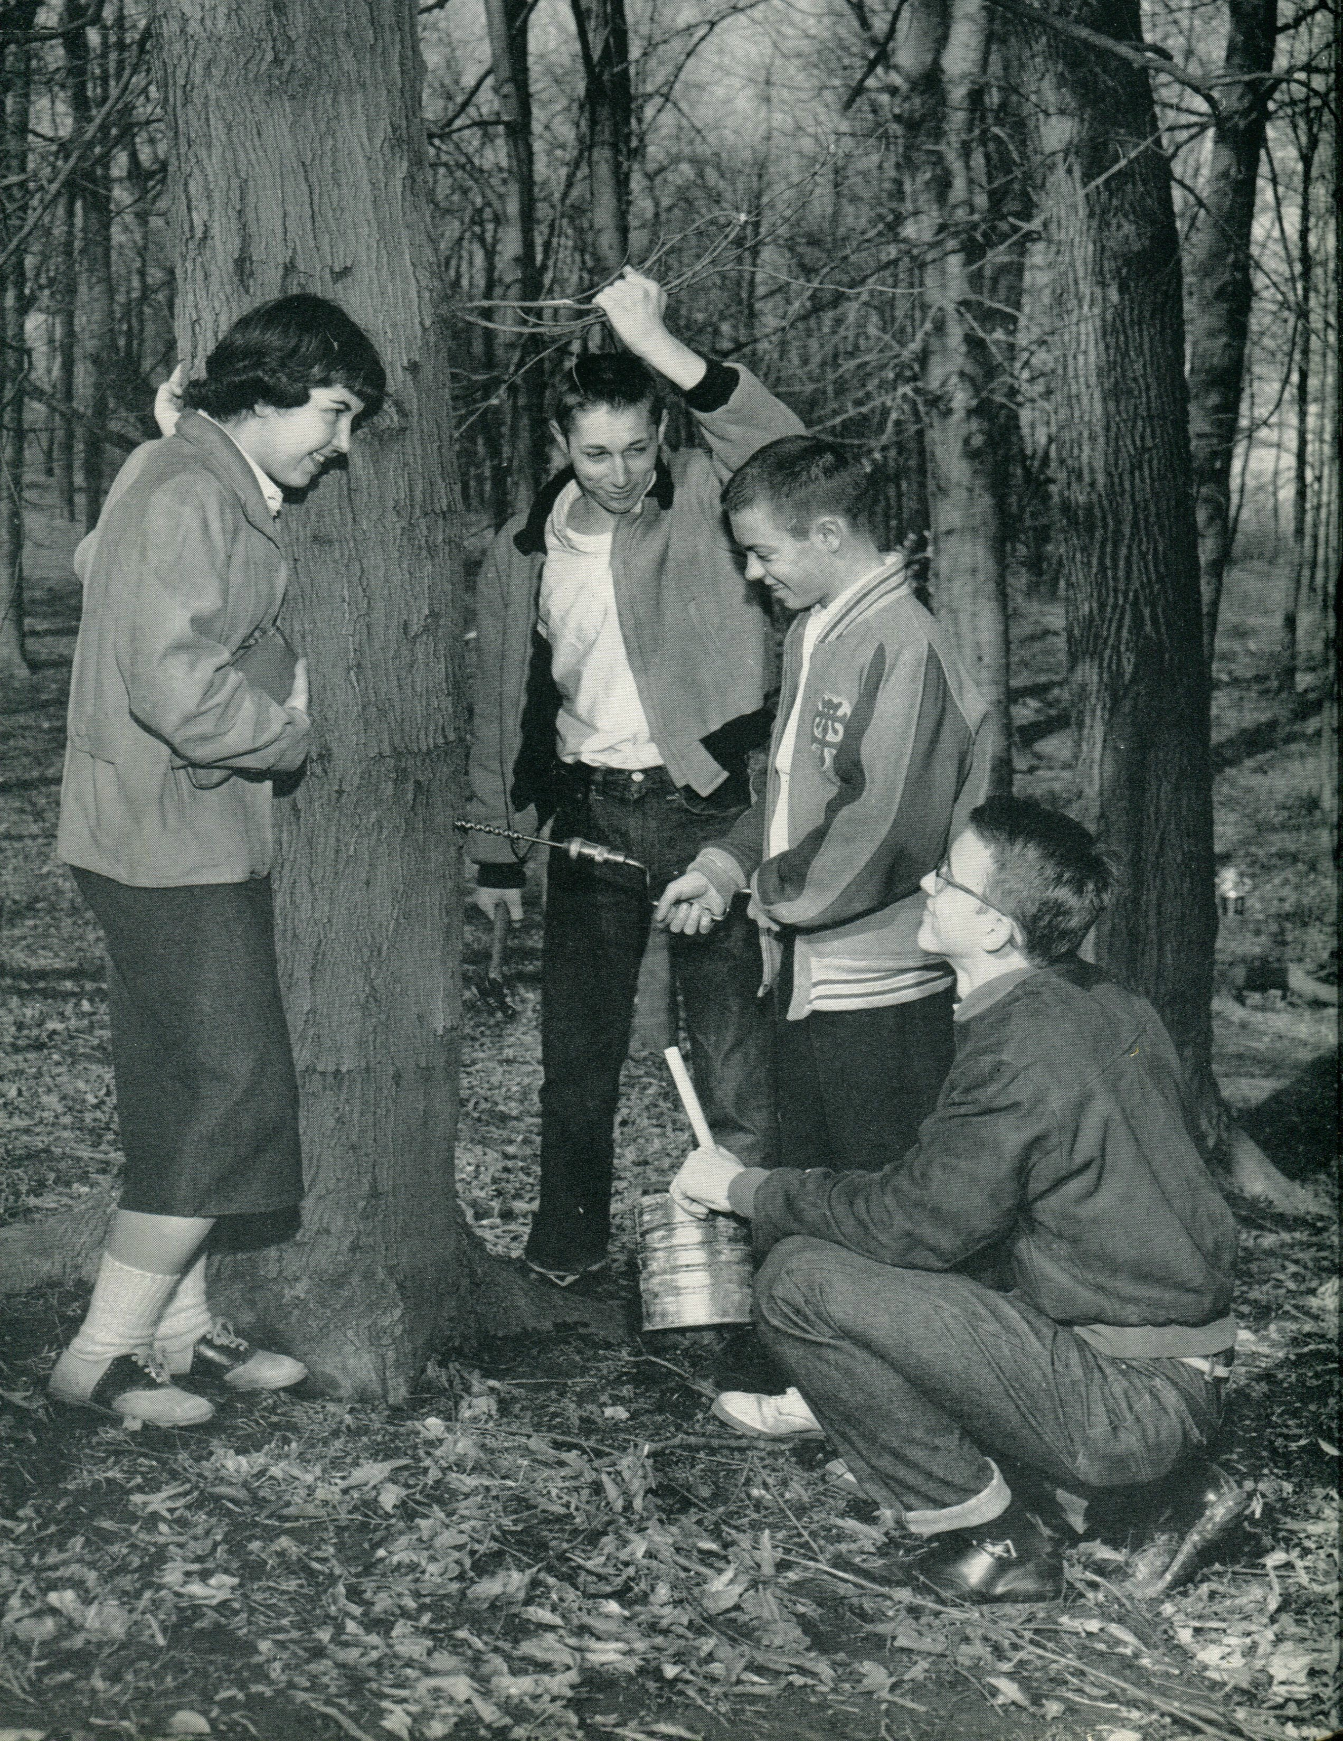
1956 Western Hills Yearbook
Unknown T.O.

Slide 29
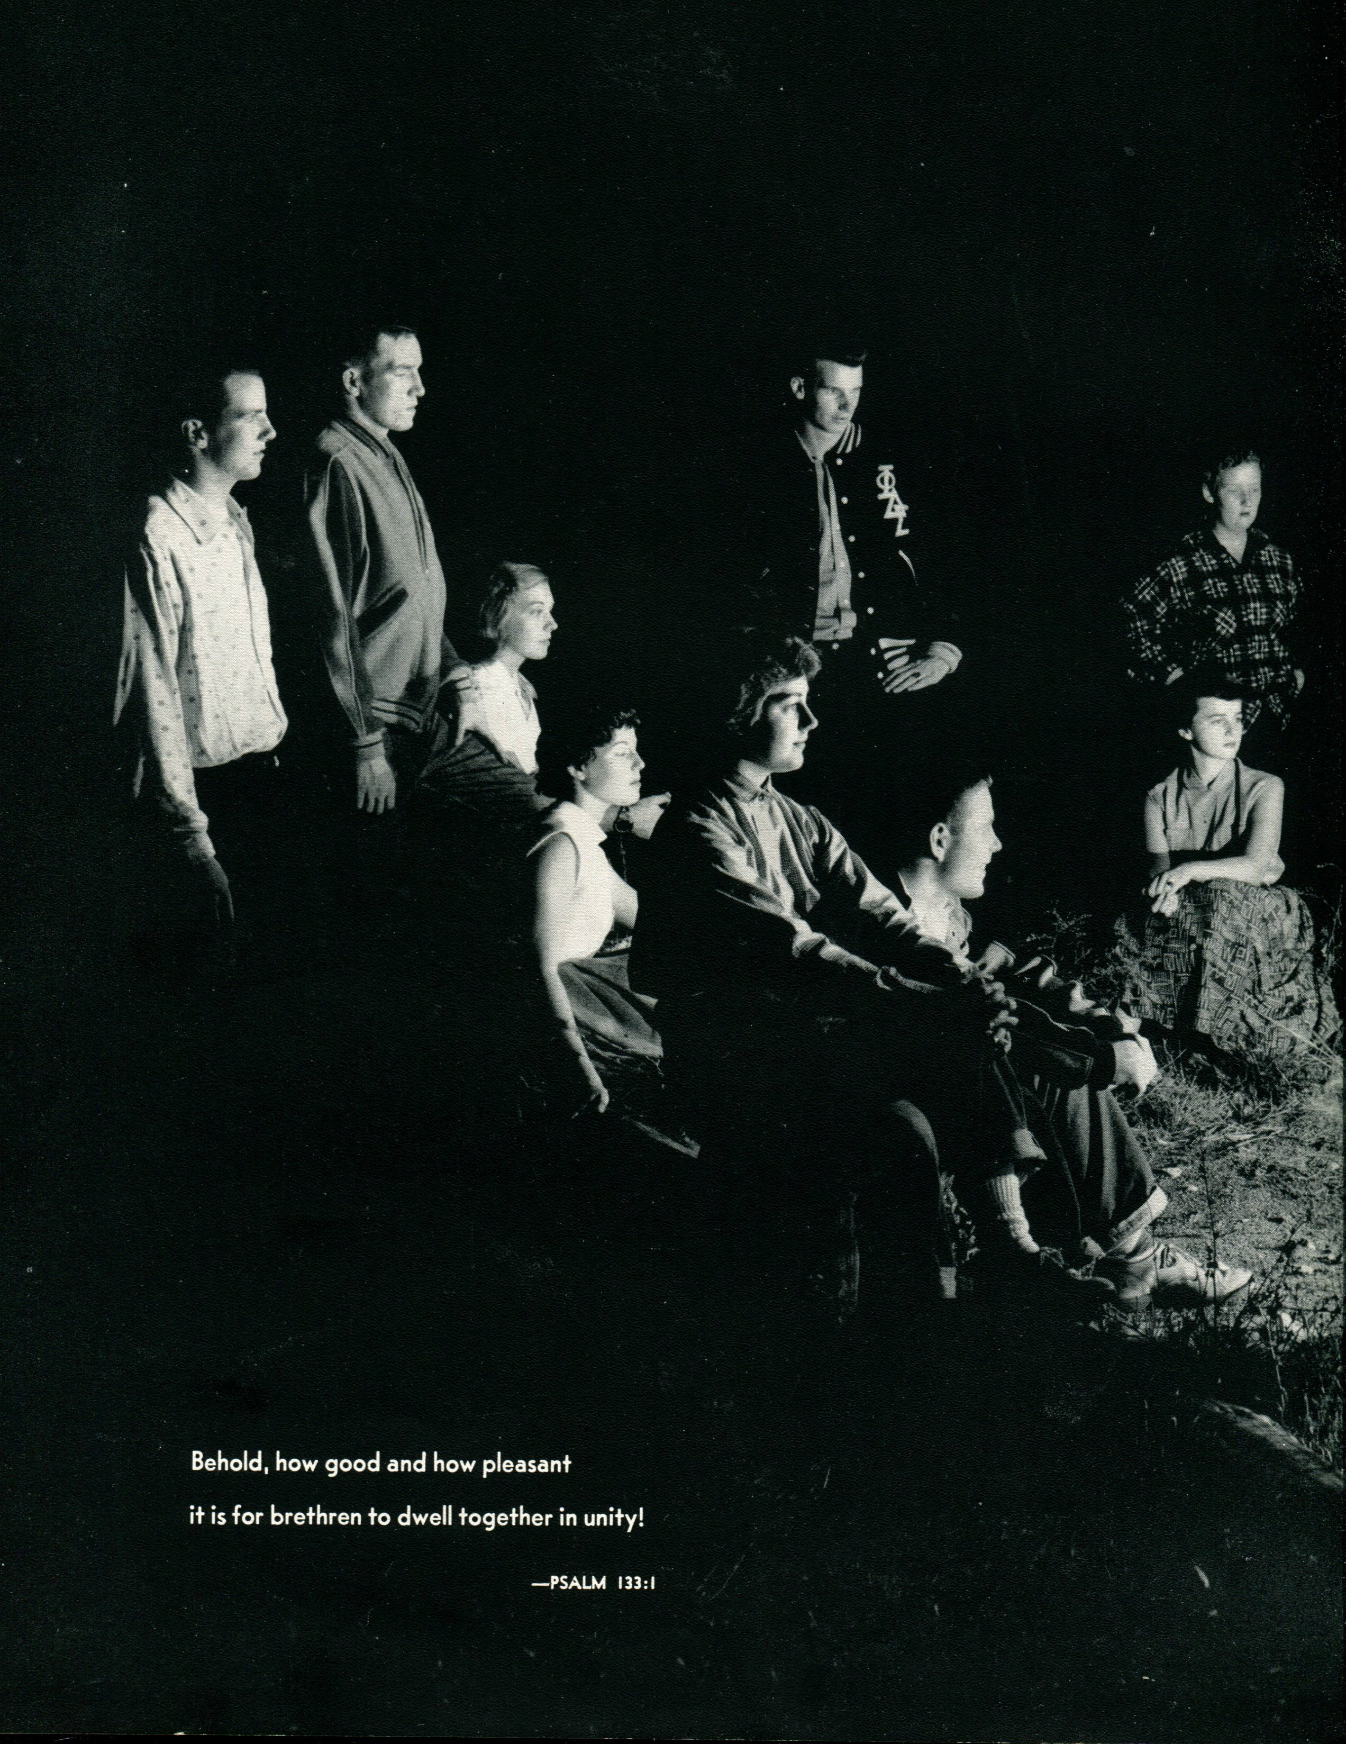
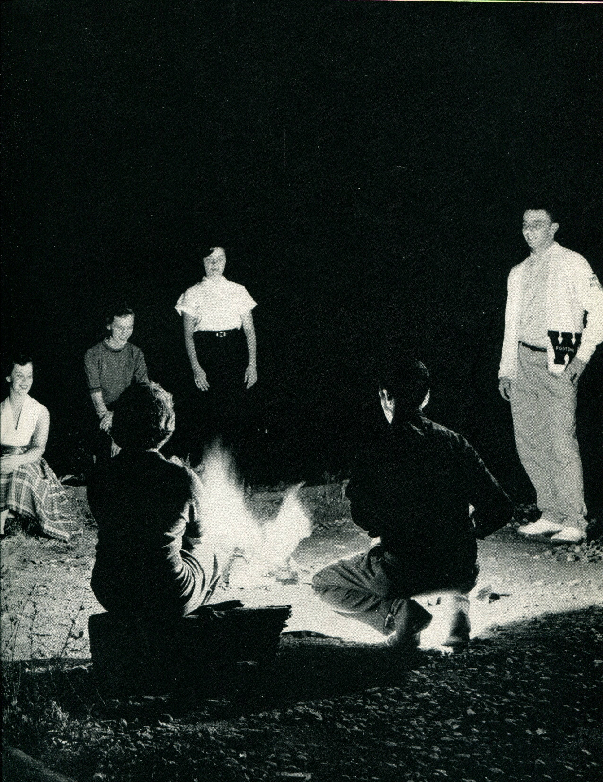
1956 Western Hills Yearbook
Paul Maxwell
(Class of 1957)

Slide 30
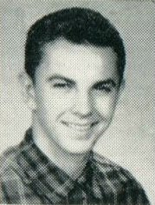
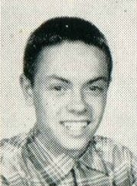
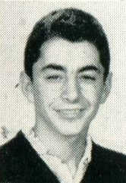
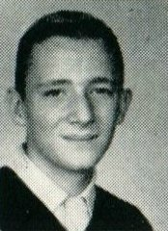
1956 Western Hills Yearbook
(Class of 1958)
Donald Carl Albert
Danny Edward Eicher
Dennis Edward Ekardt
Richard Vernon Gibson
Charles Henry Haft

Slide 31
1956 Western Hills Yearbook
(Junior Varsity Basketball)
(Class of 1958)
Richard Hayes
James Mahlon Lemen

Slide 32
1956 Western Hills Yearbook
(Class of 1958)
Jack R. Kiewit
Randolph William Fischback

Slide 33
1956 Western Hills Yearbook
(Class of 1958)
Bill Firth Fox
James Robert Luebbert
Ken Roy Martin
Dale Edward McElroy
Terry Paul Murphy
Robert Sohngen

Slide 34
1956 Western Hills Yearbook
(Class of 1958)
Michael Richard Lemert

Slide 35
1956 Western Hills Yearbook
(Class of 1958)
Patrick Nikolas Romelli

Slide 36
1956 Western Hills Yearbook
(Class of 1959)
Ken Aichele
Douglas Bunce
Rex Crockett
Howard Mangan
Mark Steele

Slide 37
1956 Western Hills Yearbook
(Class of 1959)
Jack Berger

Slide 38
1956 Western Hills Yearbook
(Class of 1959)
Walter Dietz
Tom Heidler
Richard Hoefer
Samuel Hollingsworth
James Mullen
Charles Nickoson

Slide 39
1956 Western Hills Yearbook
(Class of 1959)
Marty McMullen
(Class of 1959)
Howard Mangan
(Class of 1959)

Slide 40
1956 Western Hills Yearbook
(Class of 1960)
Bill Firth Fox
Robert William Link
Thomas Author Ranz
William Paul Schroeder

Slide 41
1956 Western Hills Yearbook
(Class of 1959)
David Roger Gibson

Slide 42
1956 Western Hills Yearbook
(Class of 1961)
Kenneth Kay
Michael Raymond Noyes
Tom Sharree Prince
John Jefferson Schiff
Stuart Christian Schott
David William Thie

Slide 43
1956 Western Hills Yearbook
(Class of 1961)
Junior Allan Morgeson

Slide 44
Thank You
For The Memories
Spectamur Agendo

